Slide 1
Barriers to Further Education
Blending research with practice – A Waterford perspective

Slide 2
Eminent Research
Saint Vincent DePaul. (2014). “It’s the hardest job in the world”: An exploratory research study with one parent families being assisted by the Society of St Vincent de Paul.
Watson, D., Banks, J., & Lyons, S. (2015). Educational and Employment Experiences of People with a Disability in Ireland: An Analysis of the National Disability Survey.
Sweeney, J. (2013). A Strategic Review of Further Education and Training and the Unemployed.
Walk. (2015). Accessing Mainstream Training: Barriers for People with Intellectual Disabilities.
Mooney, R., & O'Rourke, C. (2017). Barriers to Further Education and Training with Particular Reference to Long Term Unemployed Persons and Other Vulnerable Individuals. Solas.
Kelly, E., McGuinness, S., & O'Connell, P. (2012). Literacy, Numeracy and Activation among the Unemployed. ESRI Research Series #25

Slide 3
Barriers – Vulnerable Groups
Socio Economic Disadvantage – Poorer educational outcomes, Low School Completion
People with Disabilities
Unemployed/ NEETs
Lone Parents
New/Migrant Communities

Slide 4
The Barriers
Motivational/Dispositional Barriers
  Previous Negative Experience, Lack of familial value for Learning
Economic/Social Welfare Issues
  Variability in Social Welfare Entitlements across FET, Force people to engage (retain payments)
Organisational
  Reform of FET – PLCs, YouthReach, VTOS, Community Ed. – Diverse Breadth of options
  Perceptions of Quality – Courses not always aligned to local skills needs (little long term gain), Difficult to design courses to fit all backgrounds and abilities, School Mistress delivery, Design for Intellectual and Physical Disability. Employers Perception!
  Eligibility – Minimum Time on Live Register, September start dates, Migrant Qualifications (unrecognised)
Information and Guidance
Lack of Awareness (Cited over 30 Years and persists), Referrals from DSP not always Career Guided
Reform –ETBs, SOLAS, FÁS, QQI, FETAC
Social Welfare Entitlements -

Slide 5
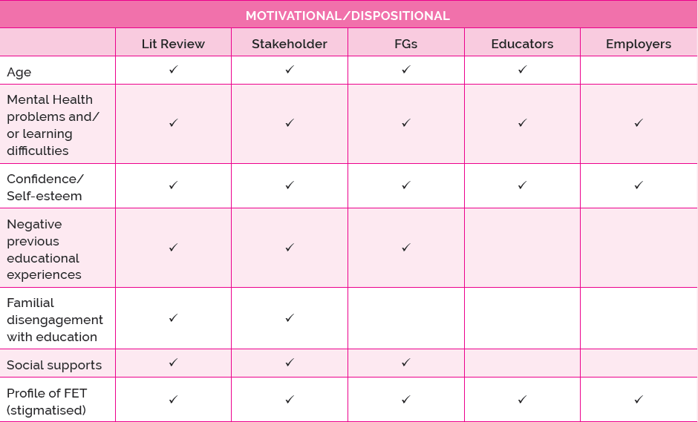

Slide 6
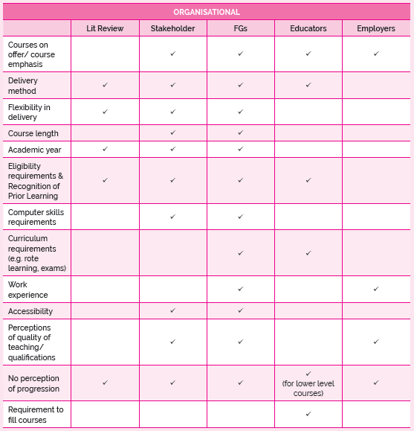

Slide 7
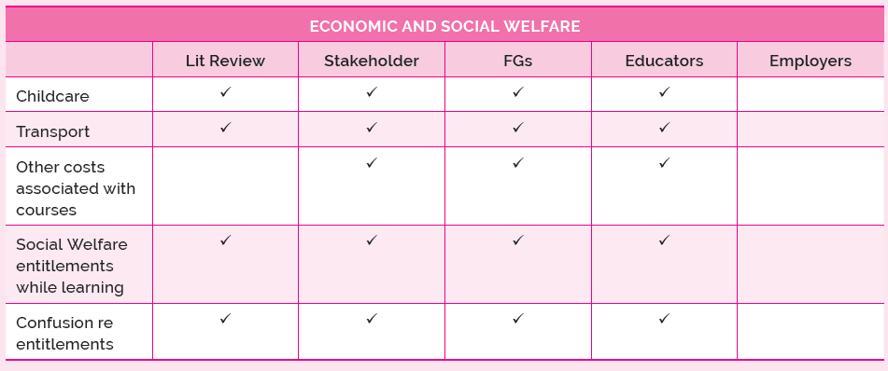

Slide 8
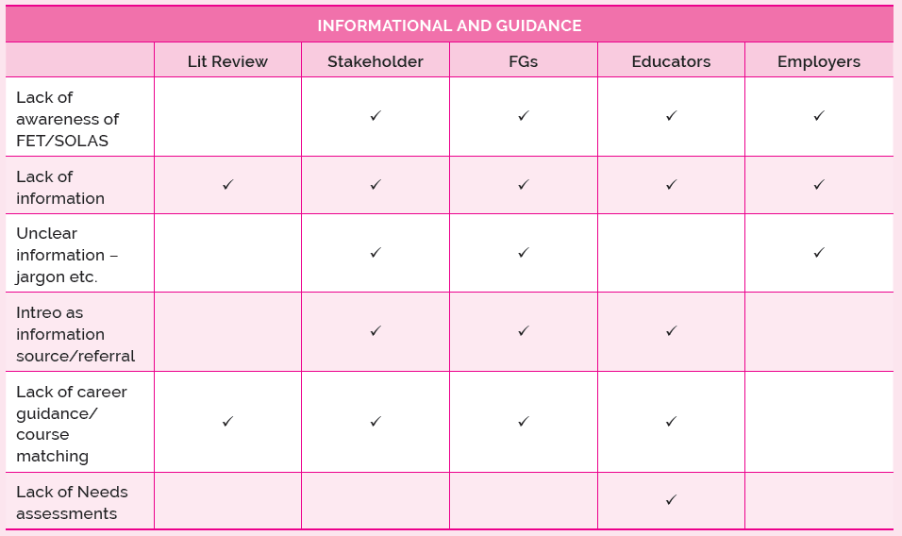

Slide 9
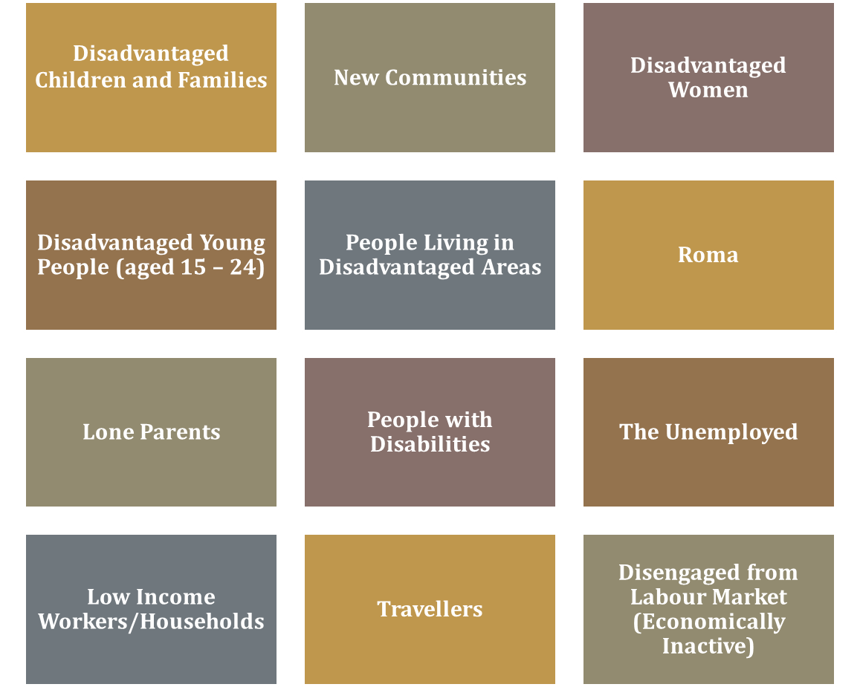
SICAP Target Groups

Slide 10
SICAP Barriers
Disability
Ethnic Minority
Homelessness
Jobless Household
Lone Parent
Transport Barrier

Slide 11
Mapping SICAP Target Groups to FET Barriers
SICAP Target Group | FET Barriers as per Literature
Unemployed Persons -------------------------------------------------------→ | Unemployed Persons
NEETs (Disadvantaged Young People) ----------------------------------→ | NEETs
People with Disabilities ----------------------------------------------------→ | People with Disabilities
New Communities ----------------------------------------------------------→ | Members of Migrant Communities
Lone Parents -----------------------------------------------------------------→ | Lone Parents
People living in Disadvantaged Communities -----------------------→ | Socio Economic Disadvantage
Disadvantaged Women ---------------------------------------------------→ | Lone Parents, Migrant Communities, SE Disadvantage
Travellers ---------------------------------------------------------------------→ | Socio Economic Disadvantage
Low Income Workers ------------------------------------------------------→ | Socio Economic Disadvantage
Disadvantaged Children and Families ---------------------------------→ | Socio Economic Disadvantage
Disengaged from Labour Market ---------------------------------------→ | Long Term Unemployed, NEETs
Roma --------------------------------------------------------------------------→ | Members of Migrant/New Communities

Slide 12
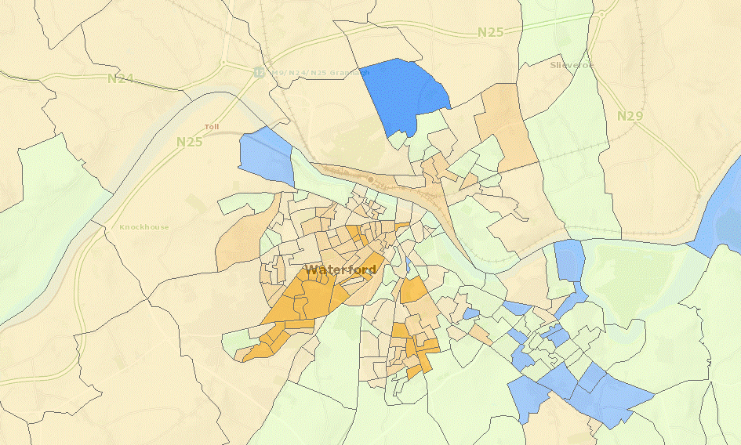
Waterford Socio Economic Profile (SA)

Slide 13
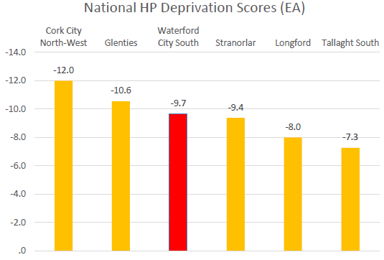
Waterford City South - Deprivation
Notes:
3rd from Bottom of 70 LOCAL Electoral Areas

Slide 14
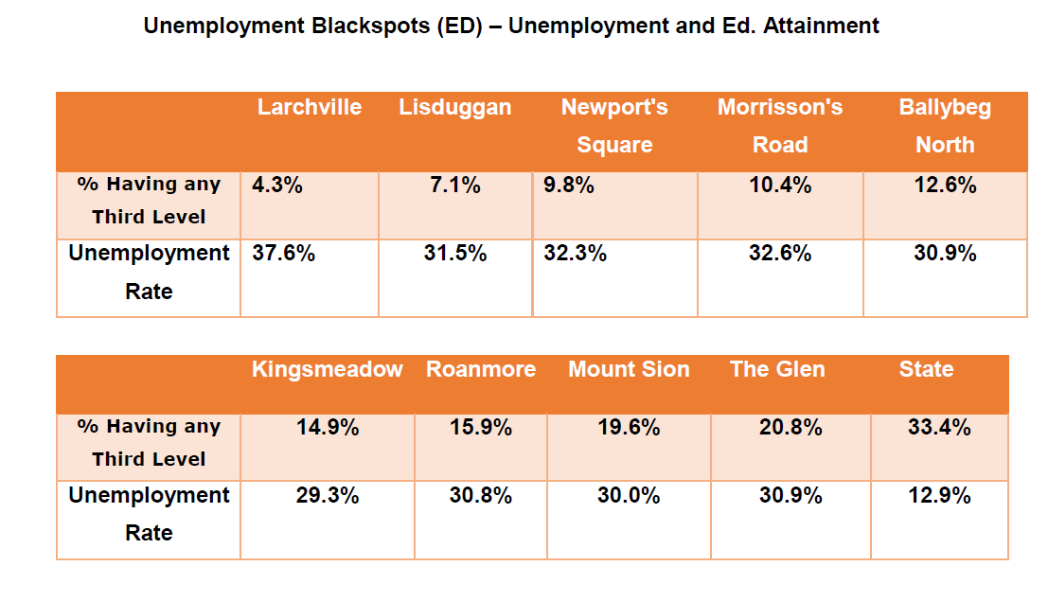
Unemployment

Slide 15
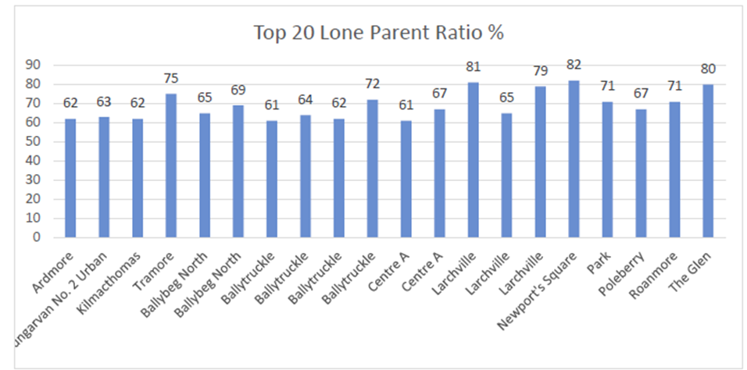
Lone Parents

Slide 16
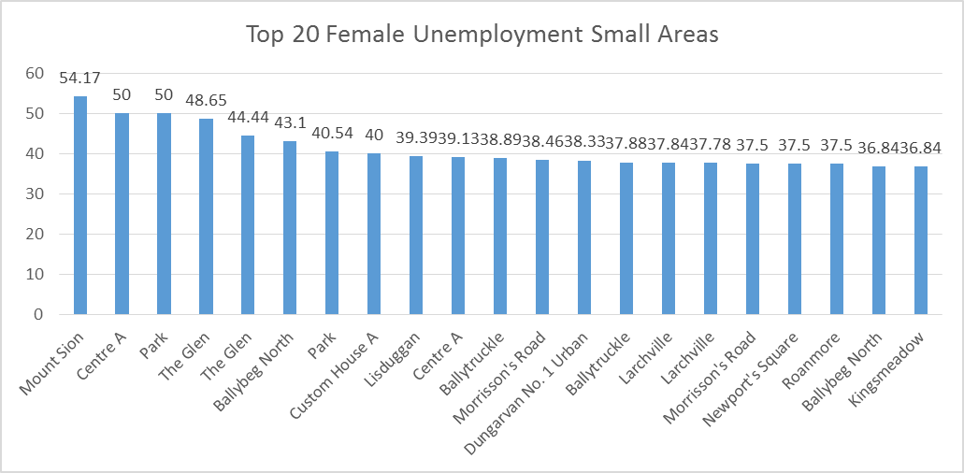
Disadvantaged Women
Most Recent HP Deprivation Statistics show that the 2016 national unemployment rate was 14.1%. In Waterford City and County there are 185 Small areas with a female unemployment rate greater than 14%.

Slide 17
Disability
According to Census 2016 13.5% of Ireland’s population is registered as having a disability. In Waterford City and County there are;
208 Small Areas showing a higher than state average disability proportion
the total population for these areas is 9,460 persons.

Slide 18
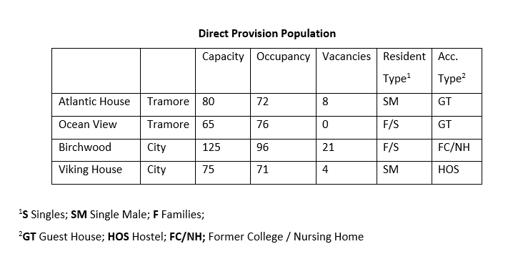
Migrant/New Communities

Slide 19
Join the Dots
Vulnerable Groups
SocEcon Data
Barriers
SICAP

