Slide 1
Presentation to Waterford LCDC on Projects Approved to Date
November 2016 – July 2018

Slide 2
Allocations to Date
RURAL DEVELOPMENT PROGRAMME 2014-2020
PROJECTS APPROVED/ALLOCATED PER THE DEPT IT SYSTEM ON 06.07.18
 | Date of LAG Approval | PO | SA | Total Funding Approved |  | Claims Paid |  | Location
 |  |  |  | € |  | €
Creation of a Plastic Fabrication Facility | 06.07.17 | CC | 2.1 | 32,500.00 |  |  |  | Tramore
Current Business Expansion & New Business Development | 06.07.17 | JT | 2.1 | 63,875.50 |  | 62,517.85 |  | Cappagh
Workhop Upgrade/Automated Drilling Line | 06.07.17 | JT | 2.1 | 140,895.50 |  | 132,687.25 |  | Ballyduff
Blackwater Eco Tours | 20.07.17 | JT | 1.1 | 21,777.15 |  |  |  | Villierstown
Ardmore Glamping Pods | 20.07.17 | JT | 1.4 | 143,247.00 |  |  |  | Ardmore
Streamline | 20.07.17 | CC | 2.1 | 200,000.00 |  | 113,282.00 |  | Butlerstown
Blackwater Distillery | 20.07.17 | CC | 2.2 | 200,000.00 |  | 55,860.62 |  | Ballyduff
Dunhill Community Hall Renovation | 20.07.17 | CC | 5.1 | 200,000.00 |  | 59,382.85 |  | Dunhill
Comeragh Amenity Area | 20.07.17 | CC | 5.1 | 200,000.00 |  | 55,192.58 |  | Rathgormack
Coastal Regeneration | 20.07.17 | JT | 6.2 | 3,000.00 |  |  |  | Waterford Coast
Valorisation of Industrial Heritage | 20.07.17 | JT | 6.2 | 3,000.00 |  |  |  | Co. Waterford
Glasha Hydro Project | 20.07.17 | CC | 9.1 | 200,000.00 |  |  |  | Carrick on Suir
Storage Room onto Centre | 09.11.17 | CC | 5.1 | 14,930.92 |  |  |  | Ballinameela
Development of Woodland Walks & Gardens in Carraiglea | 09.11.17 | CC | 1.1 | 13,213.44 |  |  |  | Carraiglea
2017-2020 Equipment Programme | 09.11.17 | CC | 1.1 | 18,150.00 |  |  |  | Co. Waterford
Dungarvan Scouts Storage Extension | 09.11.17 | CC | 5.1 | 41,672.68 |  |  |  | Dungarvan
Waterford County Ancestry Tourism Project | 09.11.17 | JT | 1.2 | 5,294.15 |  | 5,223.10 |  | Dungarvan
Equipment Upgrade | 09.11.17 | JT | 2.1 | 52,658.40 |  |  |  | Dungarvan
Repairs & Modernising Hall Facilities | 09.11.17 | JT | 5.1 | 13,894.50 |  |  |  | Ardmore
Clashmore Distillery | 09.11.17 | JT | 1.2 | 5,719.50 |  |  |  | Clashmore
Bio Mass Log Dryer | 09.11.17 | JT | 2.1 | 27,650.00 |  | 27,650.00 |  | Lismore
Tallow Community Centre Phase III | 09.11.17 | JT | 5.1 | 130,619.94 |  |  |  | Tallow
Request for Tenders for Training | 09.11.17 | CC | 3.5 | 6,000.00 |  |  |  | Co. Waterford
Anne Valley Walk Phase II | 14.12.17 | CC | 1.1 | 124,553.78 |  |  |  | Dunhill
Legacy Cider | 29.01.18 | JT | 2.2 | 36,422.50 |  |  |  | Dungarvan
The Nire Cabin Co. | 10.05.18 | JT | 1.4 | 49,335.00 |  |  |  | Ballymacarbry
Lismore Dramatic Society Sounds & Light | 10.05.18 | JT | 1.2 | 15,958.32 |  |  |  | Lismore
West Wtd Living History & Digital Training Project 1 | 10.05.18 | JT | 2.3 | 5,590.50 |  |  |  | Clashmore
West Wtd Living History & Digital Training Project 2 | 10.05.18 | JT | 2.3 | 5,535.00 |  |  |  | Clashmore
Fibre Laser Profiling CNC Machine with Expanded Capabilities | 10.05.18 | CC | 2.1 | 200,000.00 |  |  |  | Portlaw
Lafcadio Hearn Japanese Gardens | 10.05.18 | CC | 1.2 | 6,351.25 |  |  |  | Tramore
2017-2020 Mountain Rescue Equipt Programme | 10.05.18 | CC | 1.1 | 18,067.68 |  |  |  | Co. Waterford
Wtd Greenway : A History of the Towns & Villages Along the Greenway | 10.05.18 | JT | 1.2 | 10,087.50 |  |  |  | Dungarvan
Stage 15 Final Project Approved (on IT System) |  |  |  | 2,210,000.21
Training to Develop a Social Enterprise | 14.06.18 | CC | 2.4 | 13,000.00 |  |  |  | Co. Waterford
Training to Support Village Groups Foster a Local Enterprise Culture | 14.06.18 | CC | 2.5 | 8,000.00 |  |  |  | Co. Waterford
Biodiversity Training | 14.06.18 | JT | 7.1 | 10,300.00 |  |  |  | Co. Waterford
Villierstown Enterprise Centre - Phase I | 14.06.18 | JT | 3.2 | 178,200.00 |  |  |  | Villierstown
Fishermans Hall Development | 14.06.18 | CC | 5.1 | 152,183.91 |  |  |  | Dunmore East
Carbally Community Youth Group | 14.06.18 | CC | 6.2 | 40,178.15 |  |  |  | Dunmore East
Stage 10 Application Decision (on IT System) |  |  |  | 401,862.06
Total Allocated |  |  |  | 2,611,862.27
Total Claims Paid |  |  |  |  |  | 511,796.25

Slide 3
Unallocated Funds to Date
Strategic Action | Total Funding Available | Allocated 2017 | Allocated 2018 |  | Net Funding Available
 | € | € | € |  | €
Activity Tourism | 607,500.00 | - 177,694.37 | - 18,067.68 |  | 411,737.95
Culture & Heritage Product Development | 472,500.00 | - 11,013.65 | - 32,397.07 |  | 429,089.28
Eco Tourism Product Development | 54,000.00 |  |  |  | 54,000.00
Community Hostels/RV Park, Glamping/Camping | 607,500.00 | - 143,247.00 | - 49,335.00 |  | 414,918.00
Capital Investment in Existing Start -Up Technology, Graduate Orientated Rural Buisiness | 1,280,000.00 | - 517,579.40 | - 200,000.00 |  | 562,420.60
Capital Investments in Development of Rural Food Businesses | 405,000.00 | - 200,000.00 | - 36,422.50 |  | 168,577.50
Investment in Digital & New Media | 405,000.00 |  | - 11,125.50 |  | 393,874.50
Training to Develop a Social Enterprise Network | 26,000.00 |  | - 13,000.00 |  | 13,000.00
Fostering a Local Enterprise Culture | 32,000.00 |  | - 8,000.00 |  | 24,000.00
Capital Investment in the Redevelopment if 1 Industrial Heritage Building into Modern Enterprise Space | 150,000.00 |  |  |  | 150,000.00
Capital Investment in the Development of 1 new Indistrial/Office Facility in a Rural Village | 187,500.00 |  | - 178,200.00 |  | 9,300.00
Faciliatation & Training of 4 Geographic Clusters to Form Economic Development Zones | 28,000.00 |  |  |  | 28,000.00
Fostering Local Strategy at Village Level | 6,000.00 | - 6,000.00 |  |  | -
Encouraging Competition in the Rural Market place | - |  |  |  | -
Invite Identified Locations to Submit Bids for Investment Support into Community Service Delivery Hubs | 780,000.00 | - 601,118.04 | - 152,183.91 |  | 26,698.05
Community Leadership Training for Established Voluntary Groups | 34,000.00 |  |  |  | 34,000.00
Training for Communities to Support Delivery Service Hubs | 25,000.00 |  |  |  | 25,000.00
Training for Young Rural Dwellers to Support Employment Placement | 30,000.00 |  |  |  | 30,000.00
Rural Youth Service Delivery Model | 50,000.00 | - 6,000.00 | - 40,178.15 |  | 3,821.85
Training to Establish a Pilot Care Farming Programme | 20,000.00 |  |  |  | 20,000.00
Training for Local Communities on the Needs & Benefits of Bio-diversity | 12,000.00 |  | - 10,300.00 |  | 1,700.00
Protection & Sustainable Use of Water Resources | 12,000.00 |  |  |  | 12,000.00
Exemplar Small Scale Community Project on Water Conservation | 40,000.00 |  |  |  | 40,000.00
Development of Renewable Energy | 261,346.00 | - 200,000.00 |  |  | 61,346.00
 | 5,525,346.00 | - 1,862,652.46 | - 749,209.81 |  | 2,913,483.73

Slide 4
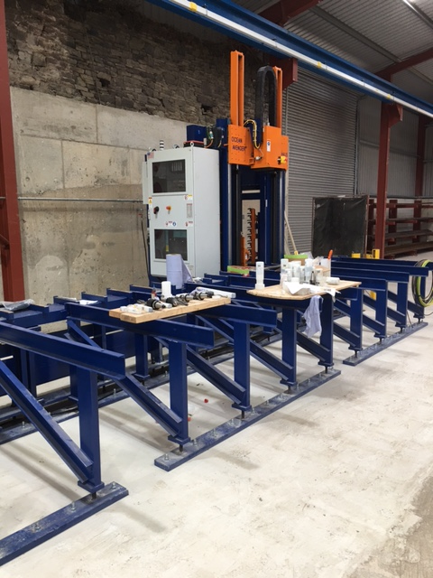
Kenneally Steel
Kenneally Steel are a light engineering business based in Ballyduff Upper, West Waterford.
The owners are actually dry stock farmers who set up an engineering
Business to supplement their farm income.
The investment from LEADER has allowed them to modernise their facilities, be inline with CE Certification requirements, obtain new customers and increase production. Prior to application, they guaranteed 3 additional jobs. Since the investment they have added 5 additional jobs, 2 of which are a fulltime accountant, and a fulltime Project Manager.

Slide 5
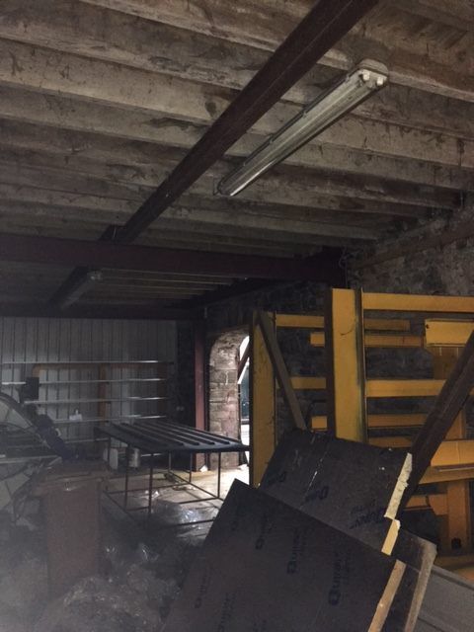
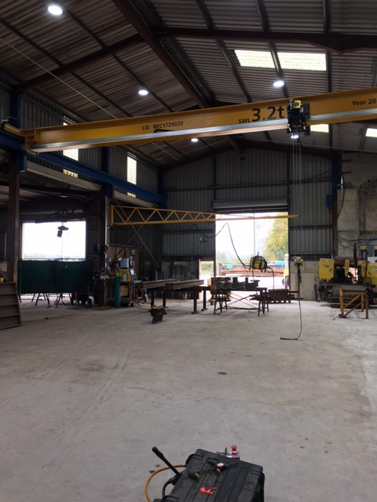
Kenneally Steel
Before- Inadequate Facilities
After – 2 Cranes + CNC Line

Slide 6
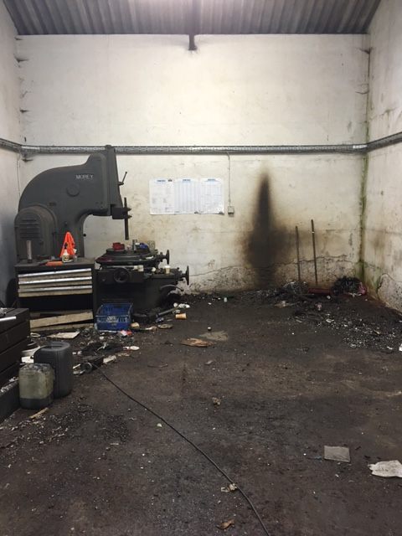
Dungarvan Precision Engineering
Dungarvan Precision
Waterford LCDC under the RDP Programme 2014 – 2017 has invested in the further development of Dungarvan Precision Engineering Ltd with the purpose of promoting the sustainability and creation of rural jobs. This investment is from RDP 1420 funding allocated under Objective 2, Strategic Action 2.1 of the Local Development Strategy for County Waterford which covers the development of high end light engineering. The RDP 1420 fund has supported the purchase of a CNC Lathe, and a Plasma Cutter. This has led to 4 additional jobs

Slide 7
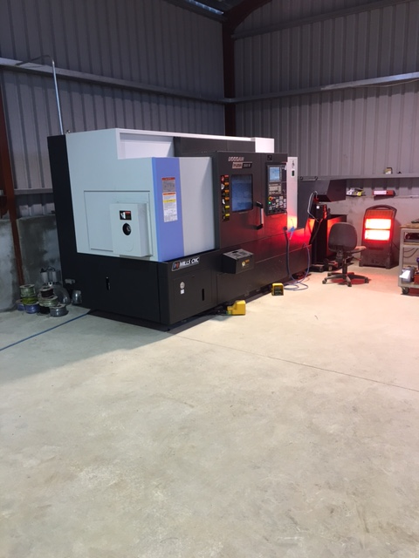
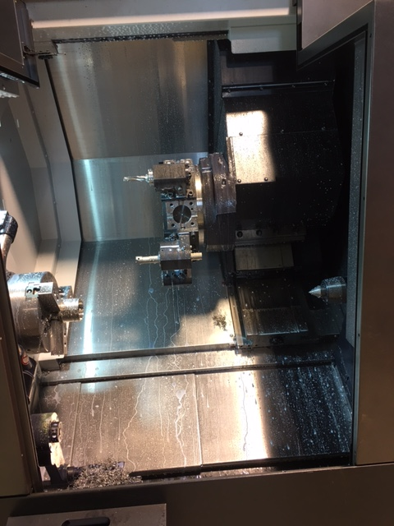
Dungarvan Precision Engineering
CNC Machine
Lathe

Slide 8
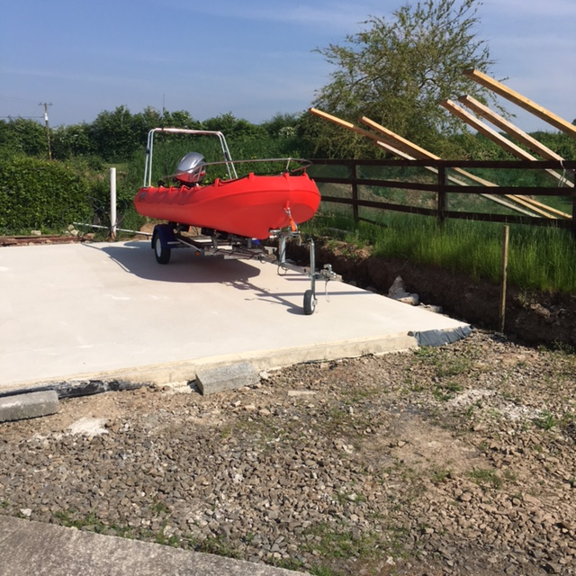
Blackwater Eco Tours
Blackwater Eco Tours is a social economy business operated by Villierstown Education & Culture Project Ltd. It provides Eco Tours of the Blackwater Valley.
The purpose of the business is to optimise the very much under exposed Tourism potential of the lower Blackwater Valley, with its great houses, abundant wildlife and scenery by escorted River Tours, both piloted and self-driven under supervision.
With the assistance of LEADER Funding from the LCDC, VECP has purchased 3 self-drive boats to provide this additional amenity It currently has 2 piloted boats, one an 8 seater, and the second a 12 seater offering tours out beyond Youghal Harbour. They also have a CSP Programme from DEASP.

Slide 9
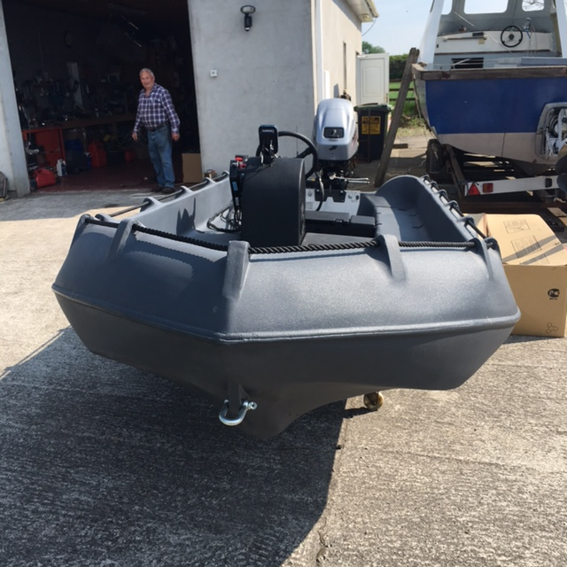
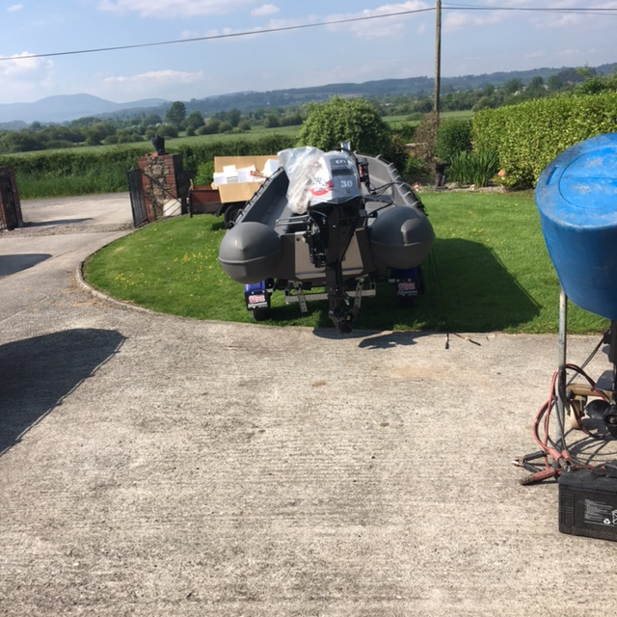
Blackwater Eco Tours
1st Self Drive Boat
2nd Self Drive Boat

Slide 10
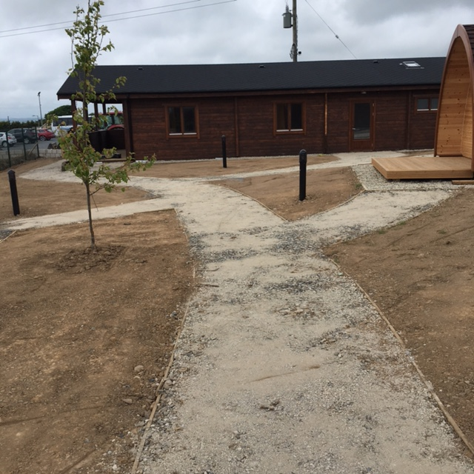
Ardmore Glamping
Glamping Pod Site was developed with assistance from LEADER through Waterford LCDC adjacent to the existing Ardmore Mini Farm & Zoo.
The 6 Pods have been built to a very high standard on a site adjoining the Car Park, and facing the sea. The Pods are luxurious, providing all year round accommodation. The adjoining log cabin will provide a T.V. Room, Lounge area, and a small kitchenette.
The addition to the current playground on site at the opposite end of the facility has involved the addition of a climbing pyramid, embankment slide, and a 10 unit obstacle course.
Business has been excellent since their opening.

Slide 11
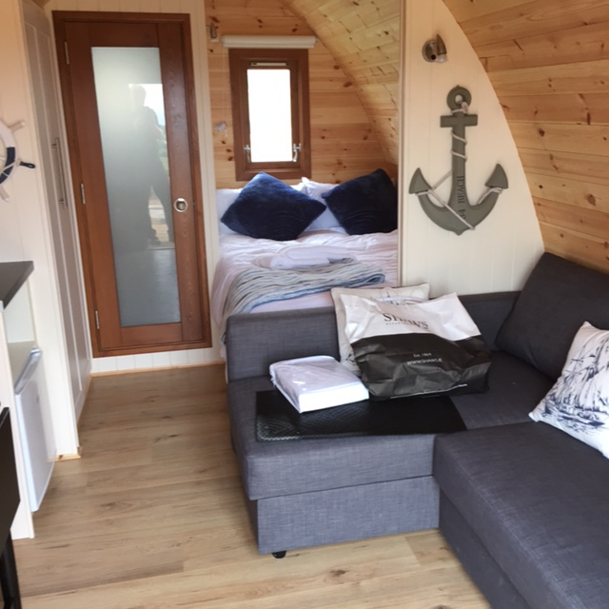
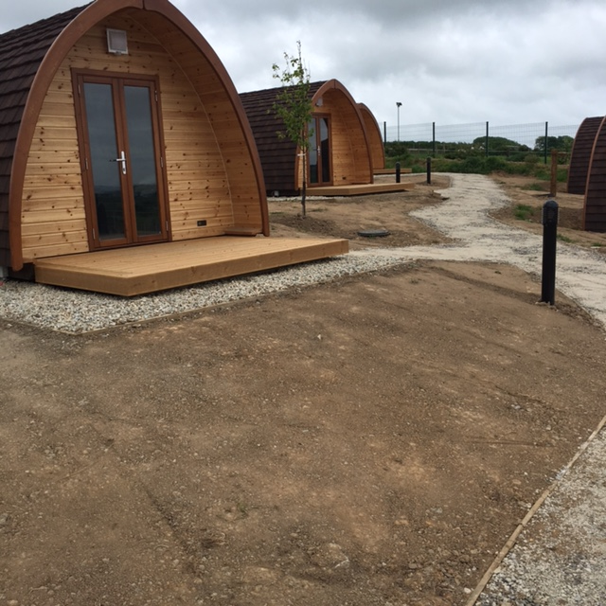
Ardmore Glamping
Interior
Exterior

Slide 12
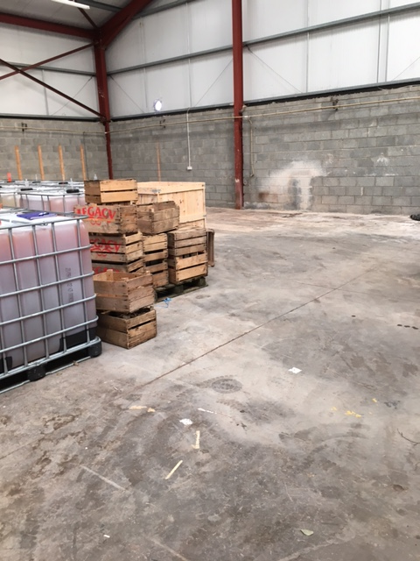
Legacy Cider
Legacy Irish Cider is a new business commenced in 2015. Initially, it was provided with Start up advice and assistance from Waterford LEO. The Company brews Craft Cider, and has moved to an industrial facility in Dungarvan Business Park. The support to the business to LEADER has ensured Capital Investment which is facilitating an increase in production from 40,000 litres per annum to 90,000 litres per annum.
A number of part time jobs have already been created.

Slide 13
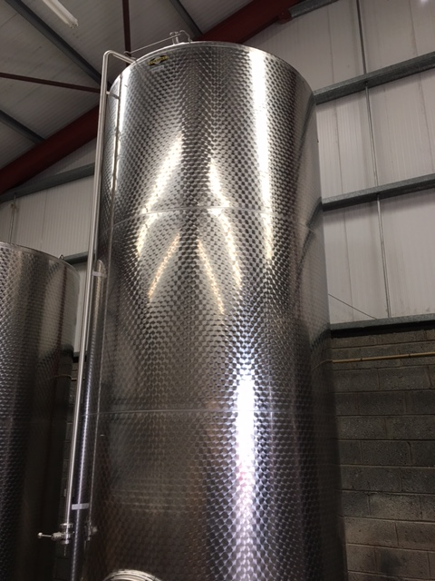
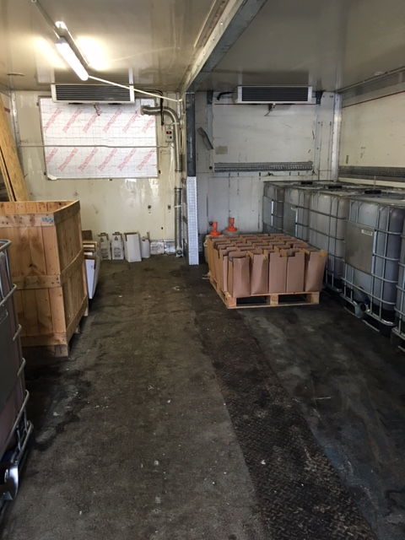
Legacy Cider

Slide 14
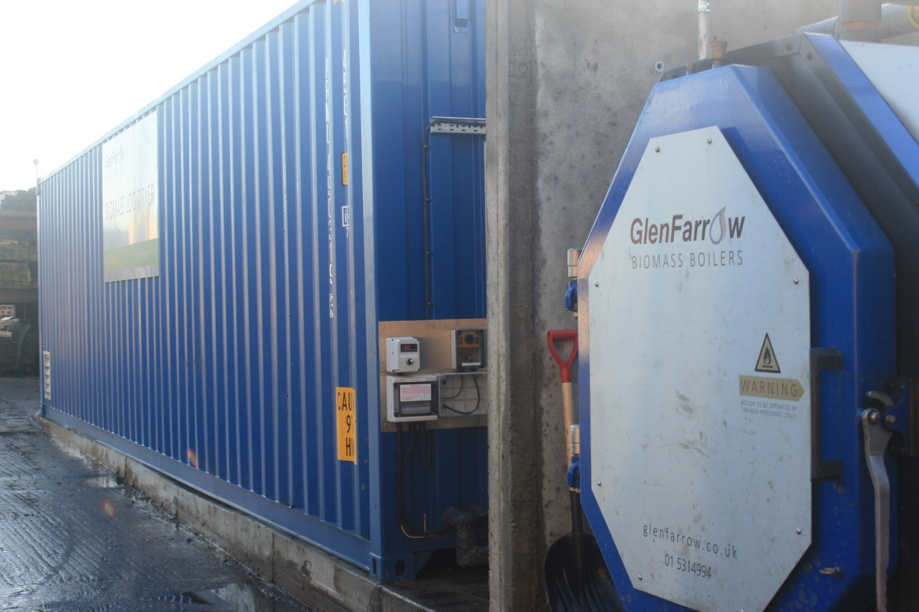
OK Fuels
OK Fuels was established by Mr. Gerrard O’Keefe as a off shoot of the family business O’Keeffe Sawmills. OK Fuels supplies dried firewood for Stoves to multiples such as Dairygold, Lidl and Aldi.
The Company has with LEADER support upgraded its production capacity and quality by installing a commercial biomass log dryer to ensure a good quality product. This has secured the existing jobs, and supported the creation of 4 more.

Slide 15

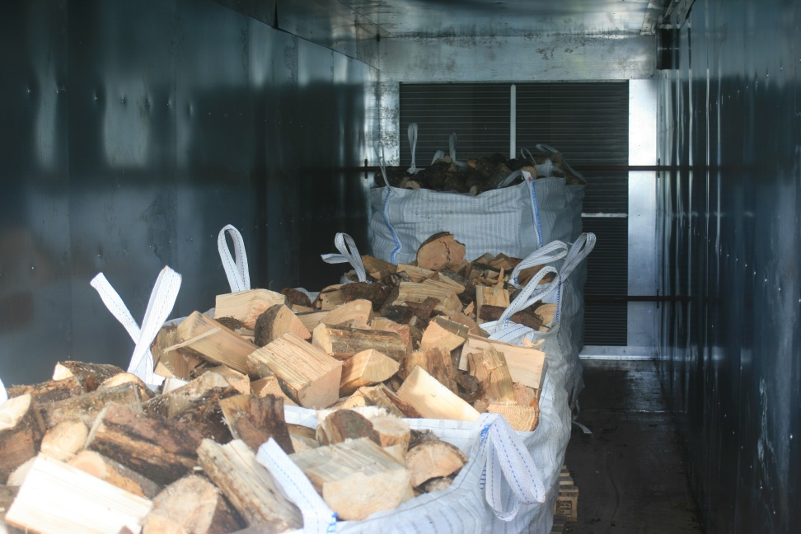
O K Fuels

Slide 16
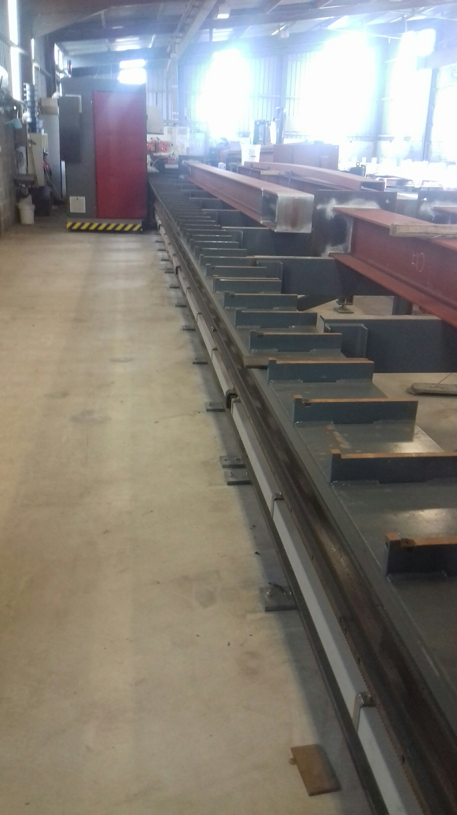
Streamline
Hugh Kavanagh Engineering Ltd was awarded maximum funding of €200,000 for his project Streamline towards new equipment that included the installation of a CNC cutting drill and plate line system. All of which are CNC controlled and serviced with a roller infeed and output conveyor. As a result of this investment in equipment, the promoter also upgraded ancillary operations including overhead cranes, new welding plant, increased efficiency of the spray shop including 2 new sprayers, installation of a shot blaster and enhancements to the stockyard. One full time job will be created in the next 6 months as a result of this investment.

Slide 17
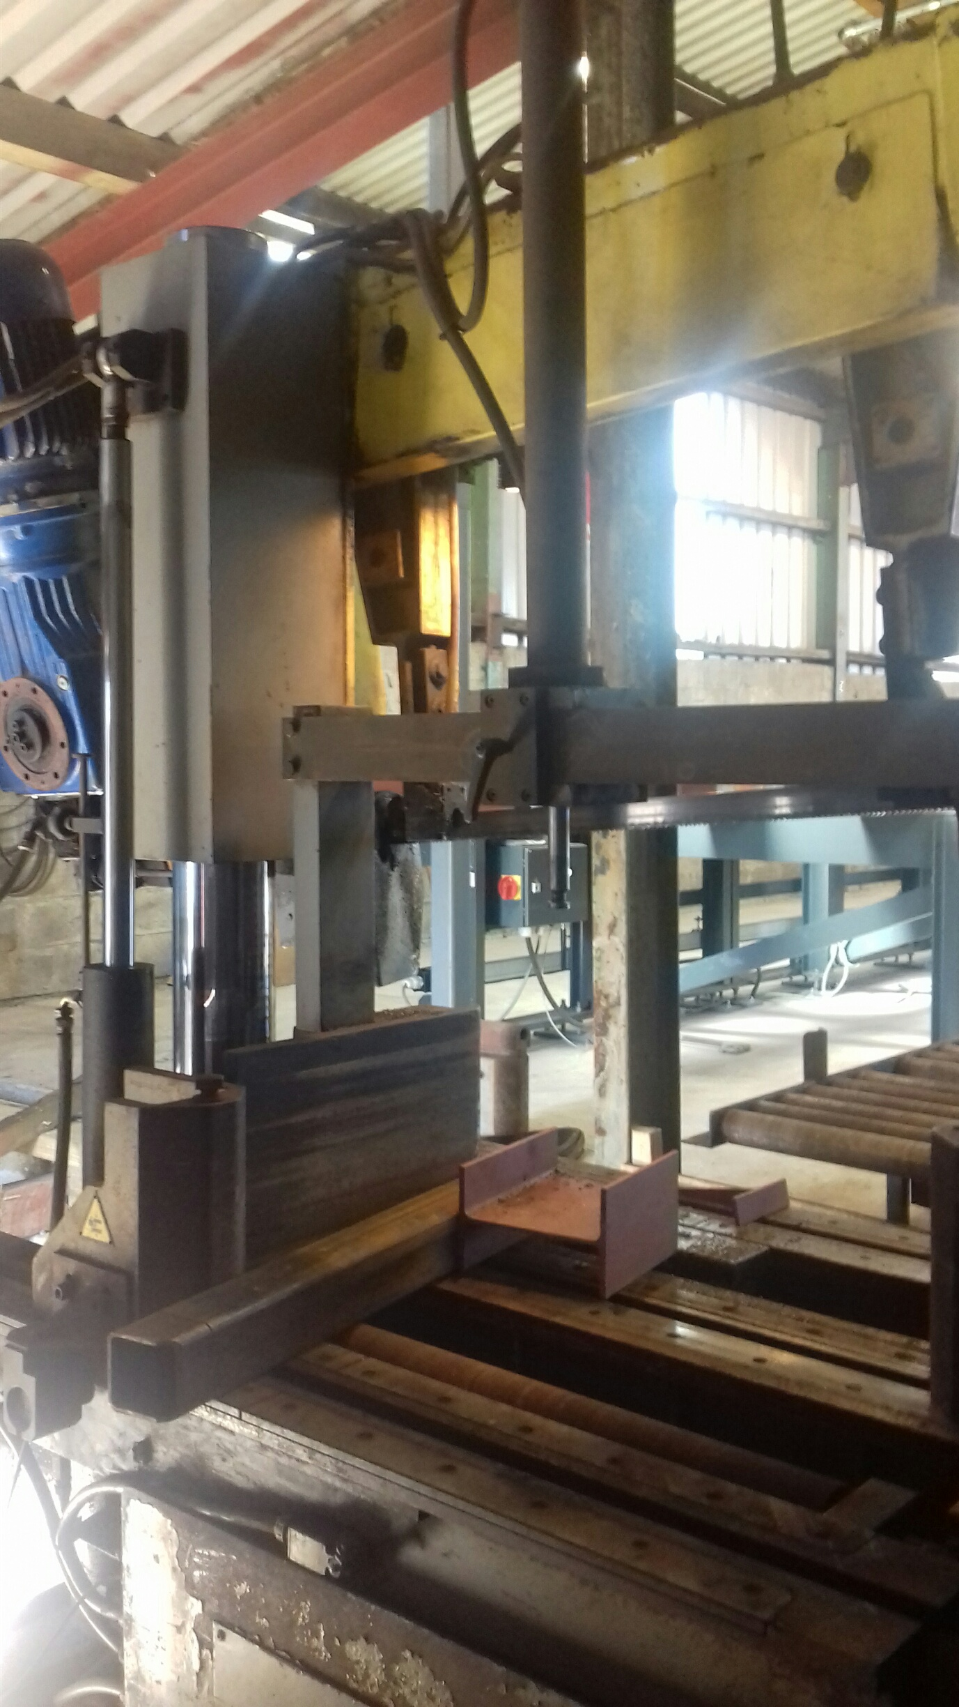
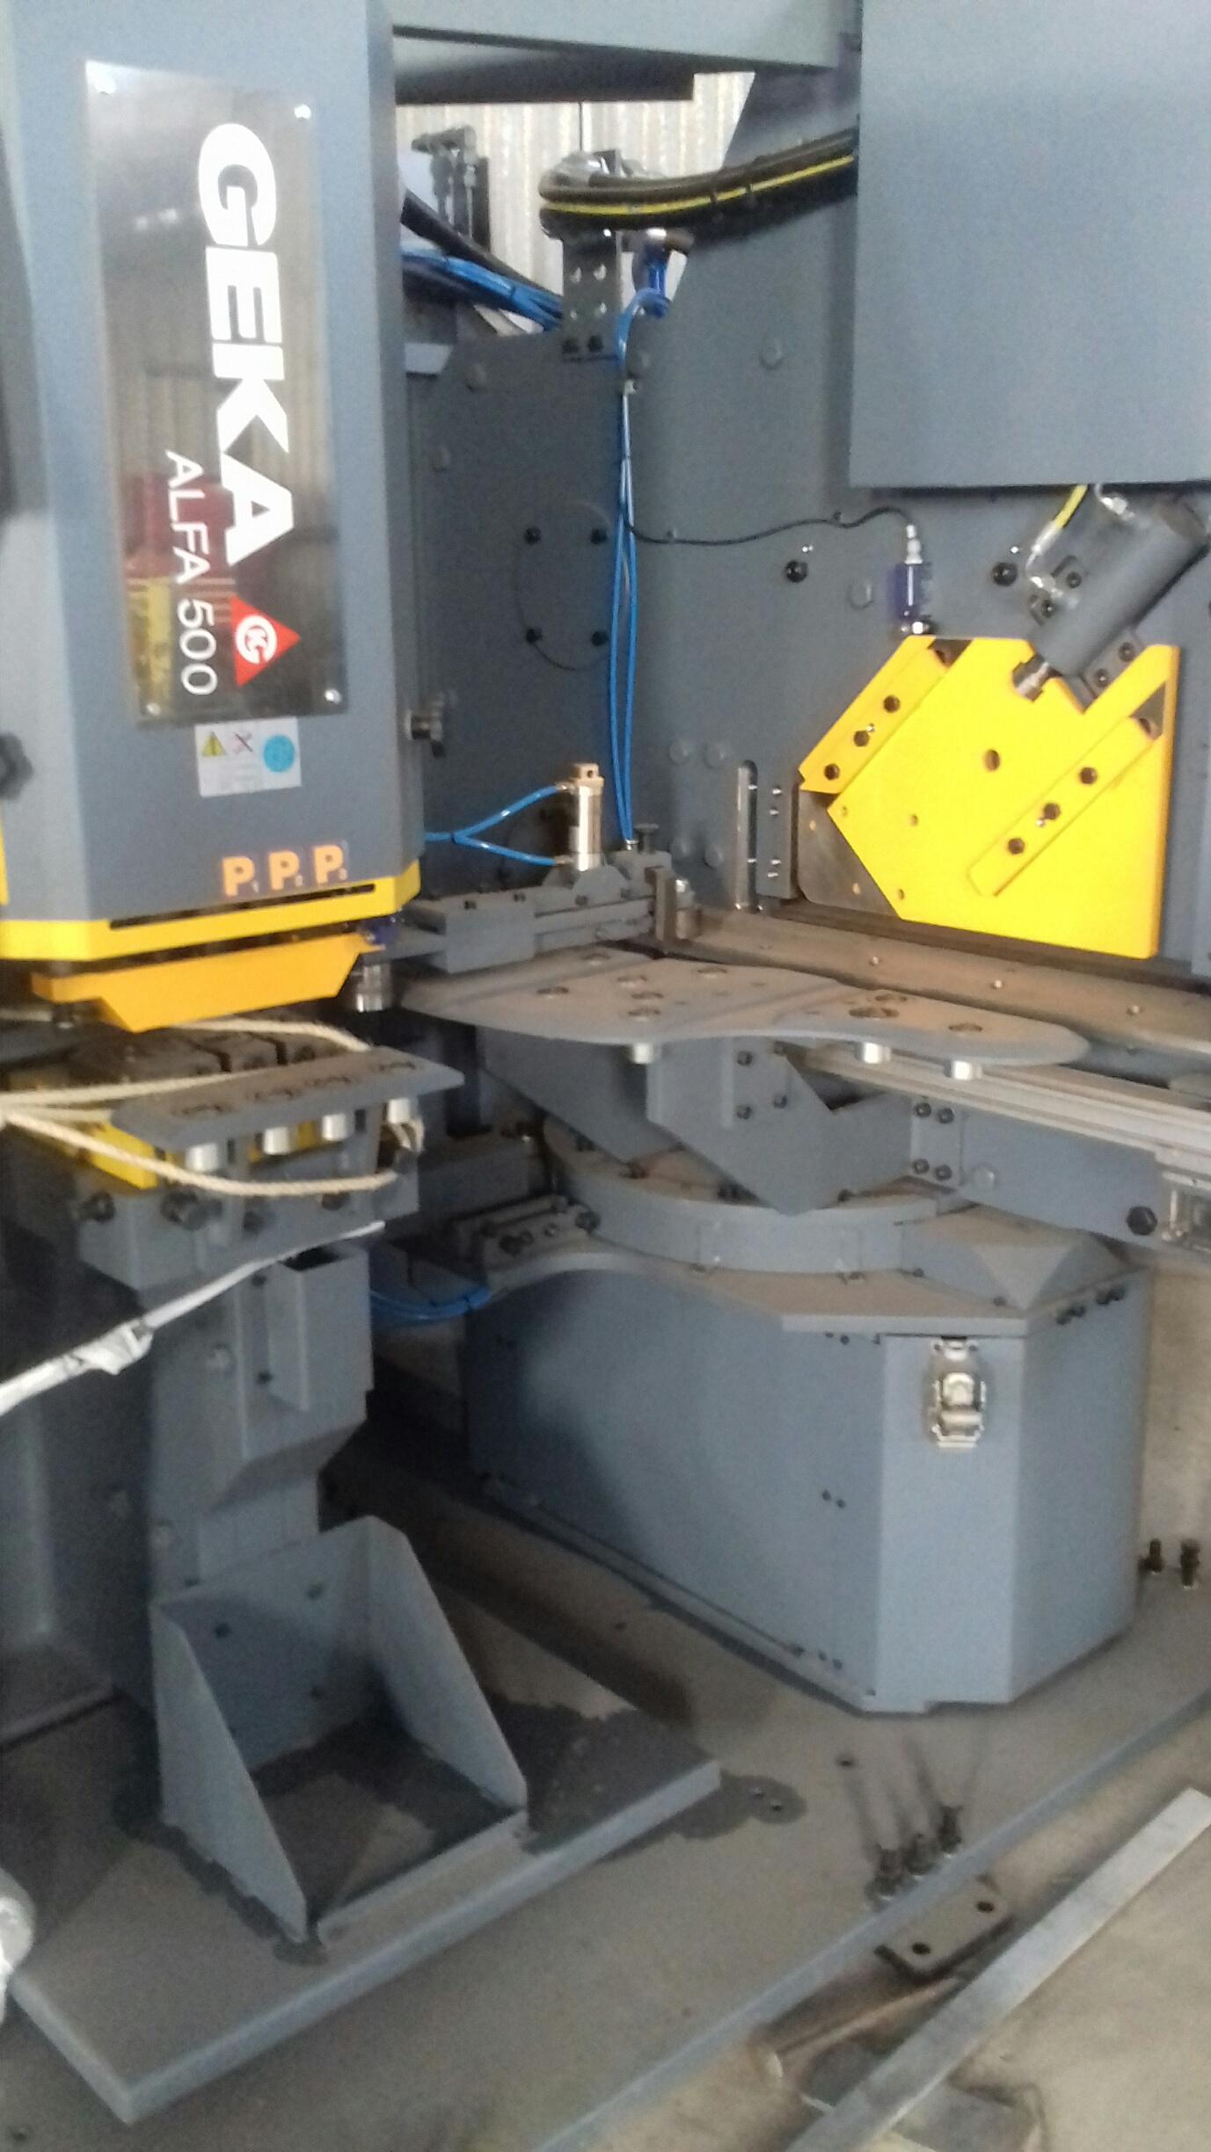
Streamline

Slide 18
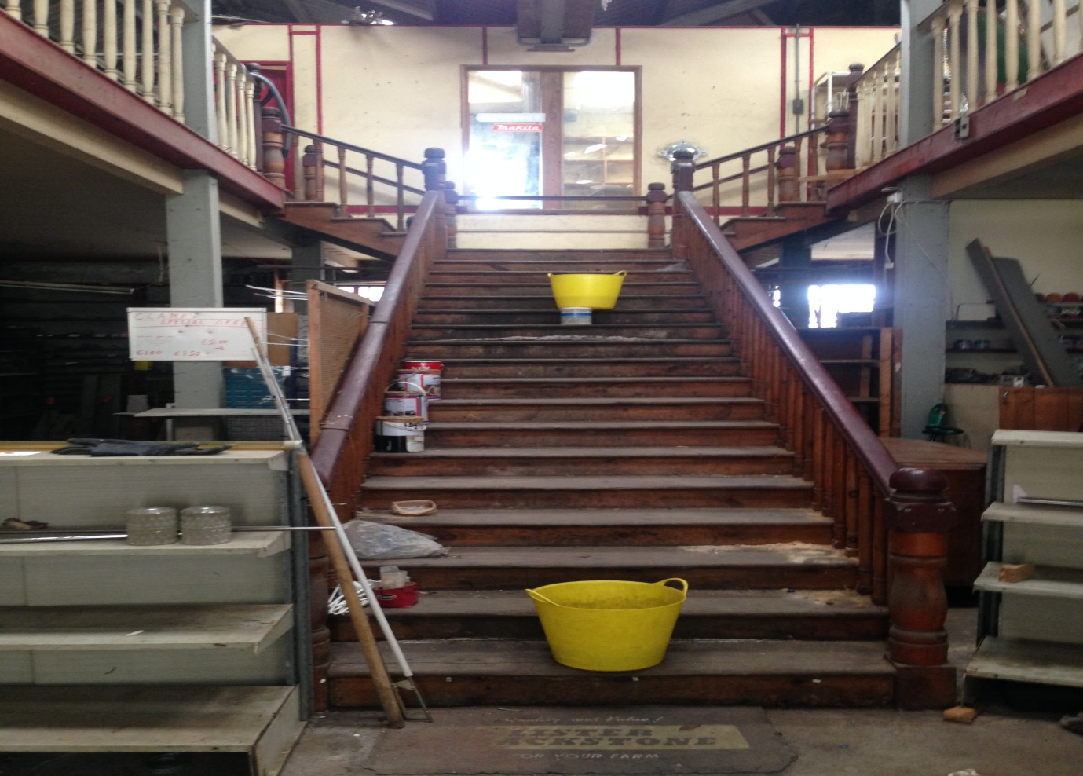
Blackwater Distillery
Founded in 2014, Blackwater Distillery is currently based in Cappoquin, in an industrial unit that is too small for its expanding output and which cannot receive visitors. The distillery will move its entire operation to Ballyduff, Co. Waterford, to McCarthy's Hardware Store, a premises on the main street originally constructed as a two storey supermarket in the 1950's. The original building will be entirely renovated, retaining much of the original character and layout, and the existing lean -to will be completed replaced with a two storey extension thanks to the LEADER investment of €200,000.. The new facility will include two new stills (total capacity 2400 litres) giving 8 times the output of the existing still, scaled up brewing equipment to allow commercial production of Irish whiskey will also be installed. The distillery will also be able to receive visitors and do scheduled guided tours of the facility, currently not possible in Cappoquin despite receiving several requests every week for tours, tastings, etc. In phase 2, the new distillery will include a cafe which will be leased to a separate operator and which will have the capacity to operate entirely independently of the distillery. The project will create 6 full time jobs on completion. Above you will see the before and most definitely the after effect as the project nears competion.

Slide 19
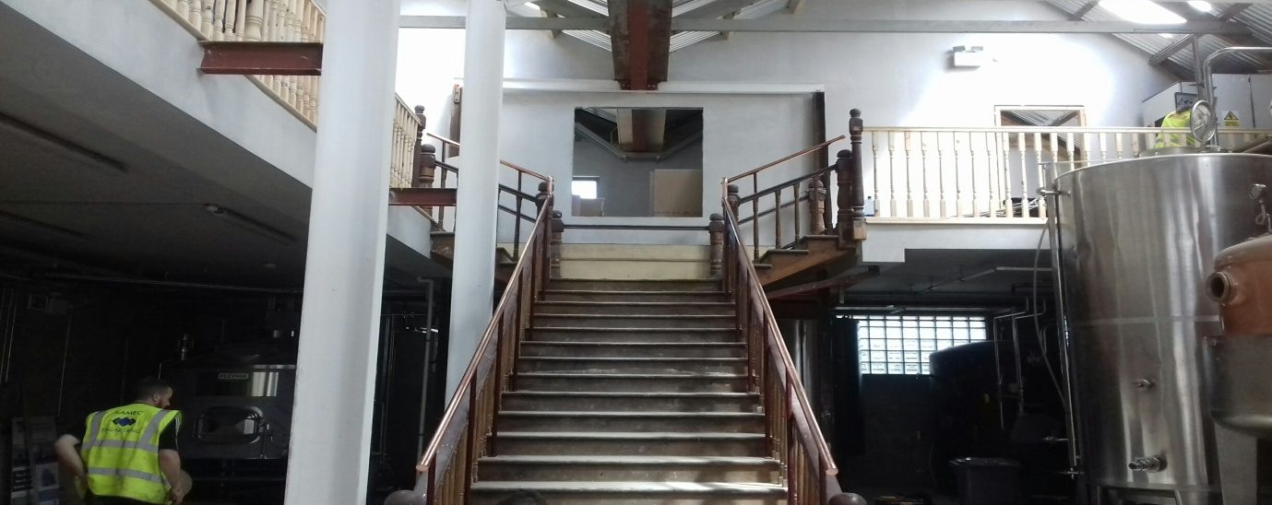
Blackwater Distillery

Slide 20
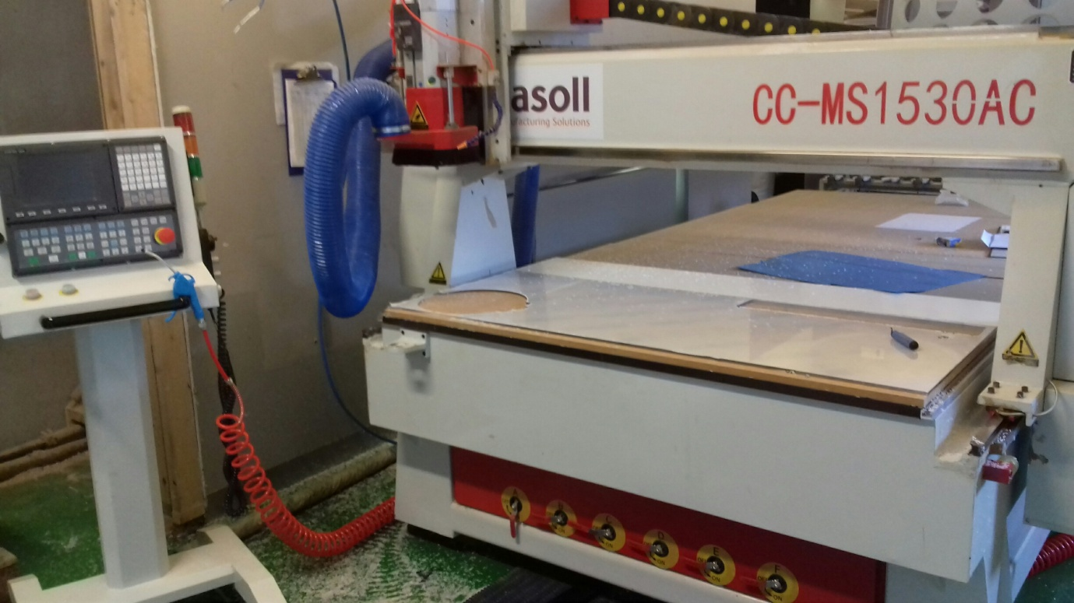
Imasoll
Inmasoll Ltd based in Tramore was seeking funds to develop a plastic fabrication facility to primarily support their clients in the food, pharmaceutical, biotech and medical device industries. Currently in Ireland there are only a handful of companies specialising in the manufacture of fabricated plastic products for the food, pharmaceutical, biotech and medical device industries. Their research has shown that a lot of companies get certain equipment made outside Waterford and even from outside Ireland because of this. From experience of working with these companies, they are requested to carry out plastic work already but have to sub contract it at present .LEADER funding enabled the promoters to invest in a new CNC router for cutting and shaping the raw plastic product and create one full time job.

