Slide 1
Staff Restructure
SICAP 2017 - 2022

Slide 2
SICAP Programme Change
SICAP 2015 – 2017 - 3 Goals
SICAP 2018 – 2022 – 2 Goals

Slide 3
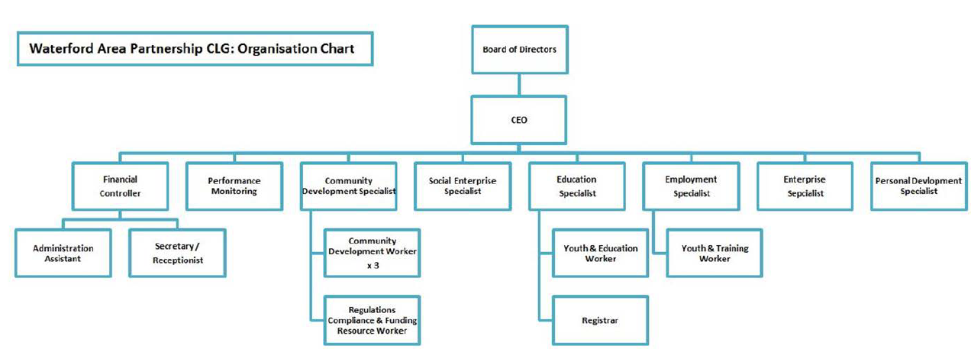
2017 Structure

Slide 4
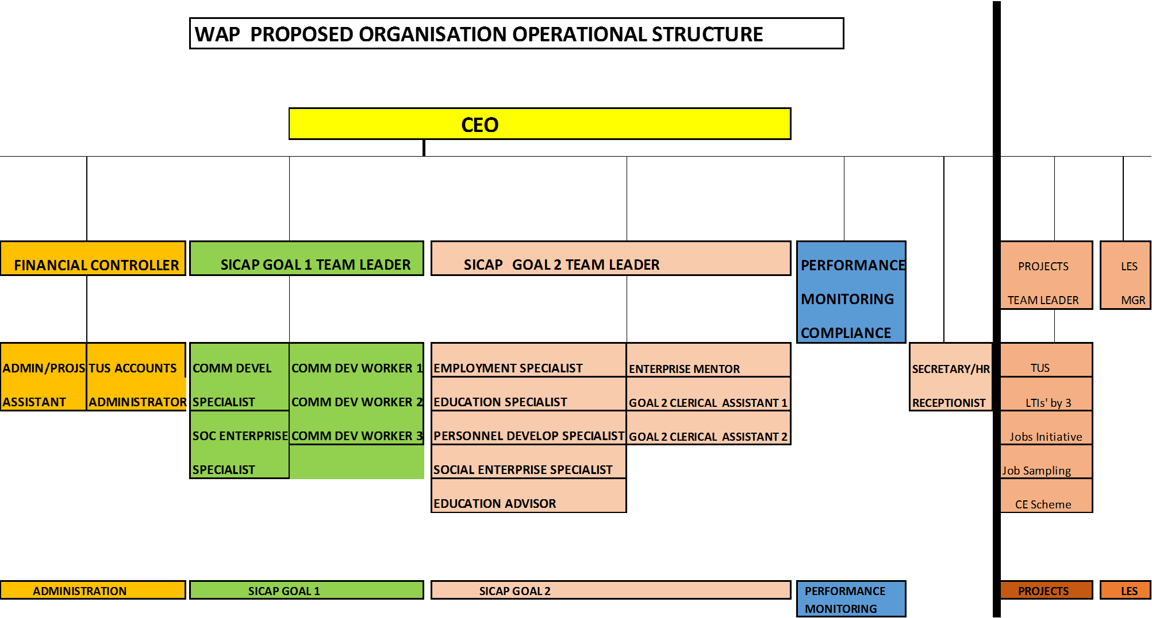

Slide 5
SICAP Rules
The total administration (indirect) cost must not exceed 25% of the total Lot budget; (SICAP Requirements pg69)
75% Goals (Staff and Action Costs)
It is recommended that each goal has between a 40% to 60% split of the total actions costs. (SICAP Requirements pg68)

Slide 6
Salary Rules
There are no salary caps or restrictions on salary amounts
Increases in the amounts charged as salary costs to SICAP from one year to the next will be reviewed by the LCDC as part of the annual planning process.
The LCDC may refuse what it deems to be excess increases in salary costs.
(SICAP Requirements pg 67)

Slide 7
Budgets
 |  | Present | Proposed
Allocation | 1 | € 1,120,415.00 | € 1,120,415.00
Admin (Max 25%) | 2 | € 280,103.00 | € 280,103.00 | (4)
Goal 1 (Total) |  | € 311,577.00 | € 311,577.00
Goal 2 (Total) |  | € 528,734.00 | € 528,734.00
Goal 1 Salaries |  | € 202,718.00 | € 209,274.00 | € 6,556.00 (5) | ↑
Goal 1 Actions |  | € 107,915.00 | € 102,303.00 | -€ 5,612.00 | ↓
 | 3 | € 310,633.00 | € 311,577.00
Goal 2 Salaries |  | € 323,675.00 | € 333,130.00 | € 9,455.00 (10) | ↑
Goal 2 Actions |  | € 200,414.00 | € 195,604.00 | -€ 4,810.00 | ↓
 | 4 | € 524,089.00 | € 528,734.00

