Slide 1

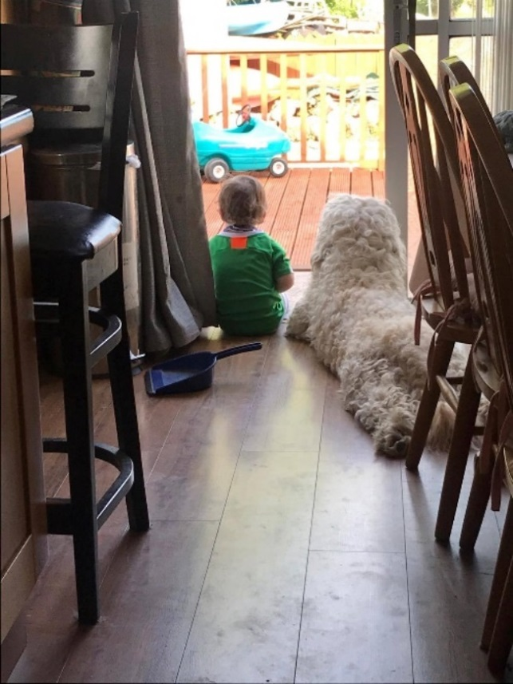
In This Together
A study of the Waterford Covid-19 Community Response Forum
October 2020

Slide 2
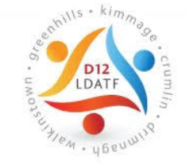


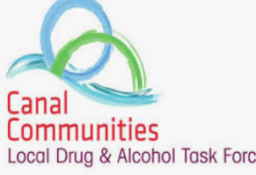
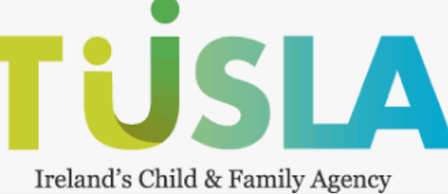
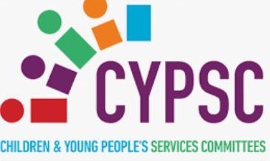
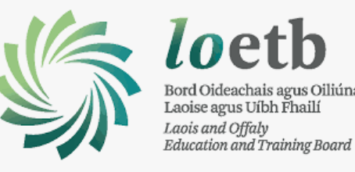
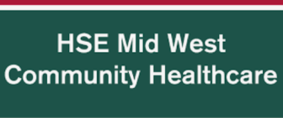
About
Aoife Dowling currently an independent research consultant. She has worked as a senior research analyst in the Maynooth University Social Science Institute. Having worked in this sector for over 10 years, Aoife has been employed within varied research areas and expertise includes needs analysis, service evaluations, data analysis, data coordination & visualisation, spatial analysis and preparation of evidence baseline reports.
Clients

Slide 3

Background

Slide 4
Aim of the research
Gather information on the initiatives and actions of the Waterford Community Response Forum (WCRF)
Engage with community groups who are registered with the WCRF.
Gather insights into how volunteers are responding to the needs of the community
Identify emerging needs as a result of the Covid-19 pandemic

Slide 5
Methodology
Research sub-group
  Healthy Waterford, Waterford City & County Council, Waterford Area Partnership and the HSE
Desk-based research
  Contacts made to the Community Call
  Volunteer groups registered with the WCRF
Online survey
  Volunteer groups registered with the WCRF
  55% response rate
Interviews with key stakeholders
  6 hours of interviews

Slide 6
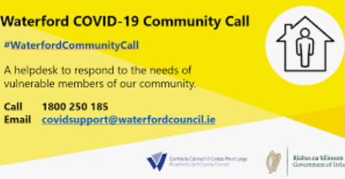

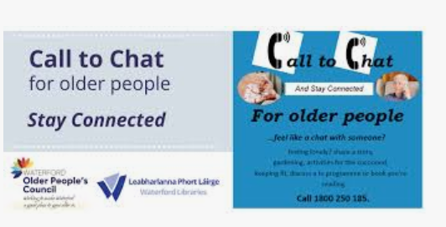
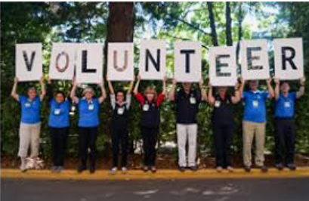
Waterford Community Response Forum

Slide 7
WCRF Responses:
2020 Covid-19 Emergency Fund
Funding was discretionary and intended to cover costs for groups that were directly involved in the WCRFs response to the Covid-19 pandemic.
Since the establishment of the WCRF in March 2020, over €70,000 of emergency funds has been distributed to voluntary groups.
  Reimbursement of travel expenses for volunteers
  Printing Costs
  Care packages
  Personnel Protection Equipment
  Food parcels
  Laptops and tablets

Slide 8
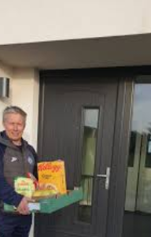
WCRF Responses:
Community Call (CC)
The CC is hosted by WCCC, managed by the Libraries section and staff from HR, Community and Library Services were tasked to operate the phone lines, supported by key HSE personnel.
Type of requests:
    Other medical
    Collection & Delivery
    Information
    Transport
    Social Isolation
    Meals
    Garda Related
    HSE Call Outs
Community Support Dashboard developed by the Waterford City & County GIS Department

Slide 9
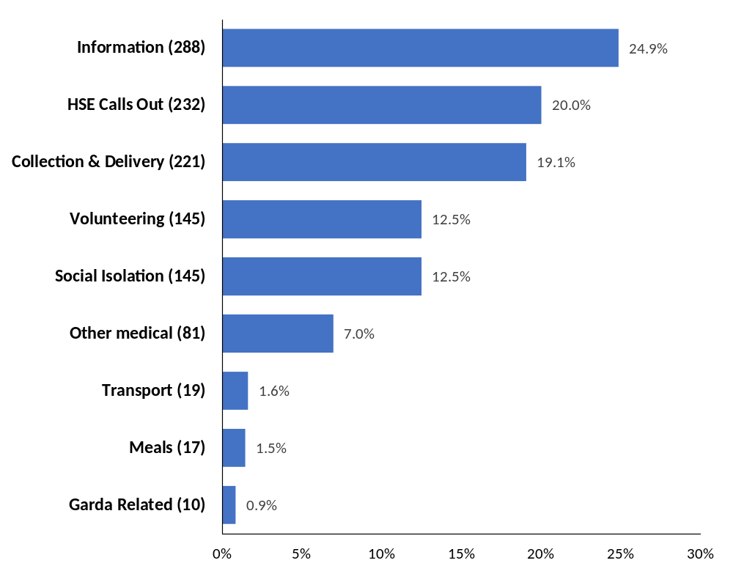
Requests by type
Community Call Helpline:
30th of March - 20th of September: 1,158 calls
Volunteering: 145
Requests: 1,013
Request Locations:
Waterford City & County – 612
Kilkenny County – 36
Wexford County – 8
Dublin City - 5
Cork County – 3
Other - 4

Slide 10
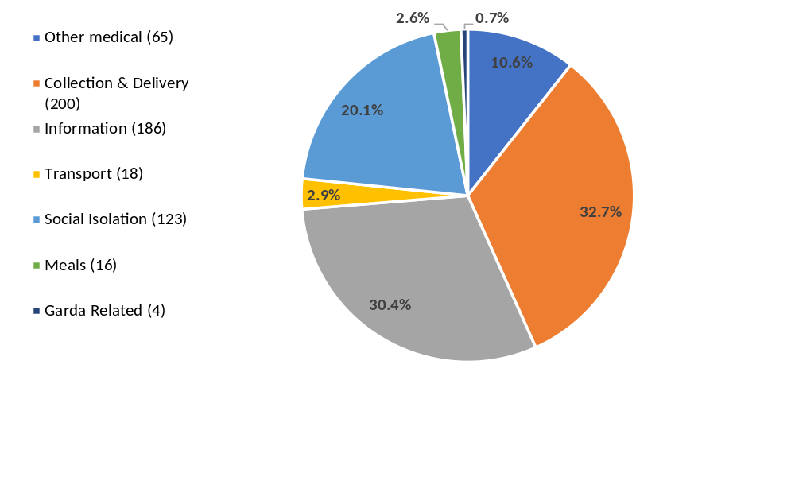
Requests by type and distribution – Waterford Electoral Divisions

Slide 11
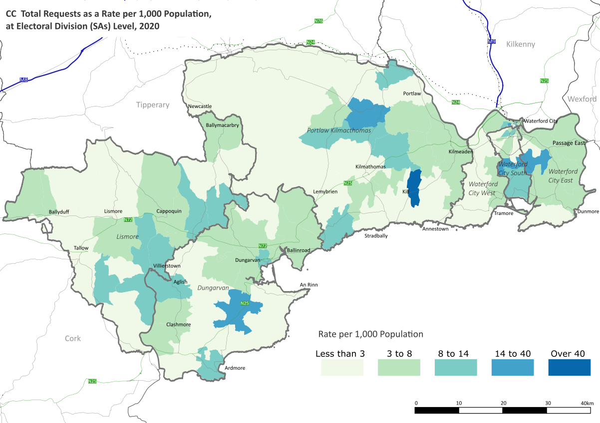
Requests by type and distribution

Slide 12
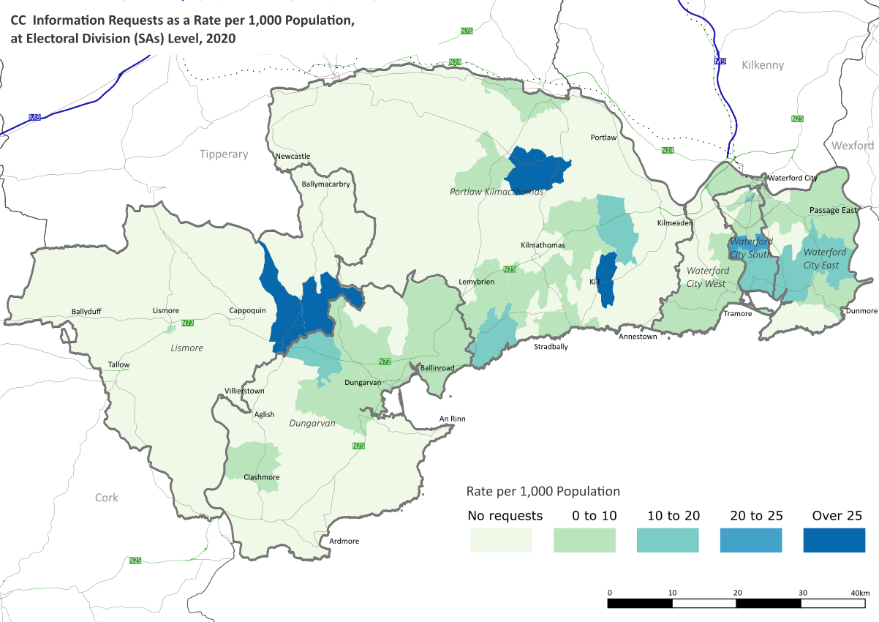
Requests by type and distribution

Slide 13
Structure of Findings
The Waterford Community Response Forum
Demand on Services
Services Response to increased demands
Care packs & outreach
Emerging Needs
Resurgence of Covid-19

Slide 14
Findings: The WCRF
Of those that took part in the survey over half (54%) described themselves as ‘Voluntary’ .
The groups surveyed reported that the WCRF & the CC made it easy for members of the community to get in touch with and them to assist them in their essential needs.
Interviewees expressed that WCRF promoted collaboration and partnership between multiple agencies.
Interviews with the various groups found that the WCRF responded rapidly to the essential needs of those whose movements were restricted.
Brought organisation to the collected efforts of the community.
Source: Online survey with voluntary groups

Slide 15
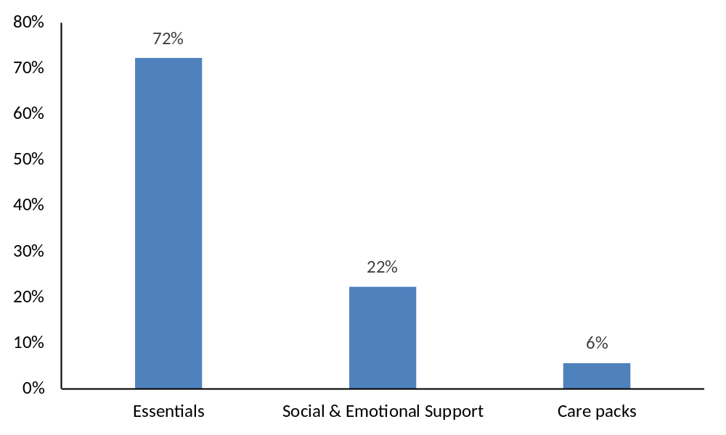
Findings: Demand on Services
Most of the groups surveyed felt that they had sufficient facilities, funding, volunteers and transport to respond to requests from the community and that members of the community responded positively to the service they were providing.
Various groups interviewed saw a significant demand on their services during the period of lockdown, particularly in regard to both social and emotional supports.
Source: Online survey with voluntary groups

Slide 16
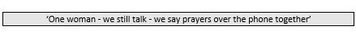

Findings: Services Response to increased demand
The CC established the ‘Call to Chat’ phone line to respond to the isolation needs of vulnerable people.
Many community groups had to change their operations in response to new social distancing guidelines as well as cater for a significant increase in demand of their services.

Slide 17
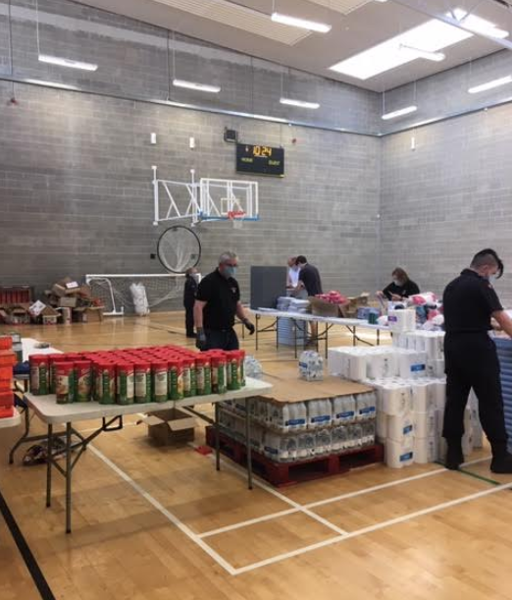
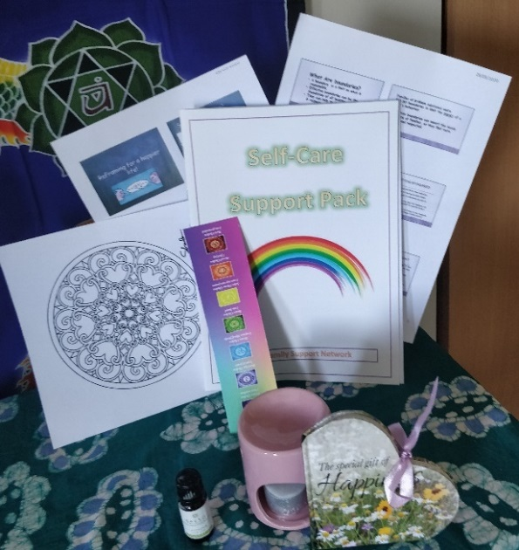
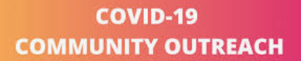
Findings: Care Packs and Outreach
In order to ensure that marginalised communities felt remembered and recognised interviewees noted how care packs were distributed and outreach was conducted, both were well-received.

Slide 18
Findings: Emerging Needs & Resurgence of Covid-19
Most voluntary groups surveyed concluded that they would be able to continue their response in the event of a resurgence of Covid-19.
In the case of a resurgence of Covid-19, groups highlighted concerns in relation to increase in demand for fuel and essential services, financial strain on households and the detrimental effect of further restrictions on vulnerable members of the community.
According to most of the interviewees, the pandemic compounded existing issues such as isolation and loneliness, housing needs of minority ethnic groups (Roma, Travellers & Residents of Direct Provision Centres), marginalised communities; as well as people with complex needs.

Slide 19
Conclusions
The Waterford Community Response Forum:
  Responded effectively and rapidly
  Innovative technology established by the WCCC GIS Department allocated CC requests to voluntary groups
  Strengthened existing relationships and collaborations between multiple agencies
Demand for Services:
  Collection & Delivery, Information and Social Isolation
  Covid-19 emergency fund
  Groups responsive to the changed environment
Care packs and outreach:
  Effective methods of communicating
  Recognising marginalised communities

Slide 20
Needs
Existing Needs:
  Food & Fuel poverty
  Loneliness & Isolation
  Lack of Technology & Internet Access
  Housing Needs of Marginalised Communities
Emerging Needs:
  Impact of the closure of day centres & support groups
  Increased need food support (food banks and hot meals)
  Ability for groups to fundraise

Slide 21

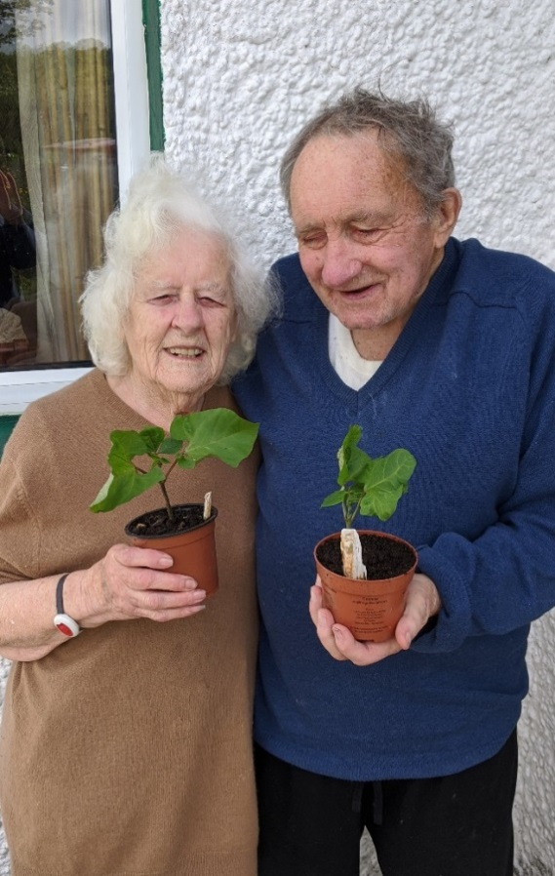


Good News Stories

Slide 22
Recommendations
WCRF remains in operation responding to the needs of the community.
The CC helpline to remain in operation as well as the Call to Chat phone line to be reestablished
Regular contact be maintained with groups registered with the WCRF to update them on on-going or possible need.
Engagement to be established with voluntary and community groups that did not engage with the WCRF.
More funding be allocated for care packs and outreach, specifically to marginalised communities.
More information to be provided to the community on local Food Banks, Care & Repair Services and DSP Fuel Allowance
Address, where possible, the housing needs of those in need

Slide 23
Questions?

