Slide 1
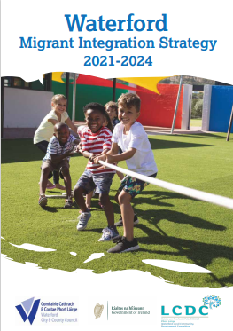
 | Waterford Local Community Development Committee Implementation of Migrant Integration Strategy 2021-2024

Slide 2
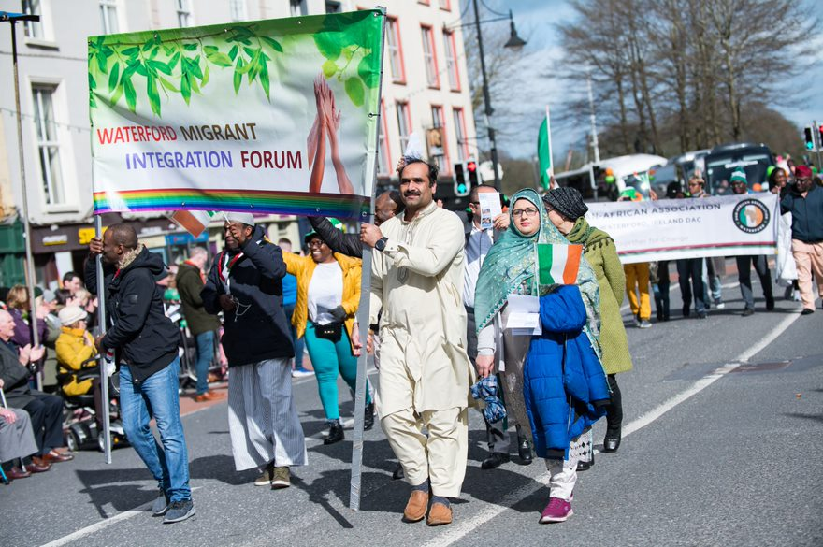
Waterford LCDC committed in 2018 to progressing The Migrant Integration Strategy – A Blueprint of the Future
 | Key Actions: Established an interagency Working Sub-group – first meeting in February 2018. Establish Waterford Migrant Integration Forum – achieved by November 2018. Waterford Migrant Integration Strategy developed – approved by LCDC in July 2020 Strategy launched – achieved in April 2021 (delayed due to Covid-19)

Slide 3
Strategy Themes 2021-2024
Access to Public Services Education & Life Long Learning Employment & Pathways to Work Integration in the Community & Social Inclusion | Health Sport Political & Civic Participation Promoting Intercultural Awareness & Combatting Racism & Xenophobia Volunteering

Slide 4
Overview of Key actions
Action: Access to Public Services Welcome/Failte to Waterford Hub Cultural Training for Agency Staff Online Directory & Information Employment & Pathways to Work Promote Entrepreneurship & Innovation Inclusive Workplaces Integration Category in Business Awards Skills audit within community Health Promote current supports Information & Access to health services | Proposed Lead & Potential Partners Waterford LCDC (Lead); Dept. of Employment Affairs & Social Protection; Waterford Citizens Information Service; Waterford Migrant Integration Forum; Waterford Area Partnership & others Dept. of Employment Affairs & Social Protection (lead) WC&CC Economic Section; Waterford Migrant Integration Forum; Waterford Chamber of Commerce; Waterford Congress of Trade Unions; Waterford Area Partnership SICAP Waterford Local Employment Services – city & county HSE Social Inclusion Unit (lead); HSE Community Care; Waterford Migrant Integration Forum; Healthy Waterford U-Casadh Atelier Roma Project; Intercultural Health Hub

Slide 5
Overview of Key actions
Action: Education & Lifelong Learning Yellow Flag Programme recognising integration & diversity Translation at Parent meetings English language classes Integration in the Community & Social Inclusion Waterford Migrant Integration Forum strengthened & resourced Housing development – avoid ghettoisation Promote inclusion across community sector | Proposed Lead & Potential Partners Waterford LCDC (lead); Waterford Institute of Technology Waterford Wexford Education Training Board Adult & Community Education; Solas; Waterford Migrant Integration Forum; Waterford Area Partnership SICAP; Secondary School Principals Network; Waterford Childcare Committee Primary School Principals Network Waterford LCDC (lead); WC&CC Housing Section; Waterford Migrant Integration Forum; Waterford Area Partnership SICAP; Waterford Integrated Services; Waterford Women’s Centre; Waterford PPN; Waterford Children & Young People’s Services Committee; Family Resource Centres

Slide 6
Opportunities for Effective Engagement with the Migrant Community
Waterford’s population is now much more diverse, with migrants estimated at 12.8% of the total population As a community, we have a collective responsibility to ensure inclusivity and equality of access to services, programmes and opportunities LCDC agencies and organisations can work together to empower minority groups through civic engagement and ensure that policies and practices that may give rise to institutional racism are challenged Waterford contributed to the development of the recent White Paper on ending the current Direct Provision system (now known as IPAS) Based on the high level of integration and inclusion work completed to date in Waterford, the LCDC can be recognised as having a valid role to play in supporting the development of the National Action Plan Against Racism (NAPAR) The LCDC can advocate for the Business Case for Diversity, more Awareness on Equality, Diversity and Inclusion

Slide 7
Implementation
Waterford LCDC to agree:
Annual Action Plan including review and monitoring
Resources i.e. Project Coordinator
Migrant Integration Strategy Steering Sub-Group – ratify Terms of Reference & Membership (not implementation focused - to guide, advise and monitor)
Establish Task Groups to progress Strategic Themes & Actions including implementation and monitoring
Monitor & Evaluation processes to capture learning and outcomes to inform future actions

Slide 8
Implementation
Waterford Migrant Strategy Project Coordinator role includes:
Delievr on approved Annual Action Plans
Coordinating themed Task Groups and progressing agreed actions
Organising seminars/workshops to support actions
Developing promotion methodologies supporting ease of access to information, facilities, services etc.
Identifying funding streams to support development of actions
Monitoring & Evaluation processes
Cost for 12-month period of €50,000 – Salary, communication, admin etc.

Slide 9
What is being asked today?
Waterford LCDC members to support implementation by:
Reviewing themes and actions to include in internal annual plans 2021-2024
Committing annual budget allocations – collectively €50,000 can be achieved
Committing time of relevant staff and resources to Task Groups
Ensuring strategy outcomes are achieved by 2024
Waterford Migrant Integration Strategy 2021-2024 included in Waterford Local Economic & Community Plan and Waterford Development Plan

