Slide 1

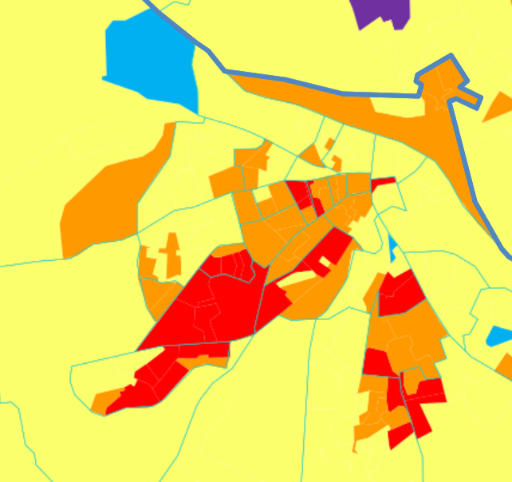
Waterford City
Area: | Waterford City
Electoral Districts: | Ballybeg North, Ballybeg South, Ticor North, Ticor South, Larchville, Lisduggan, Kingsmeadow, Roanmore, Slievekeale, Morrisson's Avenue West, Morrisson's Avenue East, Military Road, Morrisson's Road, Newport's Square, Shortcourse, Centre A, Centre B, Grange North, Ferrybank, Gracedieu, Cleaboy, Bilberry, The Glen, Ballybricken, Custom House A, Custom House B, Mount Sion, Poleberry, Park, Newtown
HP Pobal Deprivation: | 0.3 to -25.7
The
Glen
Bilberry
Ballybricken
Centre
A
Ferrybank
Cleaboy
Morrison’s Avenue
East
Military
Road
Newport’s Square
Custom House B
Gracedieu
Centre
B
Morrison’s Avenue
West
Morrison’s
Road
Custom House A
Shortcourse
Park
Slievekeale
Ticor
North
Mount Sion
Roanmore
Lisduggan
Kingsmeadow
Ticor
South
Poleberry
Newtown
Ballybeg South
Larchville
Grange North
Ballybeg North
1

