Slide 1

Utilising Business & Social Business Methodologies to Support Social Enterprise Sustainability & Development in Waterford
SICAP Case Study 2021
Thematic Area; Goal 1/Goal 2 Project
Target Group; Social Enterprise in a Disadvantaged Area

Slide 2
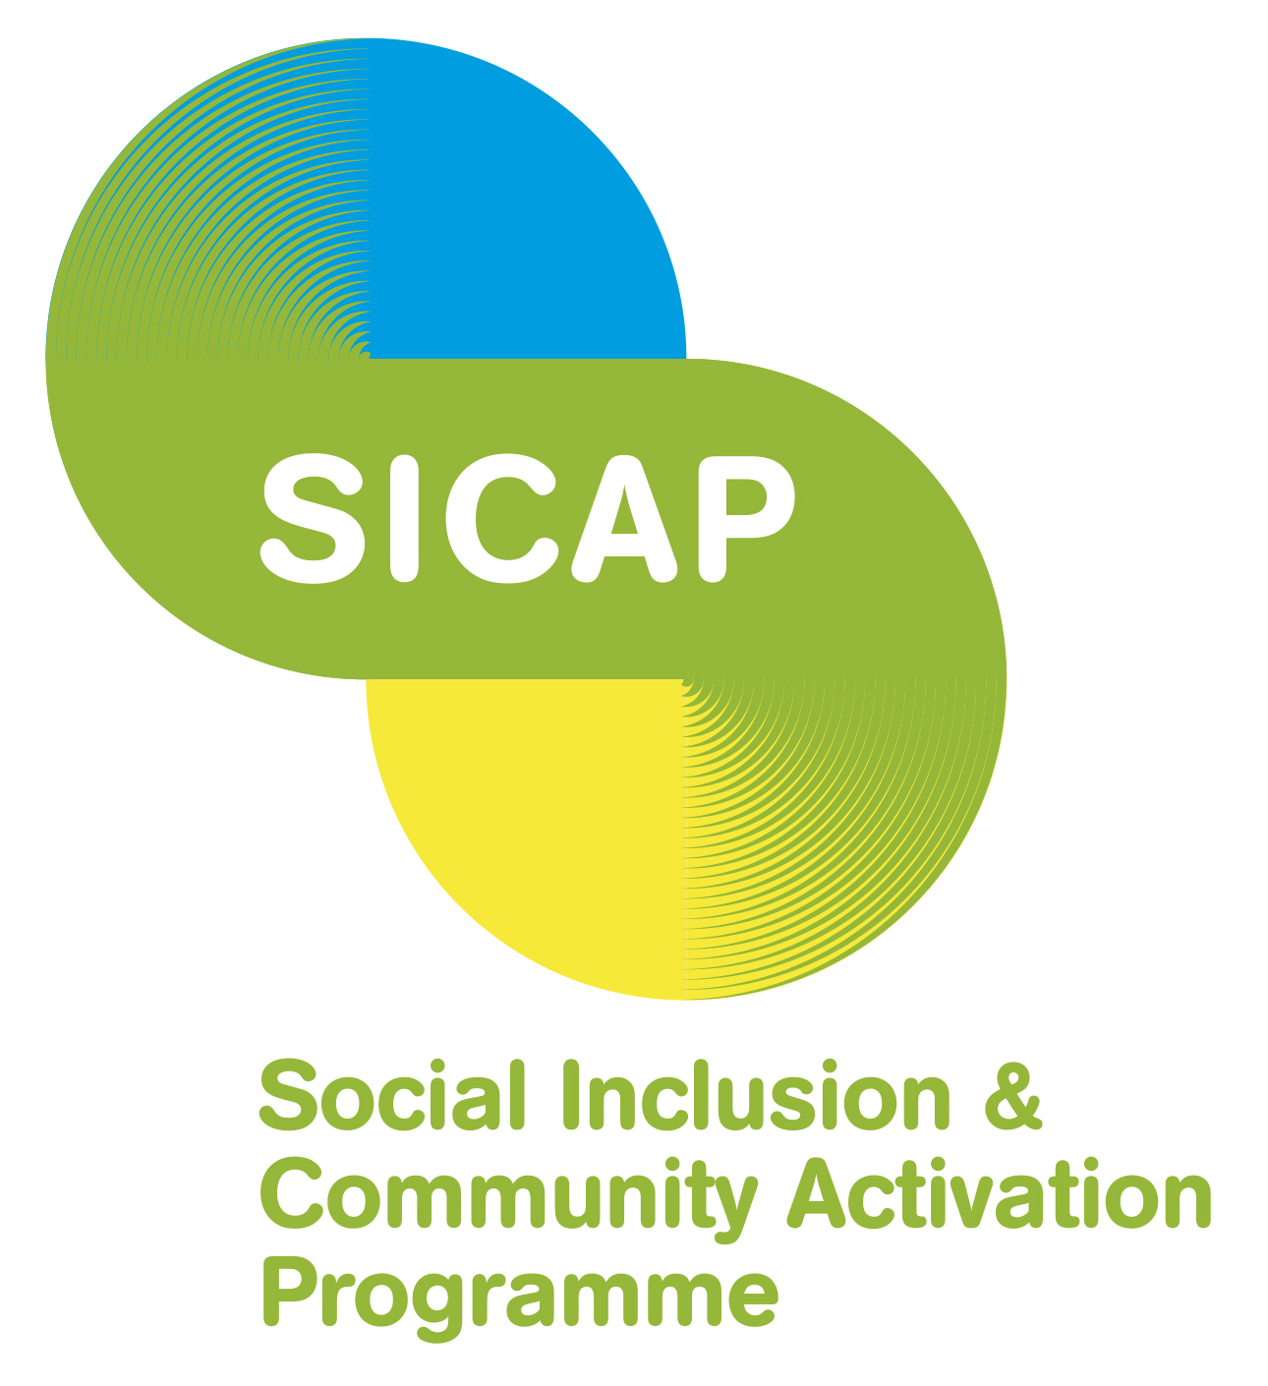
SICAP Programme Goal (1): To support communities and target groups to engage with relevant stakeholders in identifying and addressing social exclusion and equality issues, developing the capacity of Local Community Groups, and creating more sustainable communities.
SICAP Thematic Area: Increase the level and/or type of services delivered by Social Enterprises to SICAP target groups and increase the sustainability of the enterprise and its ability to contribute to the social and economic development of disadvantaged areas.
SICAP Target Outcome: G1-5:2 Social enterprises supported by SICAP are stronger and more able to contribute to local economic and community development.

Slide 3
Waterford local economic dc Objectives for work with sicap
The development of a post Covid closure Strategic Business Plan to;
Enhance the performance of WLEDC and Cill Barra in achieving strategic objectives
Assist the Board and staff of WLEDC/Cill Barra in identifying measures to increase business sustainability

Slide 4
Goals for SICAP Engagement
Revisiting WLEDC foundational principles and governance with a focus on how the company can supporting the local S/E ecosystem
A review of the operation of Cill Barra and the development of a 3-year action plan focusing on social impact and business growth.
A D.M. audit of Cill Barra.
D.M. workshops
A short test digital marketing campaign to demonstrate the benefit of a DM strategy for social enterprise.
Capitalise on the WSEN engagement with the wider S/E ecosystem in Europe
“Given the emphasis underway at an EU level in relation to social enterprise and the wider social economy, there is also an opportunity for social enterprises to benefit from Ireland engaging more closely with EU policy developments at Governmental level” National Social Enterprise Policy for Ireland. P.22

Slide 5

WLEDC Overview
Established in 2001 as a joint venture between Waterford Crystal and the Community and Voluntary Sector.
The company has charitable status and aims to address unemployment and poverty through social economic development
The first of 4 intended WLEDC flagship projects, Cill Barra Community Sports Centre was completed in 2006 with funding from the Dormant Accounts Fund.
In January 2009 Waterford Crystal went into receivership and the other 3 flagship projects were put on hold.

Slide 6

Mission Statement
‘Cill Barra Fitness provides a safe, supportive environment for everyone to be able to benefit from and enjoy health & fitness. We promote inclusivity and diversity; welcoming all individuals and groups aiming to make fitness and wellbeing entirely accessible to all in Waterford. As a social enterprise, our core value is to create a positive societal impact; this is the foundation of everything we do‘.

Slide 7
Process for engagement 2021 into 2022
Cill Barra Strategic Plan & Operational Plan
Ballybeg Social Enterprise Hub
Review & Re-align WLEDC Strategy

Slide 8
What Worked Well
Experienced and skilled SICAP staff working across G1 & G2
Building on previous work with WLEDC
In-depth SICAP engagement with Board & Staff
A mix of face to face and online sessions
The use of visual tools to explore business fundamentals such as strategic planning, branding and market segmentation
Framing the “social” and the “enterprise” elements
WLEDC engagement with WSEN and European Social Economy Workshops on Social Business Canvas Tool. Connecting the local, national & European ecosystems

Slide 9
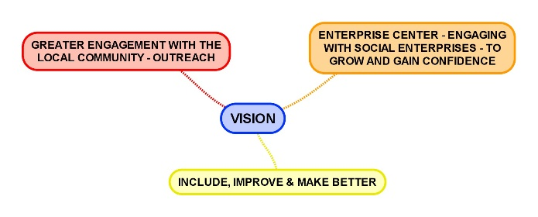
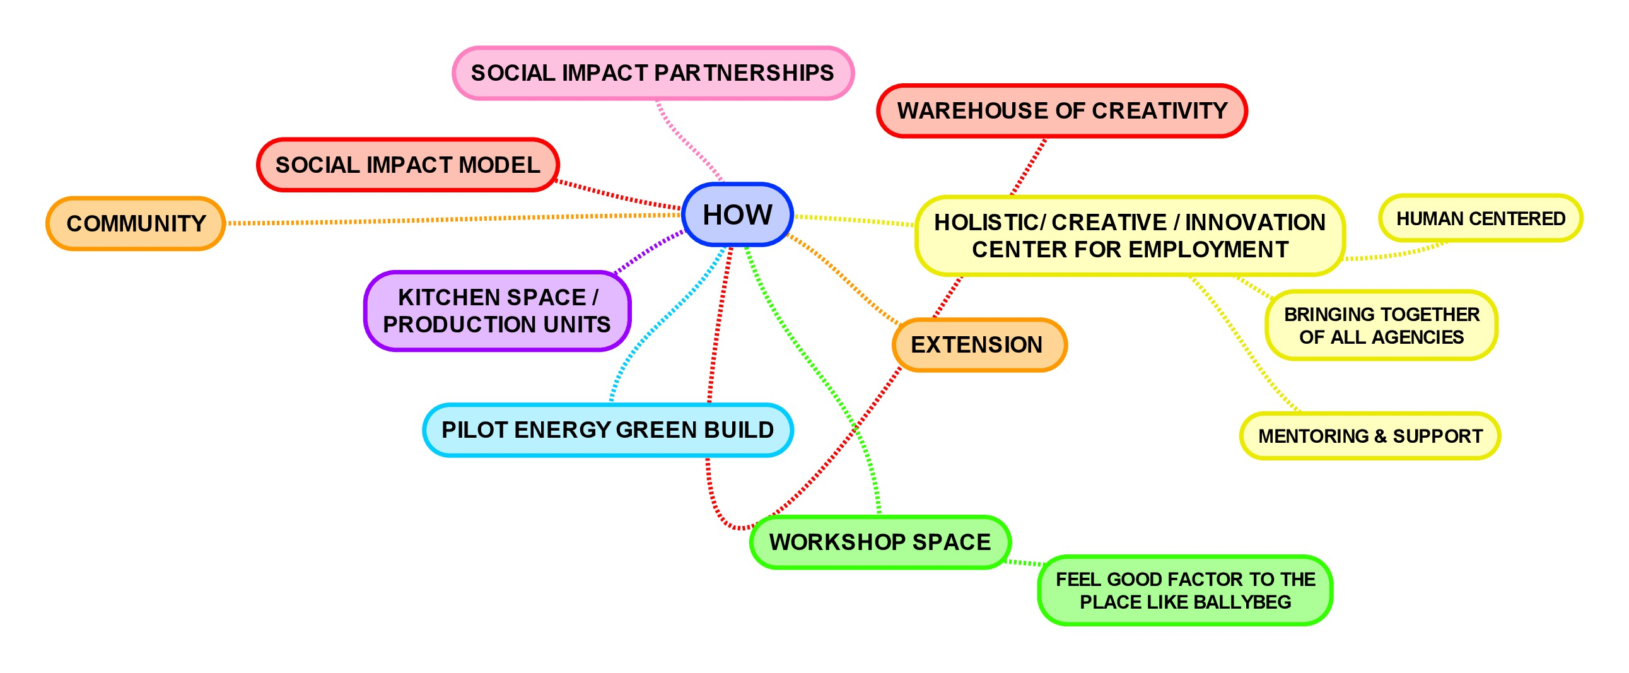
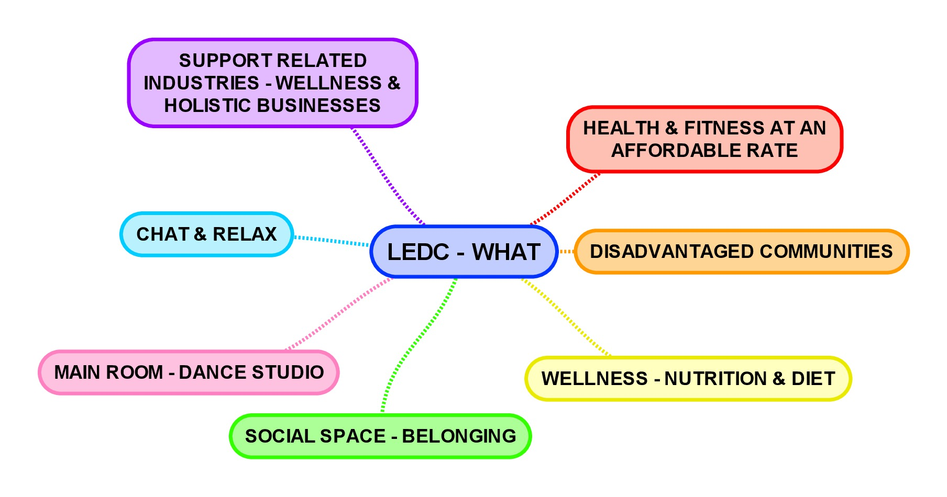
Business Analysis & Strategic planning
What is the problem being solved by the LEDC?
How does the LEDC solve the problem?

Slide 10
Demonstrate a Digital marketing strategy to support business growth/sustainability
Digital Audit – Website & S/M
Pestel & Swot Analysis
Competitor Analysis
Customer Journey
Empathy Mapping – Market Segmentation & Personalisation
Brand Identity
Short DM Campaign focused on Website improvement & re-opening promotion

Slide 11
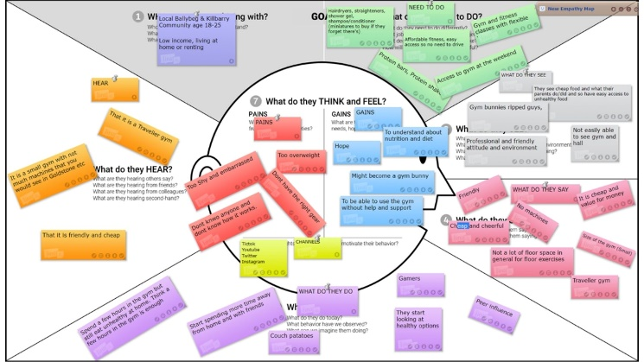
Visual & Social Cill Barra – WHO?
Product
Targeting

Slide 12
DM Outcomes of Short campaign
Facebook
Facebook reach following digital campaign; Increased by 45.3%
Pre-campaign reach; 417 Post-campaign reach; 1031
Pre-campaign shares; 4 Post-campaign shares; 35
Twitter – re-vitalisation of twitter engagement
Website
Pre-campaign page views; 87
Post-campaign page views; 499
Pre-campaign bounce rate; 34.48%
Post-campaign bounce rate; 27.81%
Increased Customer Discovery & Purchase; “There have been 14 new gym memberships since June (online campaign month). Pay As You Go gym usage increased in June and July. Usage is steady since re-opening” Cill Barra Staff member

Slide 13
Challenges
Like any other enterprises, social enterprises require, and can benefit from, the provision of business supports to help them start-up, become self-sustaining and to grow. ….. Supports are needed in areas such as business planning, mentoring, capacity building, leadership and governance, impact measurement, financial planning, digital innovation as well as access to business incubation space.
National Social Enterprise Policy for Ireland p.18
Time/volunteer engagement to develop an overall vision for WLEDC
Staffing resources to engage and drive
Reluctance of local staff to appear on S/M videos
Building business knowledge of staff and volunteers
Level of support required – maintaining the momentum

Slide 14
Outcomes
WLEDC – Commencement of Post Covid Strategic Plan & ID of Governance Issues
Cill Barra – Strategic and Operational Plan (marketing, finance, community engagement, operations)
Increased board member engagement in strategic development
Increased understanding of business fundamentals for social enterprise
Increased customer engagement & discovery
Wider engagement with others in Ballybeg Campus to develop an overall vision – Social Enterprise Hub – adapting the potential of the European Social Business Canvas tool for ecosystem mapping

Slide 15
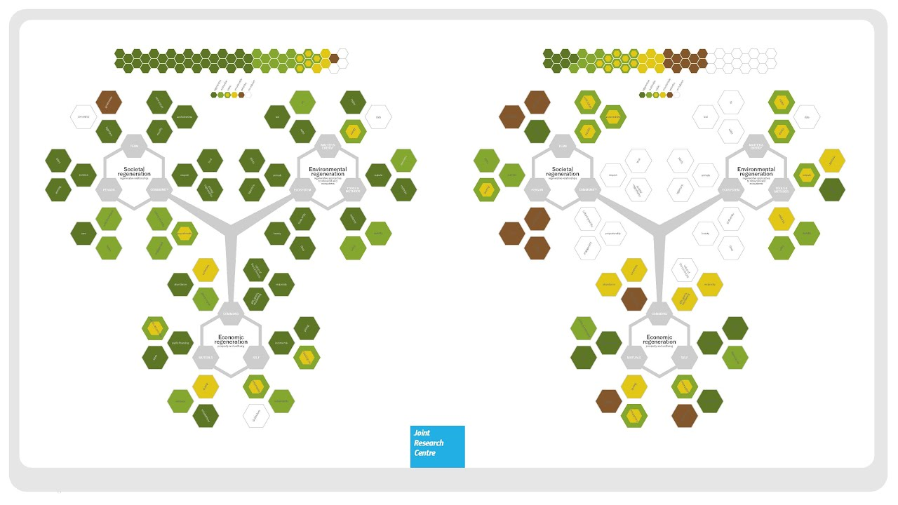

Slide 16
Learning
The importance of in-depth engagement by SICAP staff with a Social Enterprise to understand the developmental process of a community-based business and the challenges that it faces at different points of development on a non-linear path.
The value of voluntary board and staff training in business fundamentals to support work towards financial sustainability as well as having a social impact focus.
The value of board and staff understanding of (digital) marketing approaches to understand and build customer discovery, engagement, and brand loyalty.
The importance of networked local, national, and European eco-systems for the development of the social enterprise sector as a valued part of economic development and sustainability.
The importance of business planning review post Covid closure to ensure brand vitality and sustainability
The importance of policy alignment across Government departments and agencies to ensure a structured and equitable approach to social enterprise development and resourcing.

Slide 17
LCDC building on sicap work
W/Council development of a Strategic Plan for Social Enterprise as an element of LECP
Collaboration with WAP/SICAP for promotion of LDCD supports for Social Enterprise – (Digiwise/SEED2/Managing Change)
LCDC supporting access for S/E to Enterprise Ireland resources for S/Es that have charitable status (trading online voucher)
Supporting investment in human resources for S/E to enable business growth

Slide 18
“The staff of WAP have been actively supporting us to develop both a strategic plan and a marketing plan over the past year. They have been so helpful and encouraging. They were always available when needed, nothing was too much for them. Without the SICAP programme, we wouldn’t have completed this much-needed analysis.” WLEDC Board member

