Slide 1

WAP/SICAP Annual Progress Report 2021
Presentation to LCDC February 2022

Slide 2


KPI Achievement & Budget Spend
G1 KPI Target 67 LCGs Actual 68
G2 KPI Target 867 Individuals Actual 895
G2 KPI Target 37% Disadvantage Area Actual 32.3%
Total Budget Spend €1,229,025.76

Slide 3

Local Community Groups
Needs identified:
Adapting to Covid-19 guidelines led to meetings and events being cancelled
Loss of volunteers and committee members due to age profile, personal circumstances and/or ‘burn out’
Digital connectivity barriers with lack of skills and equipment led to limited engagement of target groups
Annual Support Plans – low motivation and uncertainty impacted on annual planning
Responses included
Staff communication and mentoring support critical for LCGs/community leaders (critical for motivation but hard to capture on IRIS)
SICAP Grants plus other applications to adapt facilities in line with Covid-19
Governance supports & Charities Governance Code; information on Covid-19 guidelines
SICAP actions adapted and supported target groups to link with supports e,g, Waterford Foodbank, school kits etc.

Slide 4
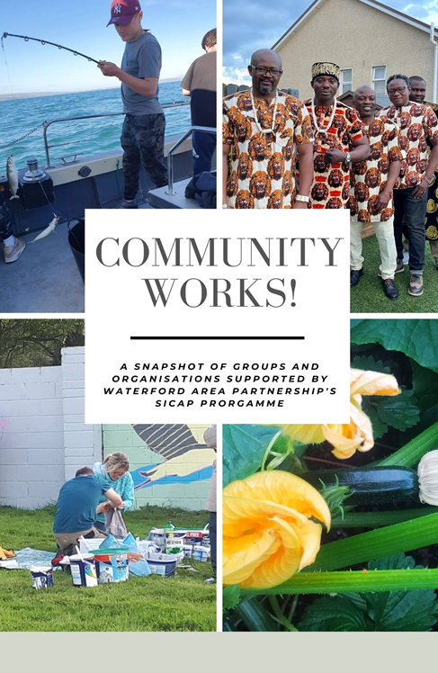
Key actions included (ongoing)
SICAP Community Stories Project – 30 groups engaged in project, reflecting on why they came together and their achievements. Positive outcomes with booklet to launch in March/April with strong social media & PR campaign #CommunityWorks!
Roma Community – through links with Atelier Roma Project outreach work, supported families with food and care parcels. Outreach work led to new families emerging (in March 2020 and increased to 67 by June 2021). Evaluation report being undertaken to capture learning including focus groups with Roma Community
Community Gardens – new projects emerged in city and rural communities with 2 successful under CLAR funding. Open spaces for social interaction with G2 providing horticulture courses

Slide 5
G1 Collaborations & Structures Included:
Waterford LCDC Migrant Integration Strategy 2021-24 – funding allocated to support delivery of strategy
Traveller Interagency Group – Needs Analysis & Strategic Plan led to G1 & G2 collaborative action with Traveller CDP
West Waterford Sports Hub – supported LCGs to engage & promotion of community sports activities
West Waterford Family Support Network – pilot project developed in Cappoquin by Tusla, Barnardos & CYPSC
Social Enterprise – Local (WSEN), National (SERI/ILDN) & European Networks (REVES)
Digital Connectivity Sub-Group – emerged from Community Response Forum and led by Waterford libraries with focus on rural community engagement

Slide 6



How Individual Needs Are Identified
Consultation with G1 / LCGs / Statutory Agencies / Tus / DEASP/ LES
Identification of Need
Identification of Gaps in Services & Supports
Collaboration to Provide Additionality
Programme Development
Individual Registration
Personal Action Plan for SICAP Support
SICAP Intervention or Output
Evaluation
Call Back
Additional Interventions / Outputs or Referral
File Dormant or File Closed
No matter how many interventions, outputs & time is associated with an individual they will only count once towards the KPI (2)

Slide 7
What Individual Needs Were Identified
English language conversation/practise
Digital hardware & connectivity
Social isolation/anxiety
Low threshold & non directive engagement programmes
Non duplication – difference/proliferation (y/p)
Career planning/anxiety/overcoming prejudice
Entry level industry standard training
Work placements
Employability programmes for young people with a disability
Finance to support access to education & work
SYOB Training
Business Mentoring
Financial planning for business
Pivoting business model to respond to Covid
Therapeutic and creative family activities connected to their known support agencies (2.3 N/C)

Slide 8
HOW SICAP Responded to Individual Needs
Phone registration/pap/follow up supports - audit
Therapeutic / health & well being programmes
Online programmes – career planning/SYOB
Face to face programmes when/where possible – Manual Handling
Tailored responses to those impacted by Covid; older women / WTCDP
Engagement programmes – Driving Ambition/creative programmes
Continuing what works – employment /self-employment training
Enso – new programme, new branding, tablet loan
Financial supports for education & employment training access
Confidence re-building – pre PLC programme
Multiple phone mentoring supports, listening, taking time
Home family fun packs, art packs, health activities, science kits with trusted stakeholders (2.3) eg Respond
Equality
Community Development
Collaboration

Slide 9

Barriers to SICAP Delivery / LCG & Individual Engagement
WAP Governance Issues / Negative Publicity / S.M Harassment / KPI reach
Individual’s Finance for online engagement (devices/phone credit/wifi)
Mental & physical well being (anxiety/covid)
Closure of venues / Closure of DPCs / 6 Summer Camp Access Providers from 6 – 2 (ie previously 50 children with disabilities down to 14)
DEASP referral slow down / Uncertain business environment
Hierarchy of need – food, housing
Taking time with individuals – pivoting plans for training. KPI reach vs community development approach – programme objective?

Slide 10

Examples of WAP/SICAP Integrated Responses
SICAP G1 & G2 Continuation of Women’s Creative Cocoon
SICAP G1 & G2 Collaboration with Traveller CDP taking a Community Development approach
Work with other WAP programmes –
LES/Tus/Mukisa to progress/engage/support
individuals
Practical Supports to Foodbank deliveries

Slide 11








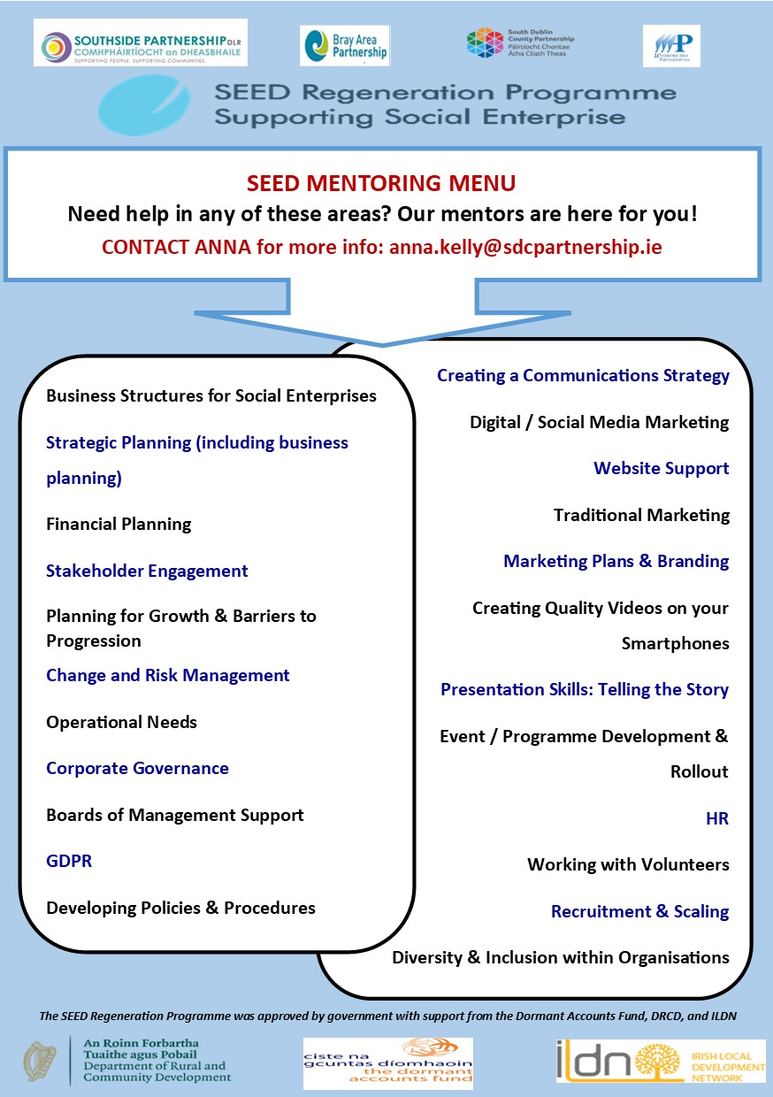
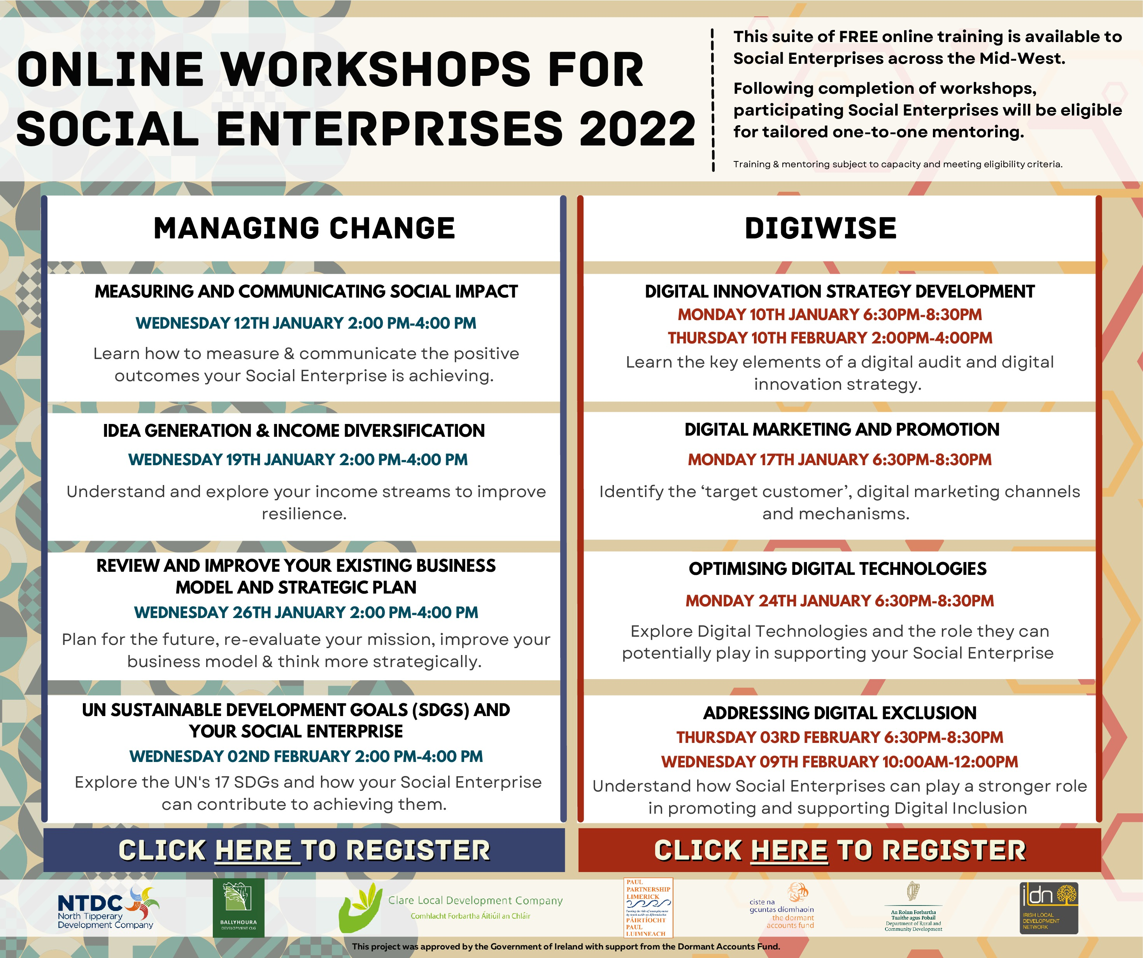

Social Enterprise Needs & Responses
Information, Workshops, Training & Mentoring
S/E Needs Beyond SICAP
Equality of status with profit based enterprise and with interventions such as SEI
Staffing to enable business growth
Coherence across Departments & Policies
Local Integrated S/E strategy & support based on CD approach

Slide 12


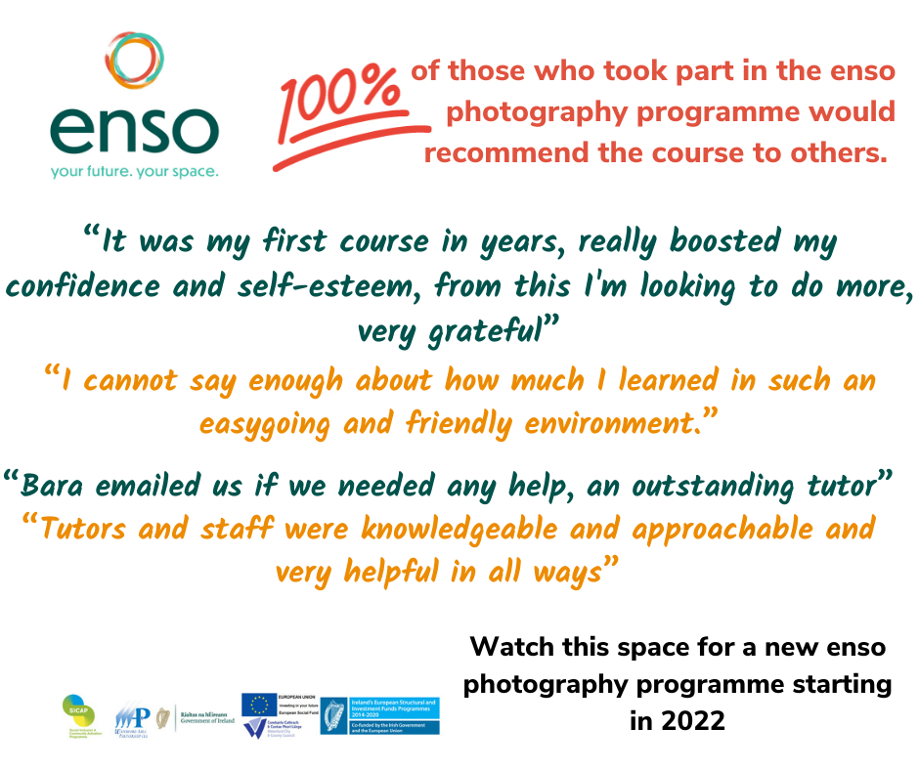

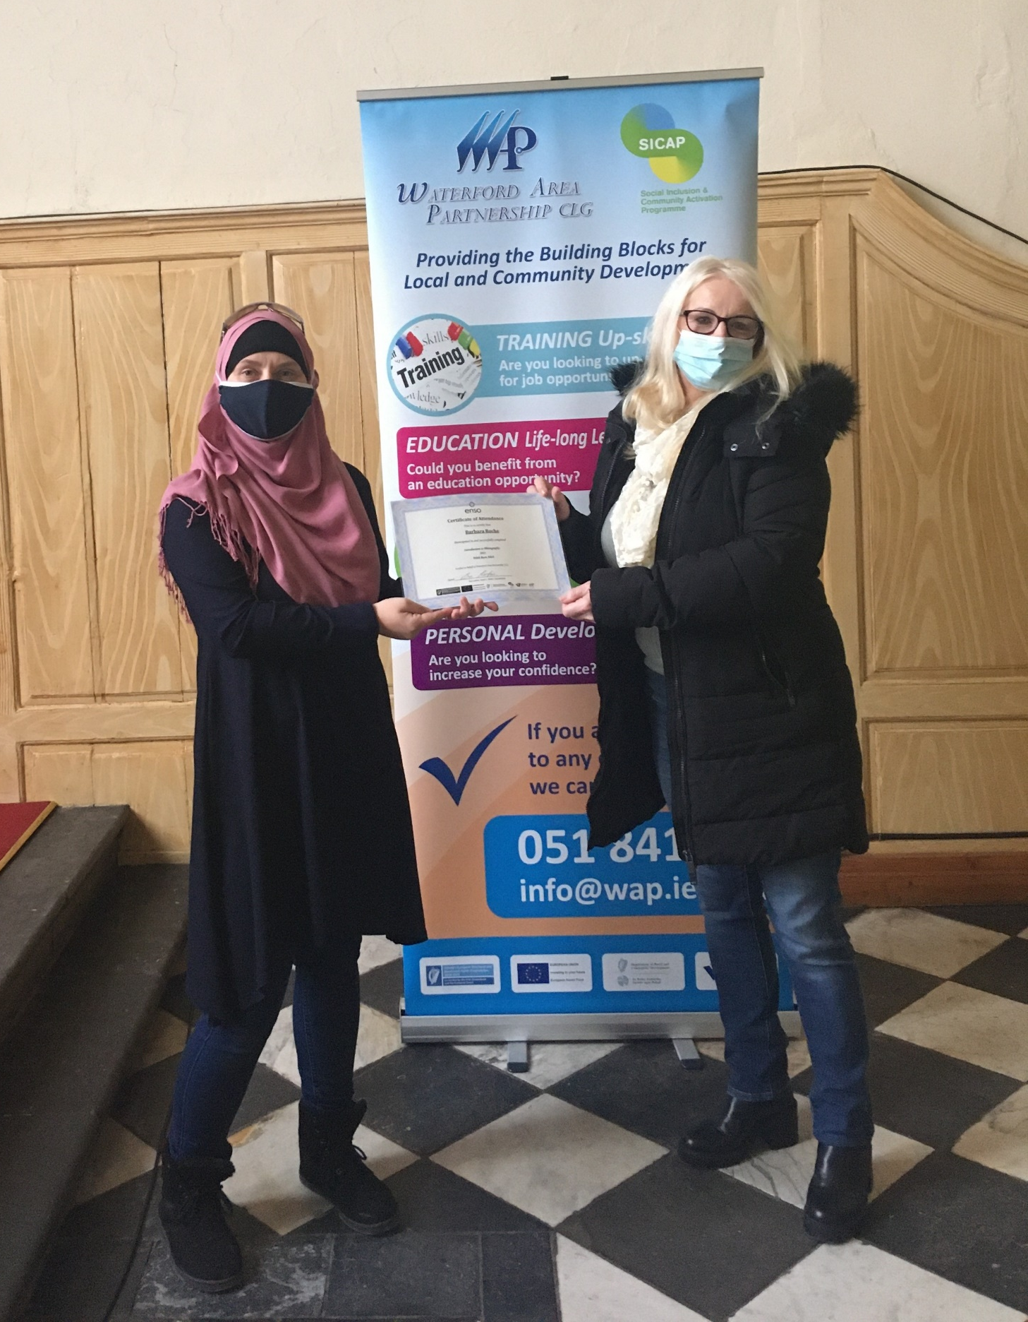
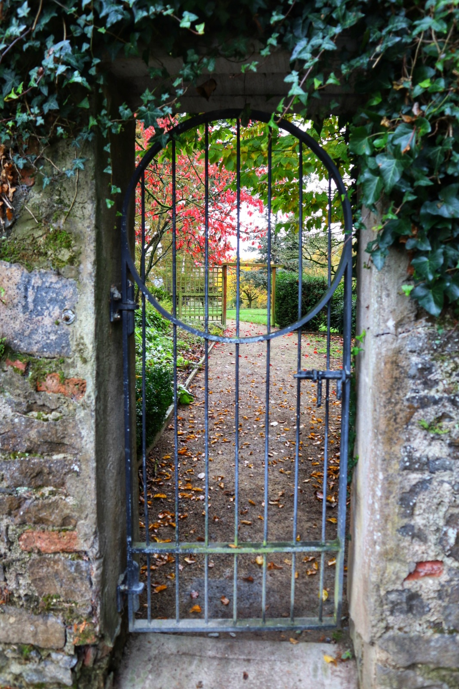
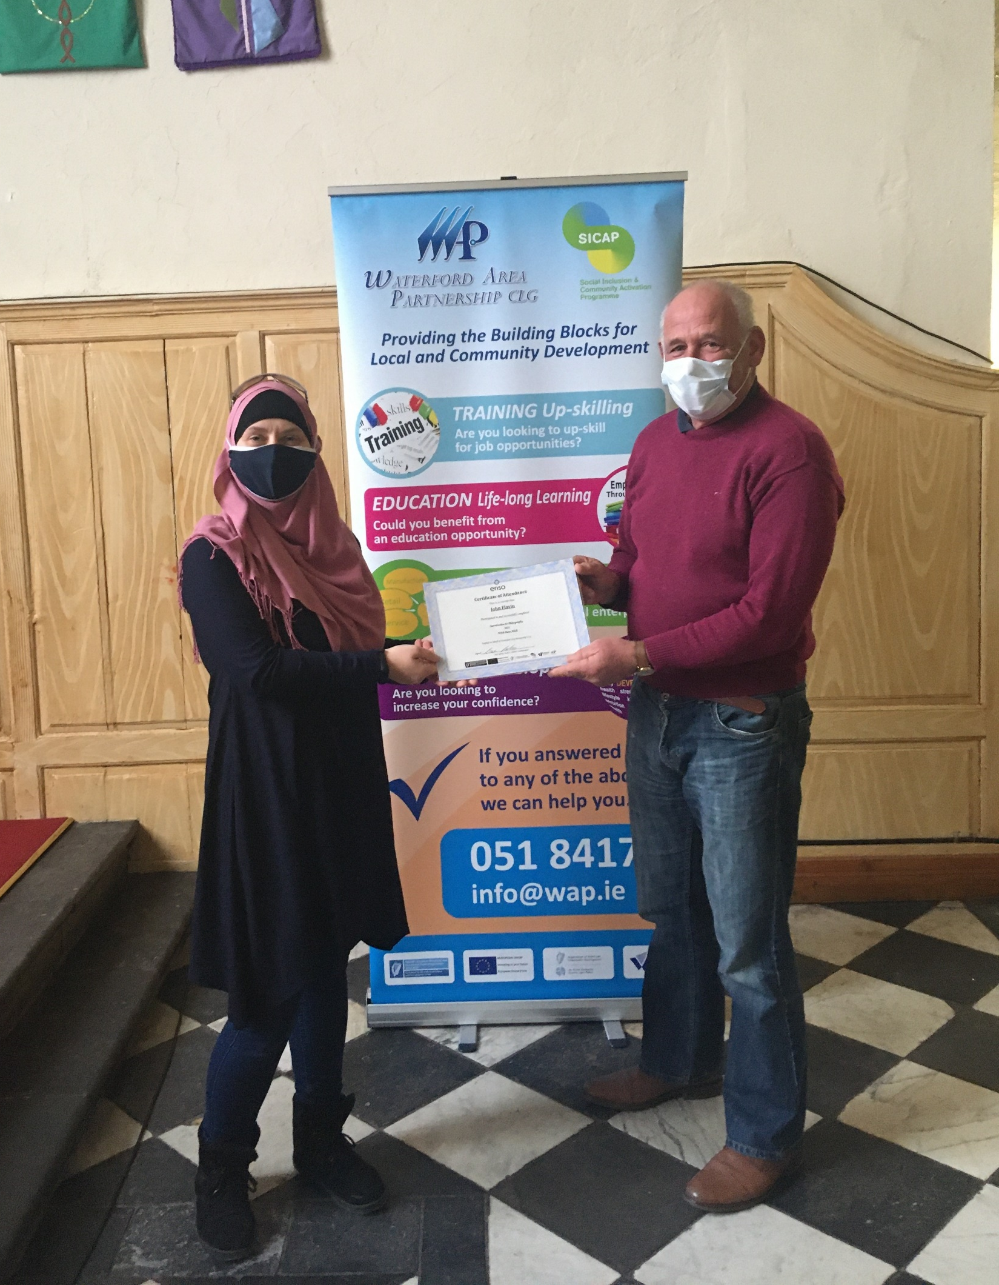
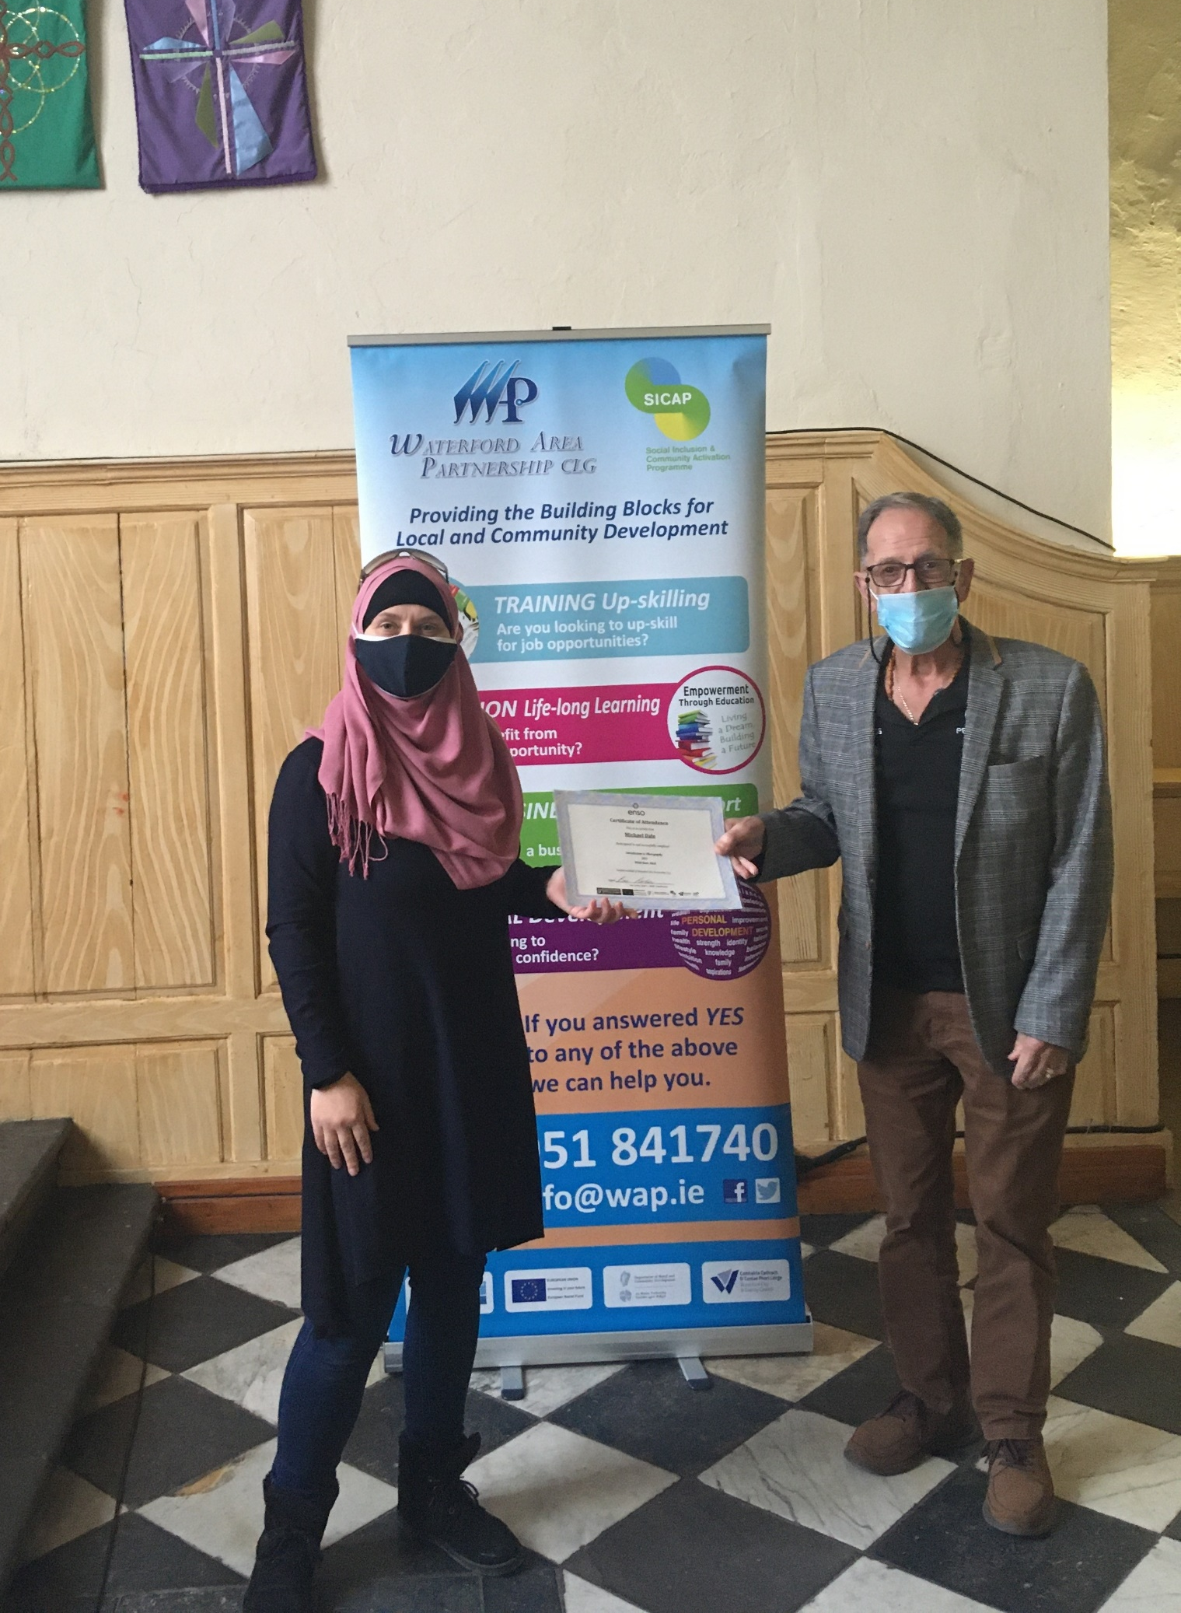

G2 Project That Worked Well

Slide 13
DRCD/Pobal Supports Required
Movement of all programme data to online. It is not environmentally sustainable nor necessary to maintain the current level of paper file requirements.
IRIS training should be delivered/available to all IRIS users. Remote training for multiple participants on a regular basis should be an inbuilt programme feature
Regional workshops to exchange how programmes operate in different areas so that other PIs & LCDCs can benefit from learnings.
Pobal could work with National Adult Literacy Agency NALA to literacy proof SICAP registration form
Online Train the Trainer Training Programme (Training Delivery & Evaluation) for Community Development Workers to upskill in delivering and facilitating capacity building with LCGs
Delivery of Reflective Practice sessions to strengthen SICAP G1 staff capacity in building community resilience and to support LCGs to develop, evolve and align values
Peer Learning events specifically for staff networking and idea sharing.
Seminar to discuss challenges within governance and LCGs in meeting compliance.

Slide 14
DRCD/Pobal Supports Required
SICAP Registration form & IRIS is limiting LCGs in acknowledging the target groups they support

Slide 15
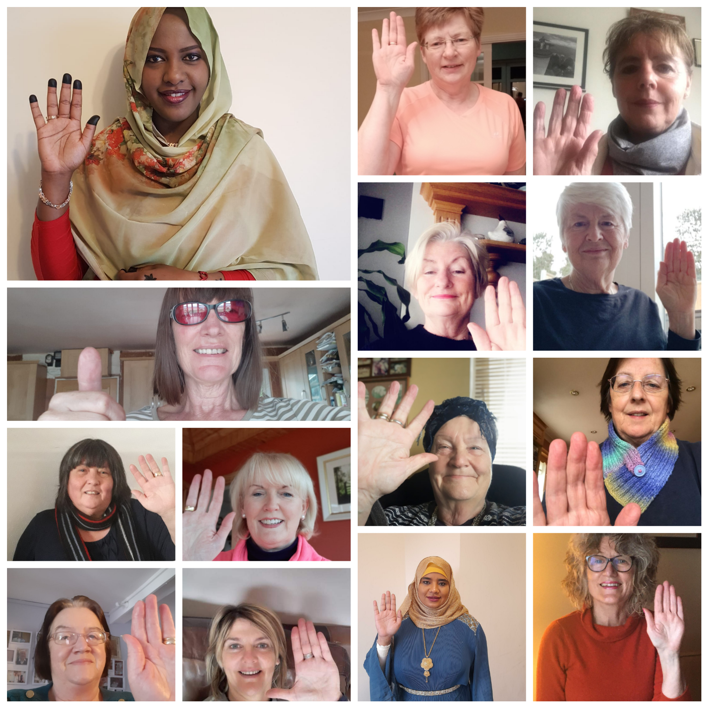
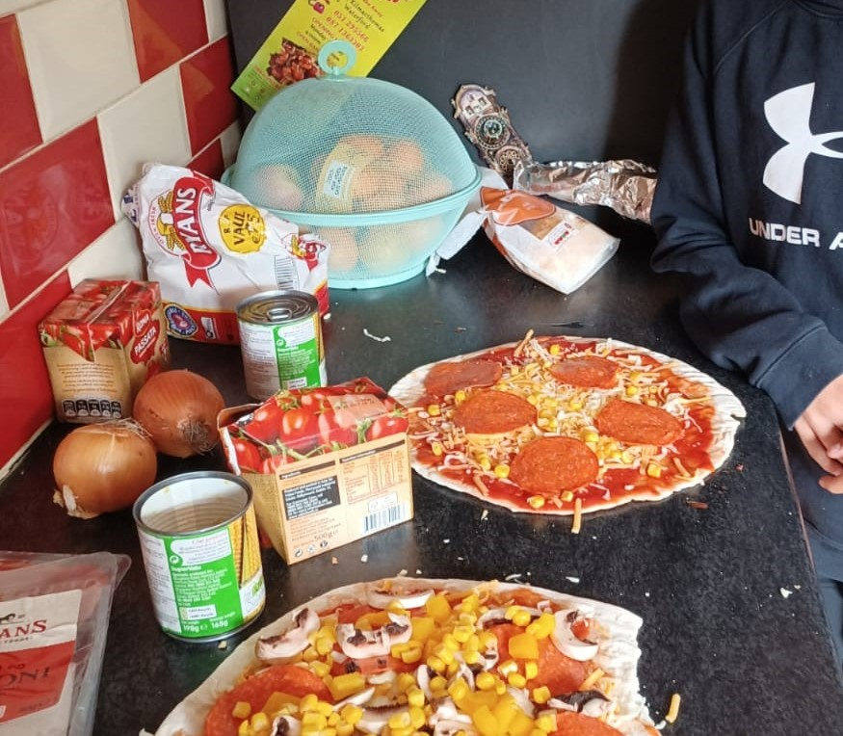

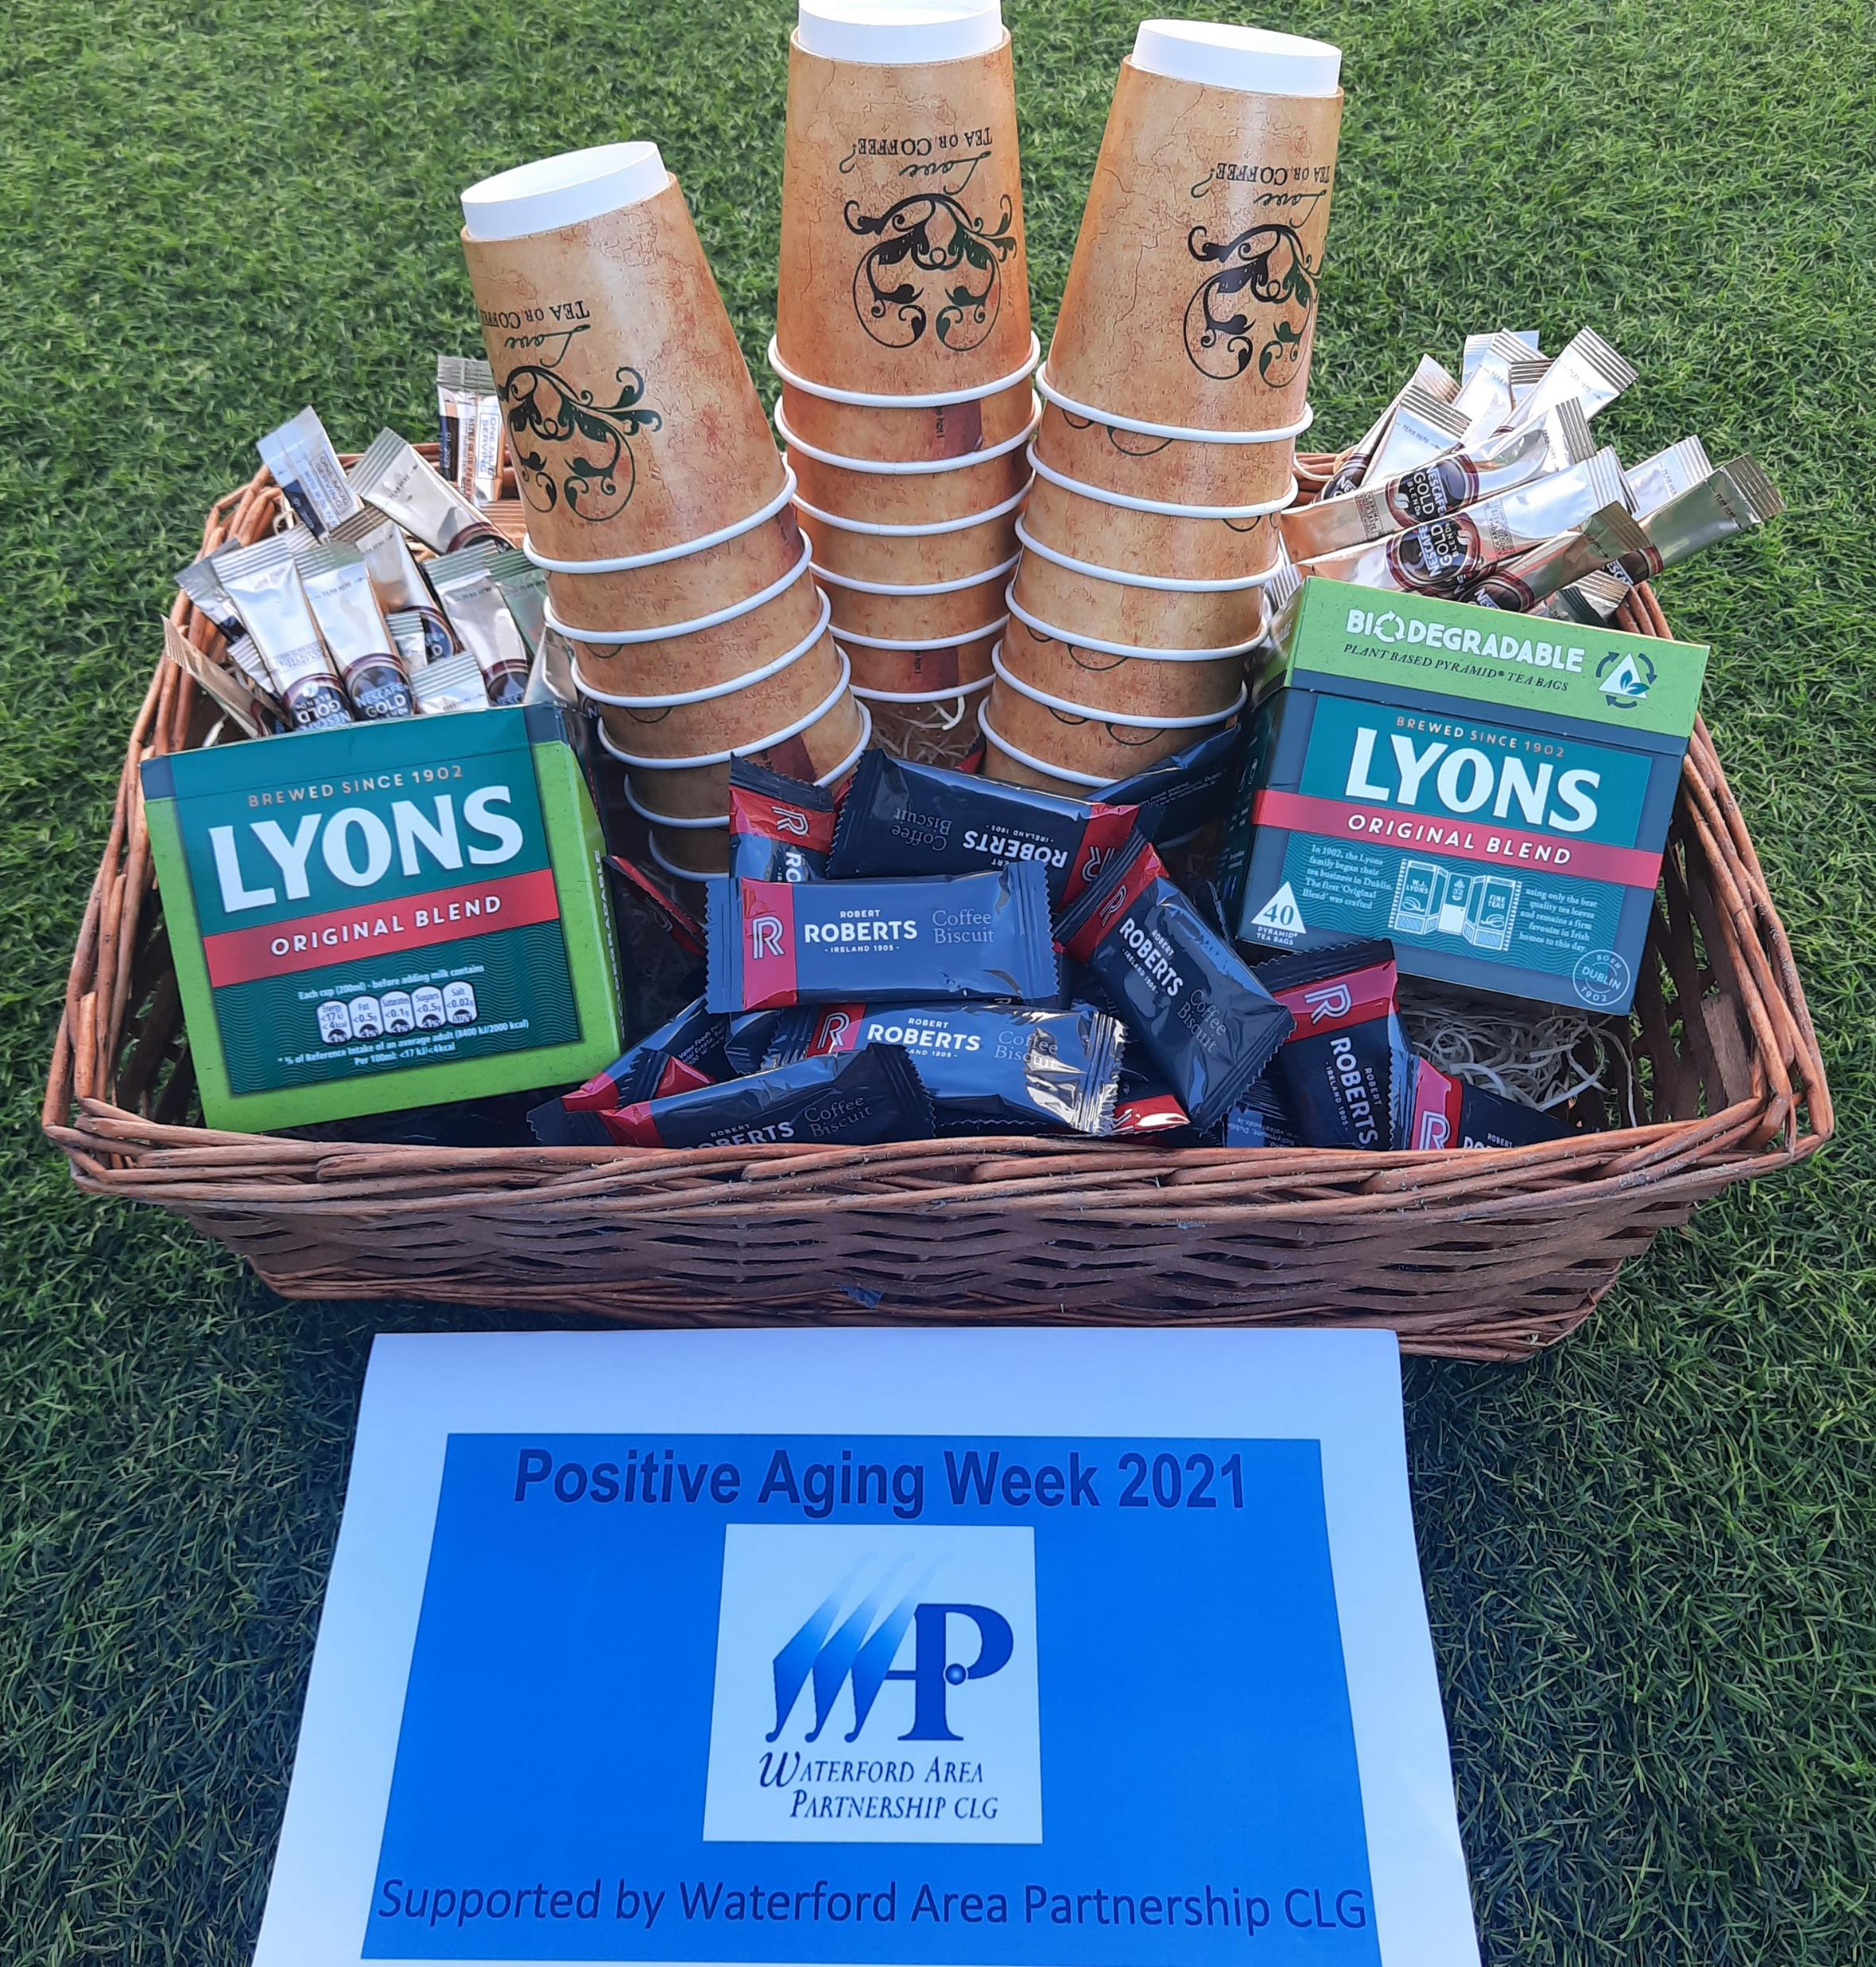

Thank You

