Slide 1

SICAP Annual Plan 2023 & Review 2022
Waterford City & County
“The aim of SICAP is to reduce poverty and promote social inclusion and equality in Ireland through supporting communities and individuals using community development approaches, engagement and collaboration.”

Slide 2


2022 KPI Achievement
G1 KPI Target 65 LCGs Actual 65
G2 KPI Target 953 Individuals Actual 999
G2 KPI Target 37% Disadvantage Area Actual 27.49%

Slide 3
Goal 1 2022 Annual Report
Key LCG updates:
65 LCGs received developmental supports which included:
Governance e.g. committee structures, CRA registration etc.
Progression of actions identified in Annual Support Plans
Mentoring supports to community leaders
Administration inc. grant applications, budgeting, reports etc.
SICAP grants – 50 LCGs supported
100% voluntary Boards/Committees with 75% no staffing
#CommunityWorks! booklet launched with weekly social media
‘At a time when I did not see if our group would survive (post-Covid) this project reminded us of why we came together and what we were proud of achieving. Can’t wait for us to get back to our activities’ ‘David’ Men’s Shed

Slide 4
Goal 1 2022 Annual Report
Reports, Strategies & Collaborations:
Evaluation Report on Needs of Community-Based Social Enterprises
Report on Atelier Roma Project’s Covid-19 Outreach Project (seminar held in November)
Waterford Migrant Integration Strategy (co-funded project coordinator)
Other structures included:
Traveller Interagency Group, Roma Interagency Group, Waterford Age Friendly Strategy (& strategy sub-group), West Waterford F&C Hub, Waterford Volunteer Centre, Well Waterford & local community networks

Slide 5
Goal 1 Ukrainian Community Response
Key actions included:
Waterford Ukrainian Community Response Committee & national foras
Full deployment of G1 team (x 5) from March to September – supported establishment of 4 Rest Centres with WC&CC and those residing in hotels
DRCD funding (August) supported 1 F/T & 2 P/T workers (2 translators)
Focus on those moving from Rest Centres to pledged accommodation, hotels and long-term housing with staff visiting to provide supports
Ongoing work includes Coffee/Information mornings, Life in Ireland sessions, information dissemination, translation supports, access to services & supports etc.

Slide 6



Goal 2 Issues of note from 2022
Number of men engaged 2022 = 427 / 42.7%
Number of interventions & Outputs per IB in 2022 >2 = 599 IBs / 59.9%
Persons with a Disability: 146 individuals / 14.6%
Number of DEASP IB referrals in 2022: 170
National Priorities;
LTU caseload 2022: unemployed >13 months = 237 individuals /26%
Older People caseload 2022: 55-65 = 128/Over 65 = 77 individuals. Total over 55 = 20.5%
New Communities caseload 2022: 237 individuals / 23.7%
Asylum Seeker = 27 individuals.
Migrant Experiencing Socio-Economic Disadvantage = 42 individuals.
Refugee = 169 individuals
SICAP Registered Ukrainians 2022 = 150
Failte Isteach = 300+ (N/C) engaged in English Conversation Classes across 17 venues with 50 volunteer tutors
Children & Families (N/C) – 857

Slide 7
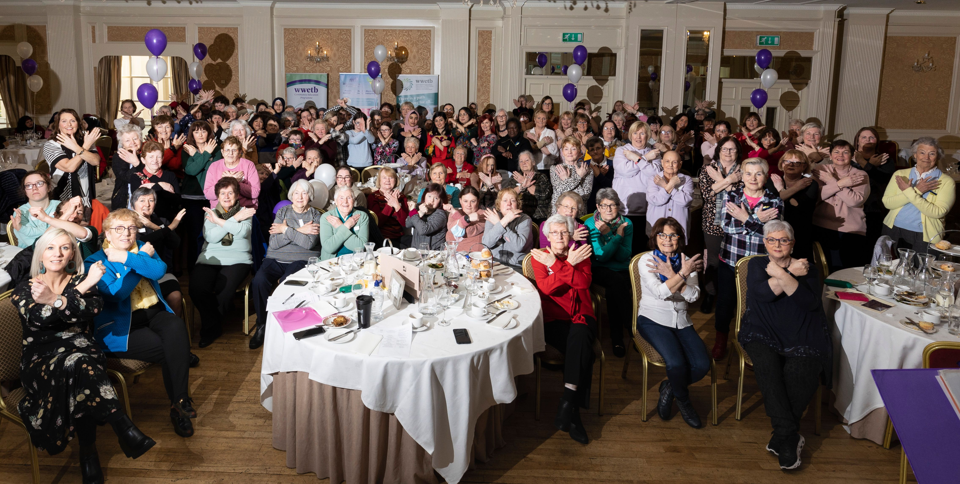
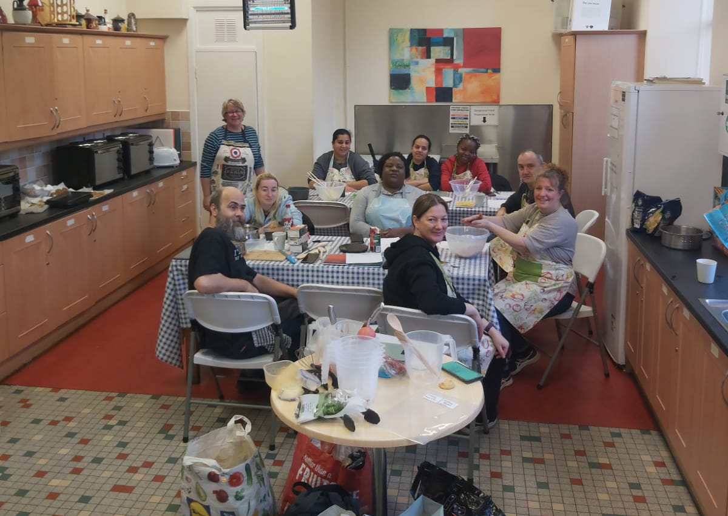
2.1 Personal Dev & Wellbeing
2.2 Ed & Lifelong Learning
KPI Actual 228
Types of Programme; drama, yoga, art, fitness, networking, dance, music, crafts, cookery
Organisations/Communities Collaborating: Rehab Care, BOC, WIDA, Ukrainian individuals, Syrian individuals, County Waterford (Lismore, Barbally, Dungarvan, Ballyduff Upr, Portlaw, Passage East), Parents from; Mount Sion School, Respond Housing , St.Saviour’s School, Ukraine, the inner city.
County International Women’s Day Event
Cooking Together Mount Sion Inner City; “I looked forward to all the sessions and Siobhan (tutor) was so helpful. The baking classes were the best”
KPI Actual 251
PLC grants allocated in 2022; 111. Attendance at pre-PLC workshops; 49
Enso photography: 19
“The most useful about this course was the fact that it gave me something to look forward to, and the assignments made me feel like I had achieved something weekly. I really enjoyed the class and I will miss it.” ENSO for Parents Participant.
Driving Ambition: 45
Mount Melleray Chair Yoga:
Tallow Wire Trees Workshop:
Smart Phone Workshop; (older men)
Failte Isteach Volunteer Tutor Induction Workshops & Events
Introduction to Pottery; Cappoquin
Writing Workshop for people with intellectual disabilities
Yoga: Ukraine & Cappoquin Women
City International Women’s Day Event

Slide 8
2.3 Prev Supports to Children & Families
Total NC for Children & Families: 857
81 NC WAP/Respond World Book Day Initiative (36 F/45 M)
405 NC Read Your Way Challenge-DEIS secondary schools (114 F/261 M)
107 NC Family Santa Visit in collaboration with BRILL FRC (57 adults 50 children)
85 NC Resilience Workshops DEIS schools (75 M/10 F)
29 NC WAP/WSP Summer Camp Access Programme children with disabilities (14 F 15 M)
150 NC New Communities Children’s Christmas Party-Waterford Libraries (75 adults 75 children)

Slide 9
2.4 Employment Supports
2.5 Enterprise Supports
KPI Actual: 380
38 training programmes delivered (Safe Pass x 5 , Manual Handling x 12, Barista x 10, HACCP Level I & II x 3, Customer Service x 4, CV & Interview Skills x 4)
Training grants allocated: 37 x €400.00 (Security, TEFL, Fork Lift Driver Training, Beauty, Site Dumper Truck, Safe Pass)
Collaboration with Skillnet and Renew to deliver Bicycle Repair City & Guilds Programme
Manual Handling and Safe Pass to Traveller men and Barista to Traveller Women
Safe Pass to Roma men and men from U-Casadh ex Offenders Programme
Barista and HACCP Level I to individuals from REHAB Vitahub programme
Carriglea Services: Manual Handling & HACCP Programmes
Delivery of programmes to Afghan and Syrian asylum seekers in EROC
KPI Actual: 194
1:1 Enterprise mentoring City & County Offices
Number of SYOB workshops delivered (3 hours x 2): 10
Number of Bookkeeping workshops delivered: 4
Number of ROS workshops delivered: 1
Number of End of Year Accounts workshops delivered: 1
Number of Simplify Finance workshops delivered: 1
Number of Market Trading Workshops delivered: 2
Enterprise Roadshow/Event – 1
There were also 6 MBN Networking Events delivered in collaboration with Waterford LEO
Market Trading Workshop; “I was at the talk this morning (15th Nov) with yourself and Keith about market trading and found it both fascinating and insightful.”

Slide 10
2.7 Ukrainian Supports (N/C)
Barista training (4 programmes) and Manual Handling (4 programmes).
Living in Ireland Workshop; 76 Ukrainian attendees
Contact with employers in hospitality sector to ascertain training and recruitment processes
CV & Interview Skills Workshops; Integrated Ukrainian & other migrants
  39 attendees; Ukrainian/Nigeria/Albania/Algeria/Eritrea. (63 non Ukrainian A/S + Refugees on Iris plus 50 Mukisa alumni/participants contacted to attend. Out of 13 confirmations only 6 attended)
  Additional 10 A/S + Refugee individuals undertook 1:1 on job search
“Very informative.. Great presentation of information…Ruslan helped a lot with translation.. Organisation of the event is top notch….The workshop was very informative with excellent presentations, very interesting.. First I need more English!”
Follow up 1:1 & support for applications completion – ongoing into 2023
Successful Ukrainian job placements – The Stable Yard & Henry DeBromhead stables
Cultural & language issues that have emerged from this process to be further explored in 2023
Failte Isteach
Maranatha Drop In
G1 & G2 Ukrainian events/translation etc…. Eg Ukrainian women and women from Deise Women’s Shed N/C – Xmas crafts

Slide 11
2.73 Children & Families; Integrated Summer Camp Programme
Child Demographics (Boys)
144 Children were provided with a Summer Camp Place in 2022
Natalya Bubenko (Hotel Co-ordinator Tramore hotels): “Parents expressed that the camp helped both them and their children. The felt that it helped with communication and socialising. The children were happy to play with the water and the overall feedback from parents at the HiB Hotel was that they felt the camps were brilliant. The overall consensus in Tramore is that the camps were fantastic. Parents mentioned that children would bump into coaches around the town after the camp and would try to hug them.”
Location | Number of children | Nationality | Age Range
Waterford City | 30 | Ukrainian | 4-16 years
Waterford city | 3 | Angola/Pakistan/Syria | 6-11 years
Dungarvan | 12 | Ukrainian | 6-14 years
Tramore | 8 | Georgia, Algeria, Nigeria, Malawi, Zimbabwe | 5-13 years
Tramore | 21 | Ukrainian | 7-13 years
Child Demographics – Boys Total = 74
Michelle Dwane (Barnavee B&B): “The kids loved the camp and said ‘Thank you Michelle, very much’
Location | Number of children | Nationality | Age Range
Waterford City | 27 | Ukrainian | 4-12 years
Waterford City | 1 | Syria | 7 years
Tramore | 18 | Ukrainian | 7-12 years
Tramore | 5 | Algeria, Malawi, Congo, Georgia | 5-11 years
Dungarvan | 19 | Ukrainian | 6-13 years
Ken Fox (Project Co-ordinator The Barleyfield): All very positive and worthwhile. Integration was achieved and the staff were enthusiastic and engaging.
Mary Kearney (Project Co-ordinator 360 Rest Centre, Dungarvan): the feedback was all positive! Nothing negative at all. Everyone was well engaged and had lots of fun!
Child Demographics – Girls Total = 70
Olena Pravytska (Parent of child at Rinka City Camp): Thank you so much. It was excellent!

Slide 12
WAP/SICAP Action Plan 2023

Slide 13
Goal 1 2023
Goal Objective: Supporting Communities – To support communities and target groups to engage with relevant stakeholders in identifying and addressing social exclusion and equality issues, developing the capacity of Local Community Groups, and creating more sustainable communities.
Target Groups: as outlined plus focus on geographical areas
G1 Budget
SICAP €493,817.37
Ukrainian specific € 78,206.69
GI KPI: 79 Local Community Groups
Disadvantaged areas across Waterford including Larchville, Lisduggan, Ballybeg, Ferrybank, Kilcohan area, Inner City, Dungarvan, Tallow, Cappoquin, Clashmore, Portlaw, Kilmacthomas.
Other areas as agreed with Waterford LCDC are Aglish, Lismore, Faithlegg, Kinsalebeg, Cheekpoint, Passage East, Villierstown, Carrickpherish, Knockanore, Touraneena and Ballyduff Upper

Slide 14
G1 Actions & KPI Targets 2023
Community Engagement – KPI 14
Annual Support Plans include:
Local community events aimed at integration & social engagement
Information & links to local services, agencies etc.
Networking to strengthen local links
Promoting volunteering
Mentoring & guidance on event management
Ukrainian Community Response – KPI 2
Pre-development support to 2 Ukrainian LCGs aimed at empowerment
Waterford Ukrainian Community Response & other collaborations
Maintain supports to those in hotels, pledged & long-term accommodation
Activities organised to support information, access to services & integration

Slide 15
G1 Actions & KPI Targets 2023
Group Empowerment & Progression – KPI 55
Key developmental supports to LCGs which enables other SICAP actions
Annual Support Plans include:
Group development on SICAP Matrix
Governance structures
Community leadership mentoring
Informal skills based training
Grant applications inc. SICAP
Outreach offices in Dungarvan and Larchville & Lisduggan

Slide 16
G1 Actions & KPI Targets 2023
Social & Community Enterprise KPI = 4
Progression of report recommendations
Waterford Social Enterprise Network
Workshops to support development e.g. marketing, business planning
Explore funding to support SE sustainability
Local & national policy development
Participation in Decision-making Structures KPI = 4
Annual Support Plans identify relevant structures
Support engagement & progression of local strategies inc. LECP
Staff participation on local & national strategies
SICAP supports to progression of local strategies and implementation

Slide 17
Goal 2
Goal Overview To support disadvantaged individuals to improve the quality of their lives through the provision of lifelong learning and labour market supports.
G2 Target Groups
Children & Families
Individuals 15+
G2 Budgets
SICAP = €573,938.56 / Ukraine Specific = €107,999.71
G2 Individual Beneficiary (IB) KPI = 953
G2 Disadvantage Area KPI 37% minimum proportion of KPI 2 individuals residing in disadvantaged areas (as per the Pobal HP Deprivation Index).
Disadvantaged Children and Families, People living in Disadvantaged Communities, Disadvantaged Young People (aged 15 – 24) People with Disabilities, Disadvantaged Women, Roma, Travellers, Lone Parents, The Disengaged from the Labour Market (Economically Inactive), Low Income Workers/ Households, The Unemployed, New Communities incl Ukrainians, Older People (55+), Residents of DPCs

Slide 18
G2 5 Action Themes & Staff
2.1 Personal Development & Well-Being KPI = 140 (Gayle Barry)
2.2 Education & Life-Long Learning KPI = 220 (Sue Larkin)
2.3 Preventative Supports to Children & Families (N/C) (Gayle Barry)
2.4 Employment Supports KPI = 220 (Mary Byrne/Nuala O’Farrell)
2.5 Enterprise Supports (incl Social Entrepreneurs) KPI = 220
(Victoria Wilmott & Nicola Kent)
2.7 Support to Ukrainan Refugees KPI = 153 (Ruslan Ihnatenko + AN Other)
All 1 x Clerical Officer: Supporting paper files, Iris, registration processes & audits. (Mary Cowman)

Slide 19
Programmes 2023 – All Target Groups (includes potential for specific tailored & requested actions)
Personal Development & Wellbeing: Yoga, art, drama, music, confidence & motivation building, social networking, gardening, fitness, resilience, positive parenting, mental health & wellbeing. Cookery, Furniture Upcycling
Education & Lifelong Learning: PLC grant support & pre-PLC course, career guidance workshops, enso creativity education, driving ambitions, supporting digital capabilities (smart phone training), information workshops on further & community education (including with schools)
Preventative Supports to Children & Families; DEIS Schools actions - cross-school book clubs, positive mental health workshops and resilience programmes, family support programmes through art and craft activities, family fun days, seasonal camps, needs based work with DPC residents
Employment Services: Industry certified training, grants, CV & job application, interview skills, engagement with employers, employability programmes (disability, traveller, Roma, DPCs), building collaboration with WCLAES, kickstarter,
Enterprise Supports: BTWEA collaboration, mentoring, syob workshops, business fundamentals workshops, financial, sales & marketing training, trading at markets workshops, WMBN

Slide 20
Ukrainian Refugees & Integration of N/Cs incl Residents of DPCs
Failte Isteach
Living in Ireland Workshops
Specific employment training, support & referral actions
Integration events
English for Enterprise
SYOB & SYOSE
Health & Wellbeing focus for new arrivals including cookery & upcycling
Jobs Fairs
Engagement with employers & collaboration with IEMP
Cross Goal Actions

Slide 21
Thank You

