Slide 1
Well Waterford 2022 – 2025 +
Subcommitee of the LCDC with the responsibility for Health and Wellbeing Projects and Initatatives

Slide 2
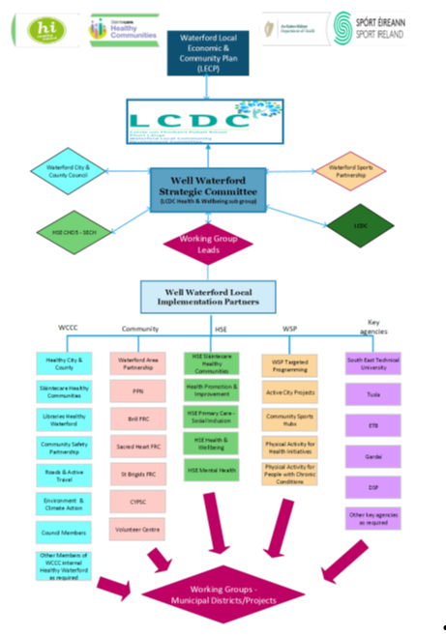
In-person meeting August 2022
Wide representation
Overview of new posts/roles
Develop a model for future cross-sectoral engagement & collaboration
Structure devised
Terms of reference agreed

Slide 3



A rebranding & broadening of HW
Sub-c’tee of the LCDC
Formalisation of informal meetings
Cross-sectoral
Multi-agency
Information sharing
Broad health determinants

Slide 4


Collaboration remit
All have a remit to
  Collaborate with local stakeholders
  Address environmental and systems barriers to health and wellbeing
  (determinants of health)
All have access to significant funds
  Partners required
Potential for c’tee membership burden if each role has its own working group
  Duplication of effort & reporting

Slide 5

Next Steps

Slide 6
2025 +++
Invitation to Nominate: Following LCDC approval, we will issue an open letter to all LCDC representatives, inviting them to nominate one representative from their respective sectors.
Ideal Candidate Profile:
The nominated representative should be capable of playing an active role within the committee.
They must possess a broad interest in the area of health and wellbeing and/or be involved in a similar role within the organisation.
Crucially, the representative should feel empowered to work on behalf of their organisation and actively contribute to advancing the health and wellbeing agenda.
The next Well Waterford meeting is scheduled for the 15th of September so we would be looking for nominations before the 5th of September

