Slide 1

Local Community
Development Committee
Kathryn Kiely
Vice President for External Affairs
December 11, 2025

Slide 2
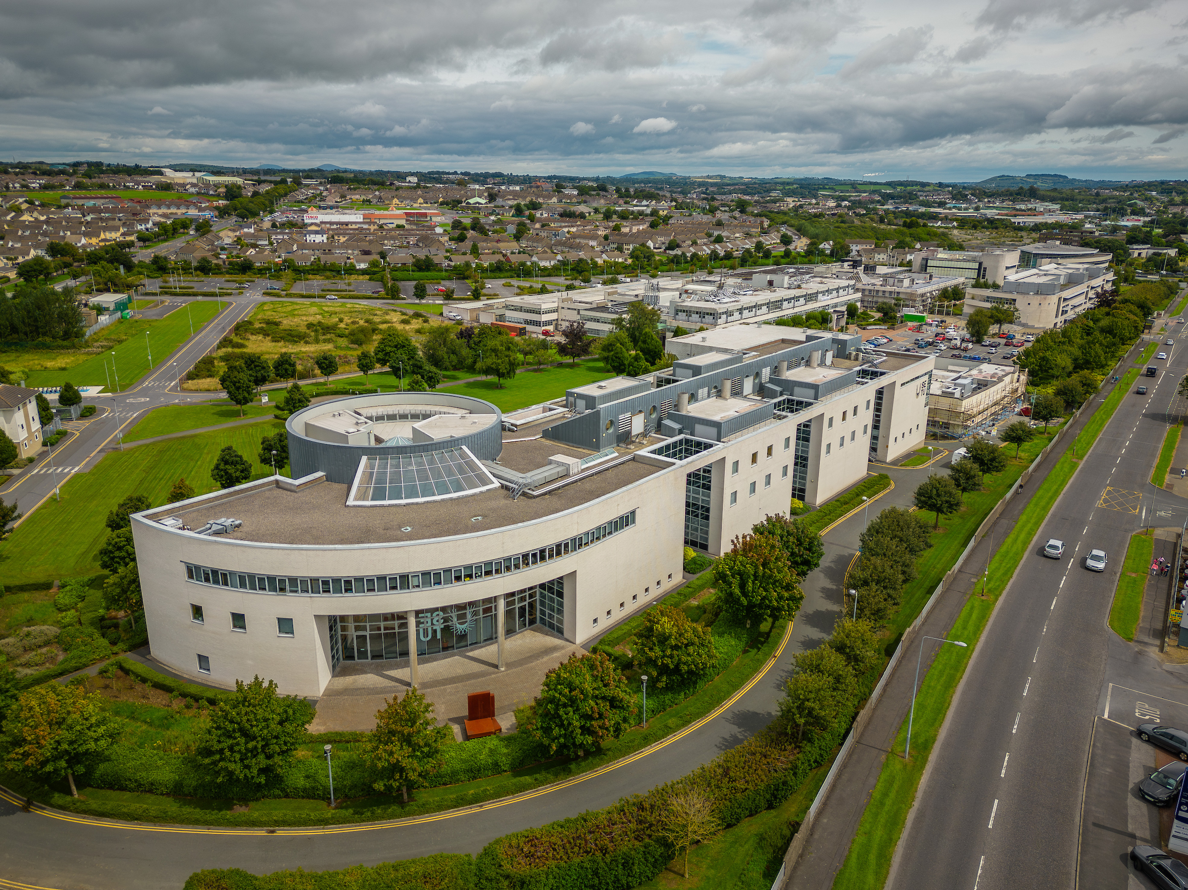
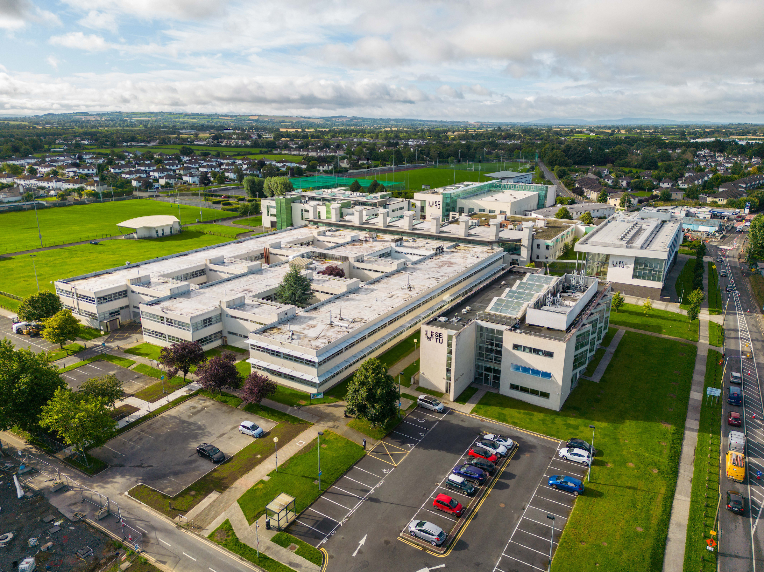

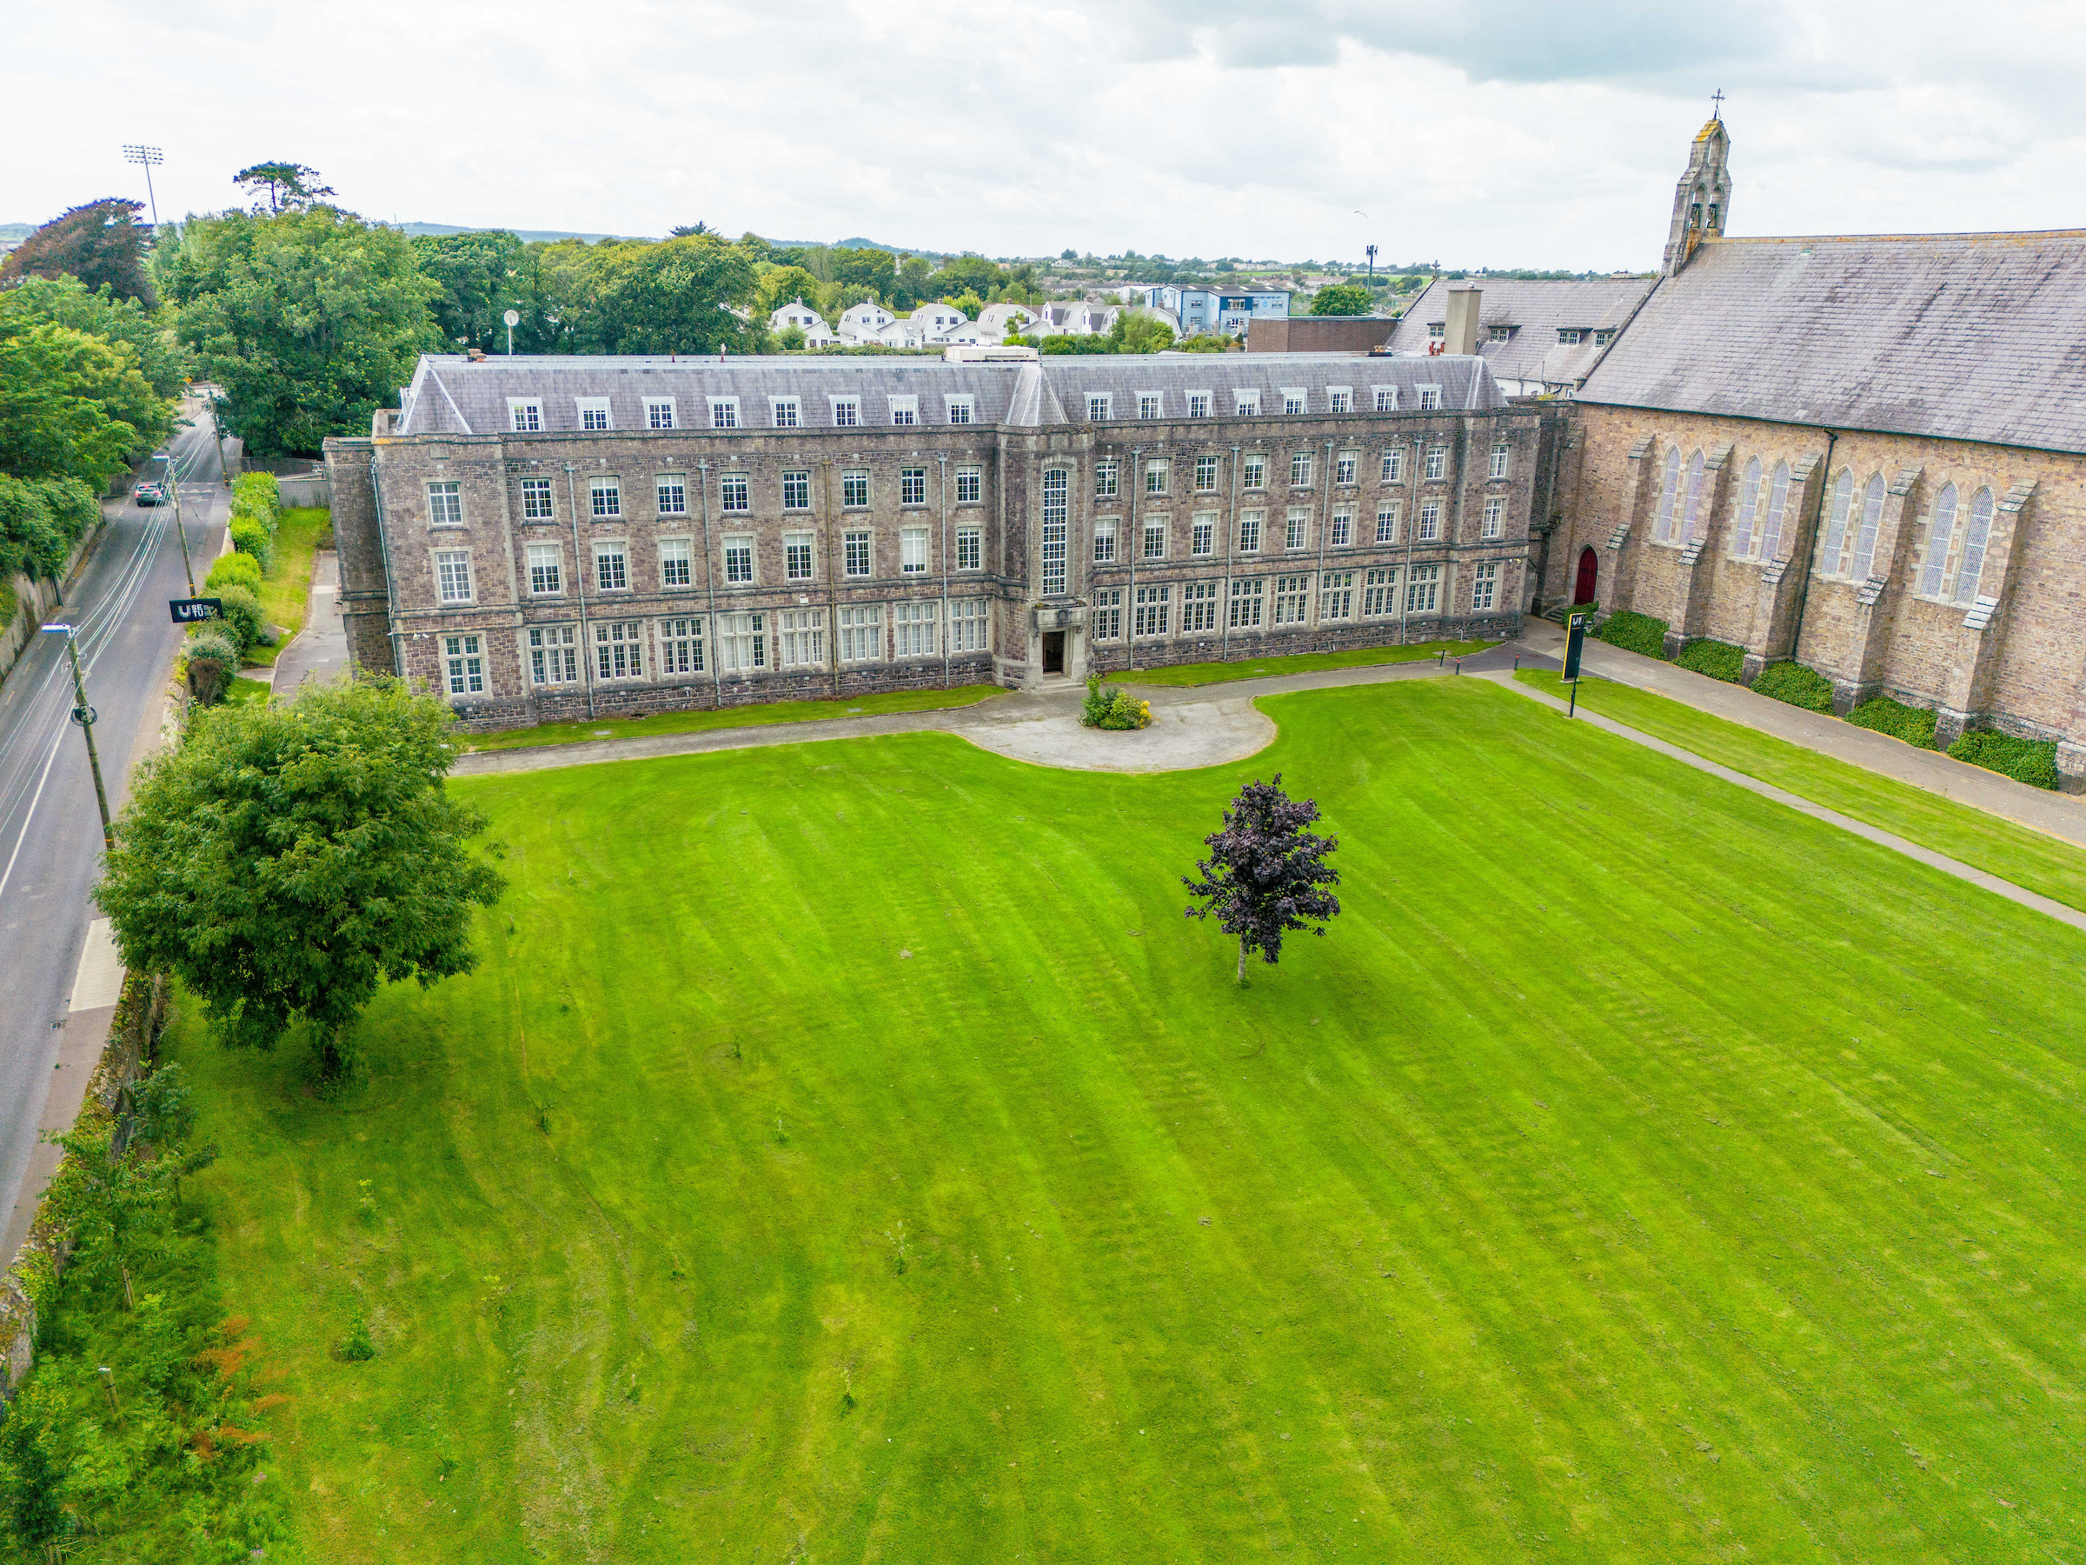
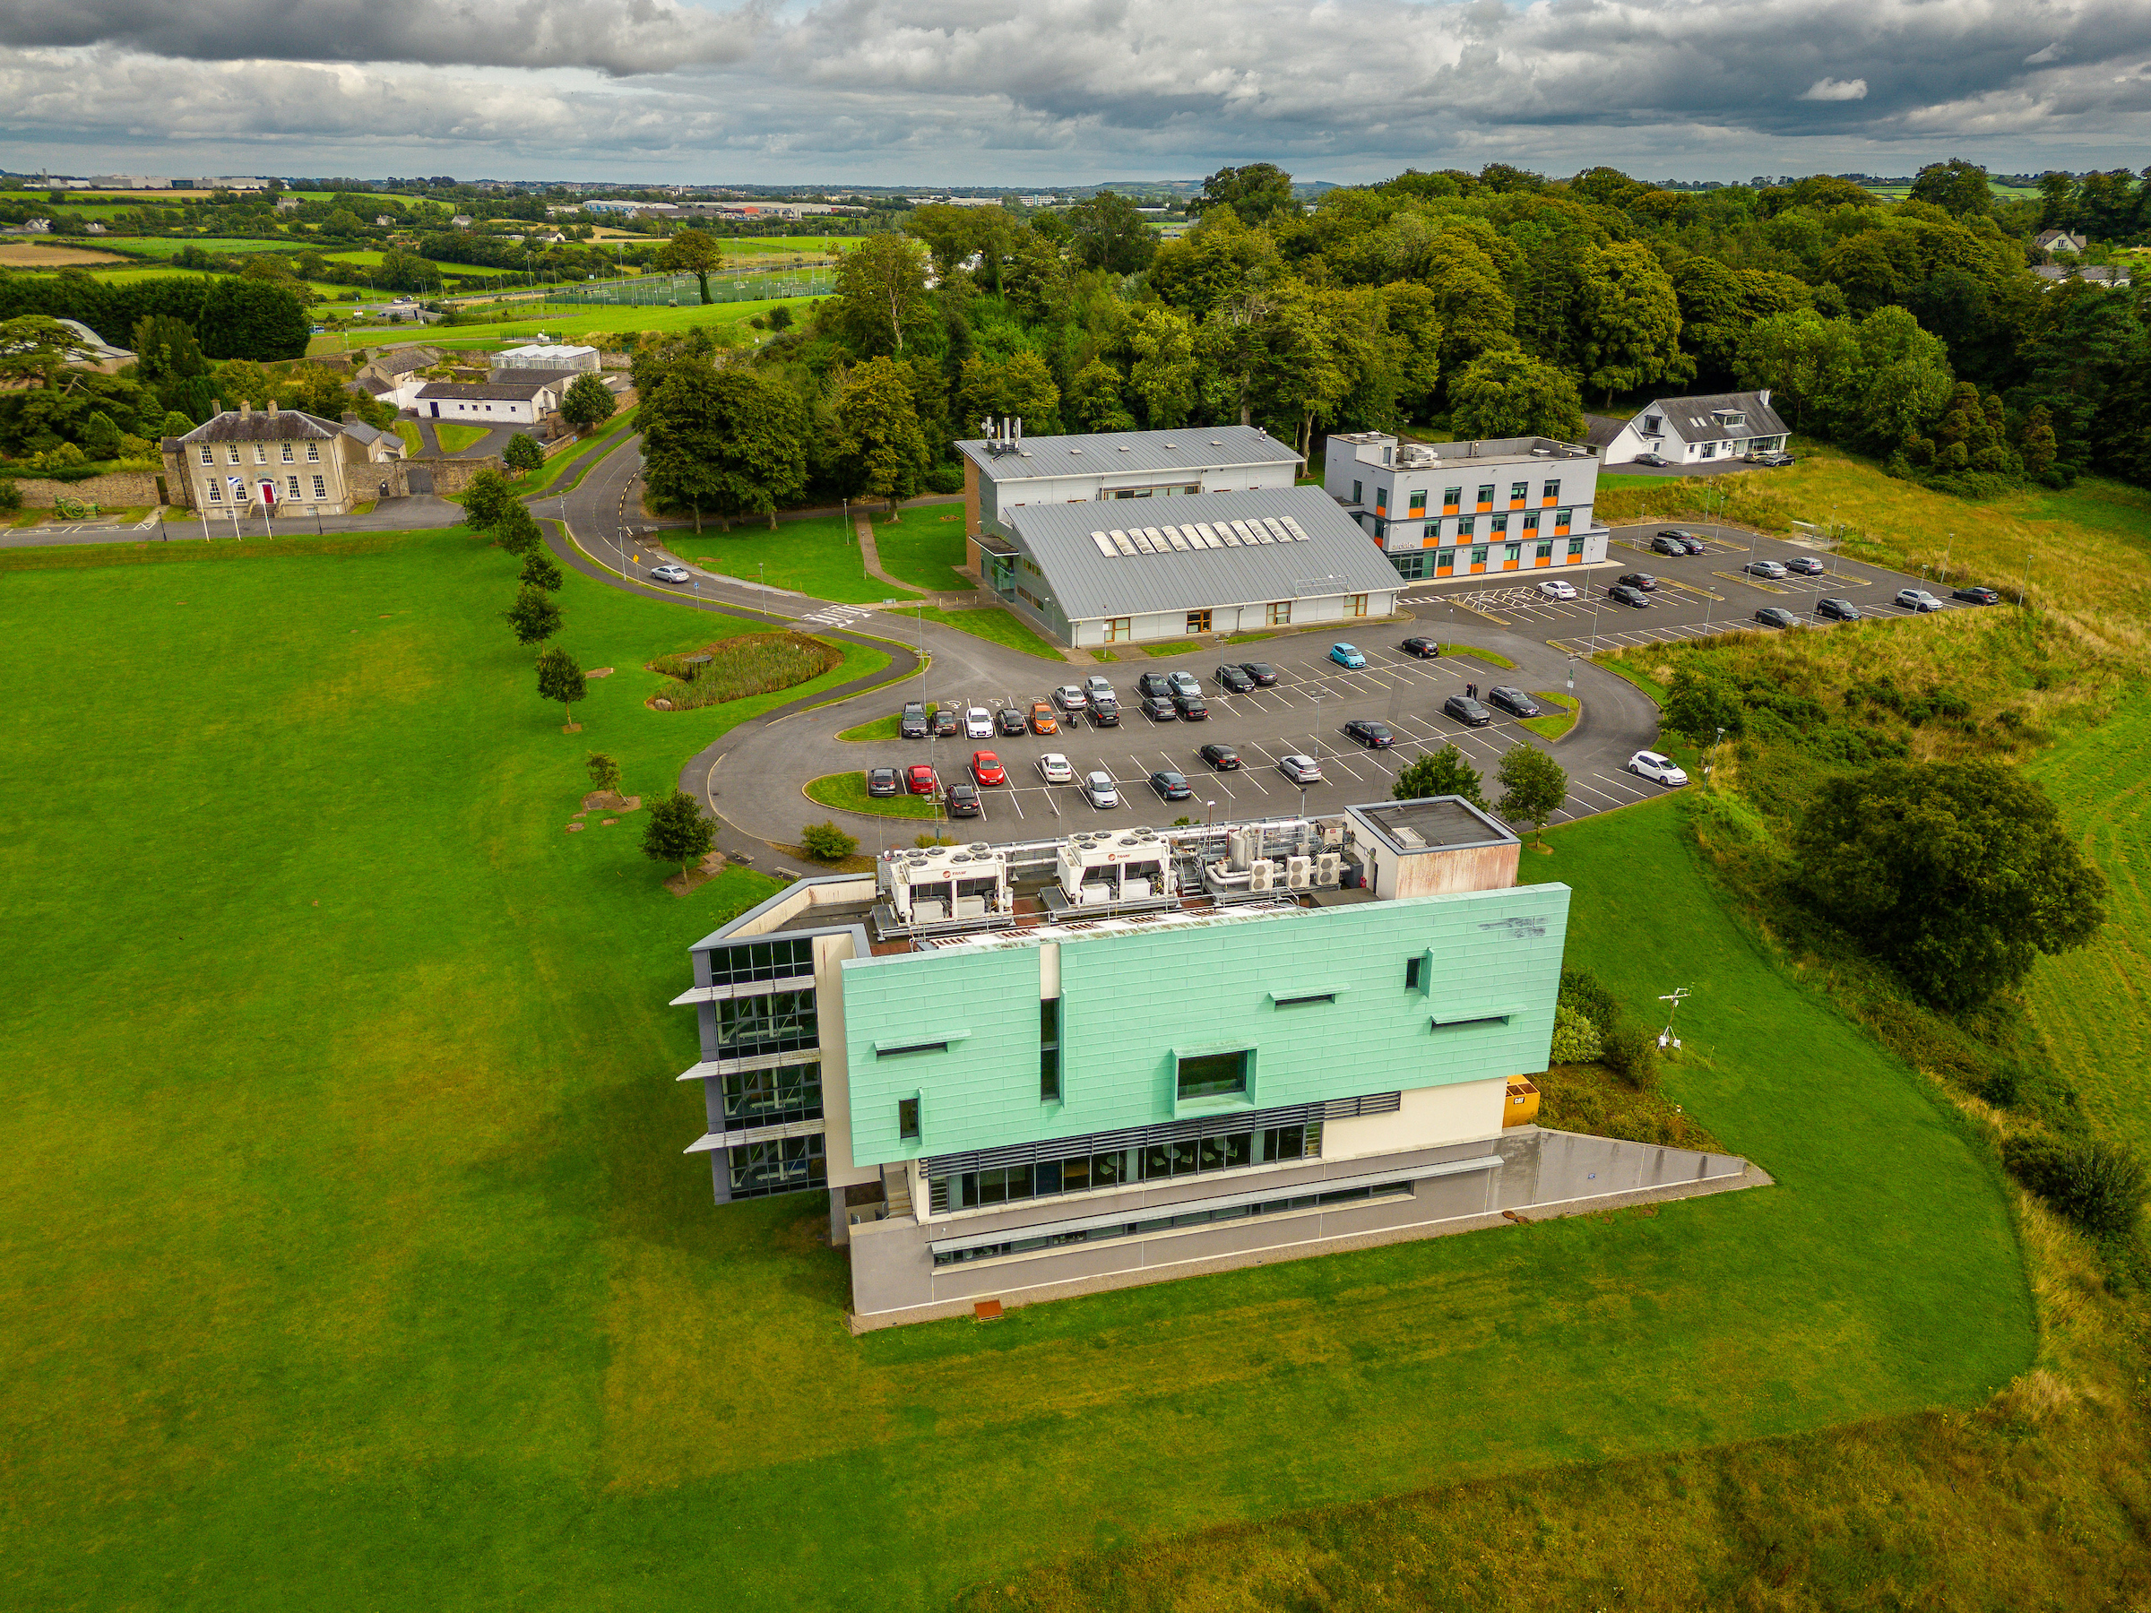
Multi Campus
University
for the South East
Cork Road Campus, Waterford
Carlow Campus
5 campus sites in Waterford
Carriganore Campus, Waterford
St Peter’s College, Wexford

Slide 3
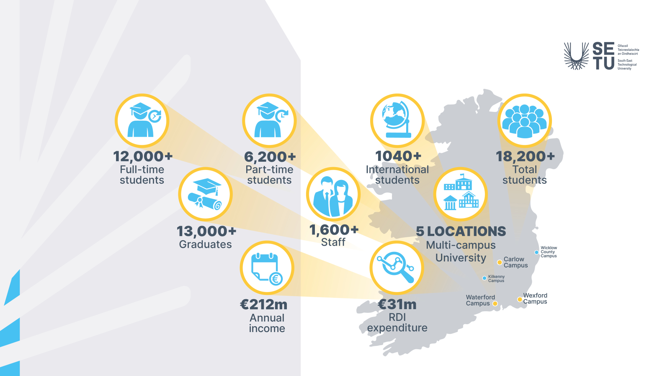

Slide 4

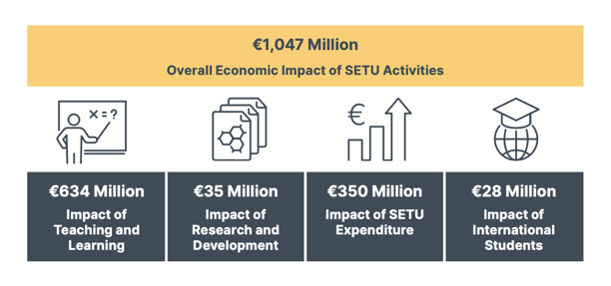

Slide 6
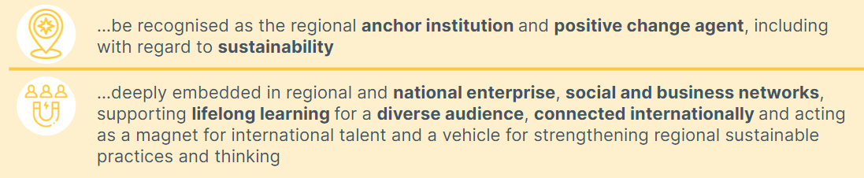














Our Region

Slide 7
Regional Engagement in Action
… diversity of channels & stakeholders

Slide 8
SETU – Expanding our Programme Portfolio
Veterinary Medicine
Pharmacy
BA (Geography & Home Economics)
Increased capacity in nursing
Expansion of Apprenticeship capacity
In Development
Optometry
Teacher Education
Physiotherapy
Body text here.
Visit to Royal Veterinary College
Pharmacy Education and Networking Event

Slide 9
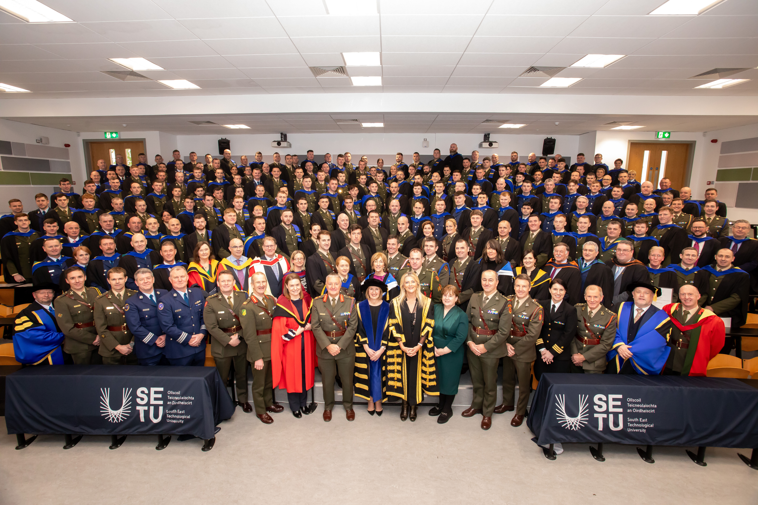
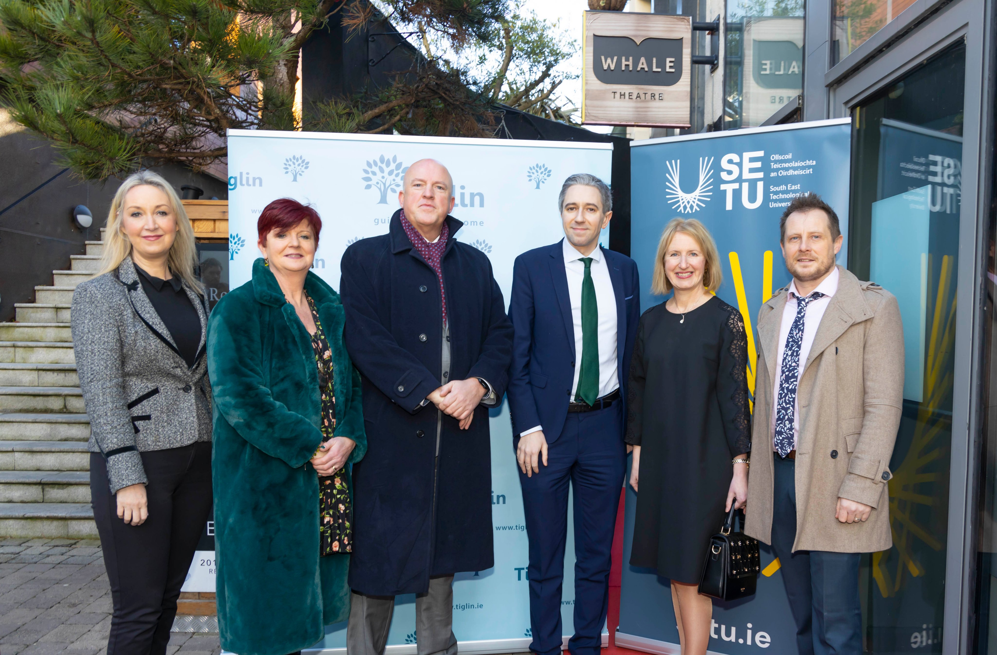
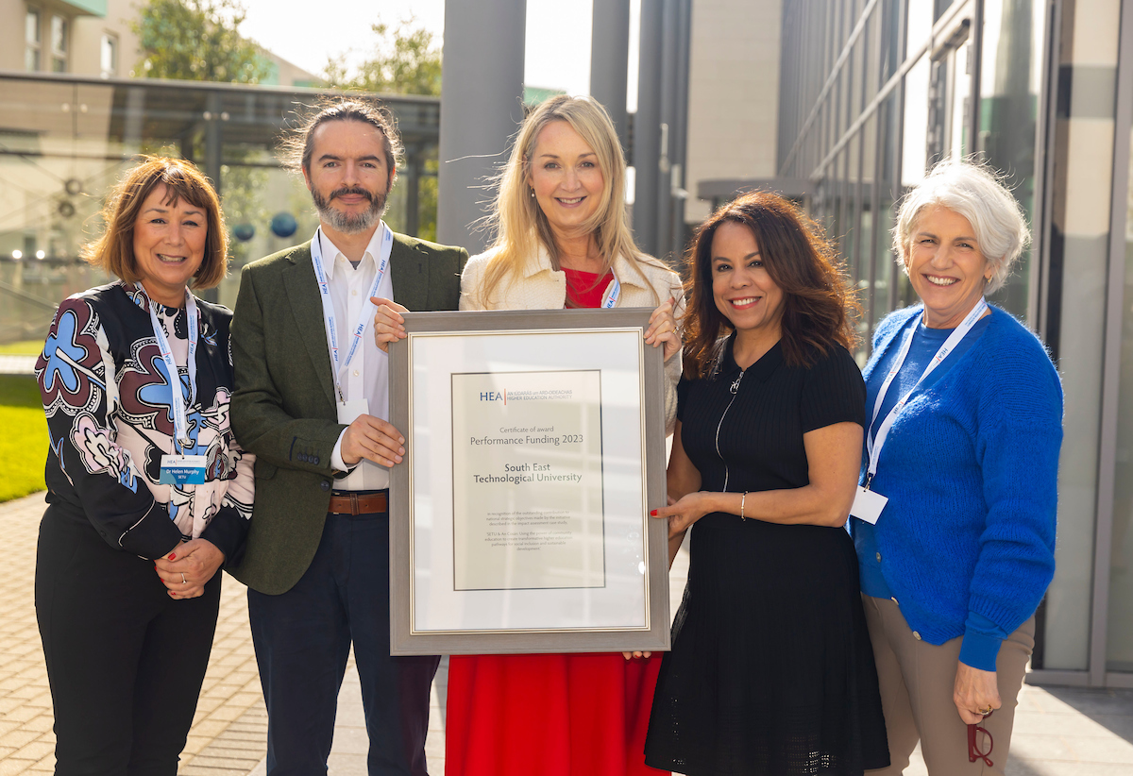
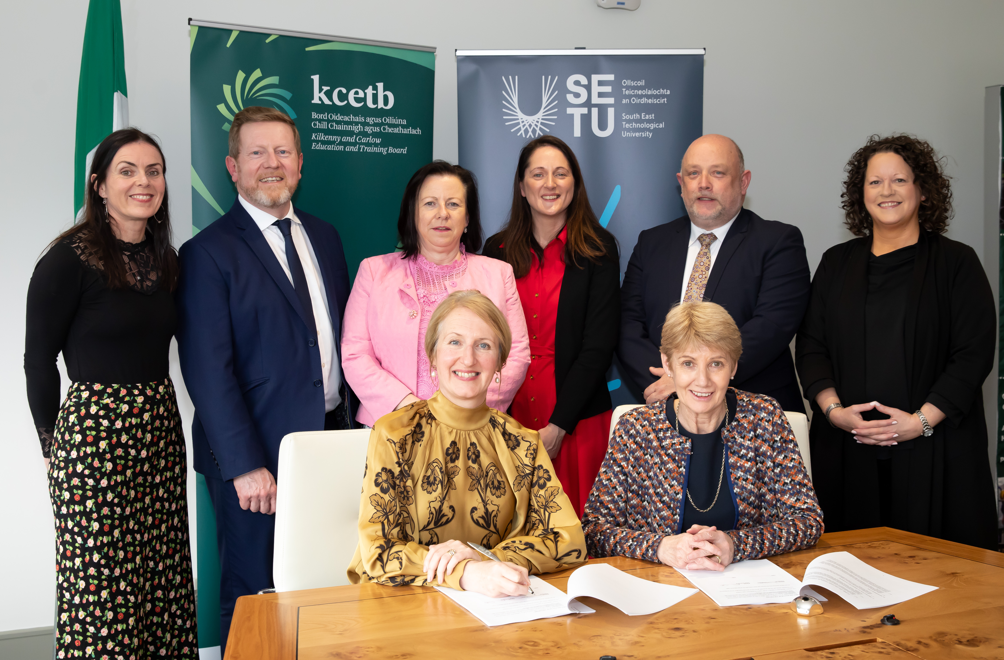
Widening Access through Partnerships & Lifelong Learning
Body text here.
Defence Forces
ETB Partners
An Tiglin
An Cosán
Notes:
SETU has secured multiple HEA Performance Funding awards for transformative education initiatives:
An Cosán Partnership (€1M, 2023) SETU and An Cosán were awarded €1 million for their long-standing collaboration in community education. Their joint model supports adult learners facing social inequality, aligning with the National Access Plan 2022–2028.
Defence Forces Education Pathways (€1M, 2025) SETU received €1 million to expand tailored education pathways for enlisted Defence Forces personnel. This initiative supports lifelong learning and public service reform.
An Tiglin Collaboration While specific funding details are less publicized, SETU’s work with An Tiglin—focused on addiction recovery and social reintegration—has been recognised as part of its broader access and inclusion strategy.

Slide 10
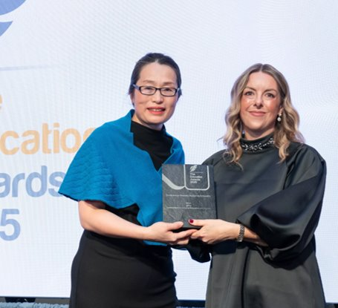
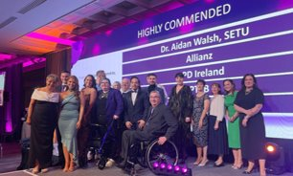
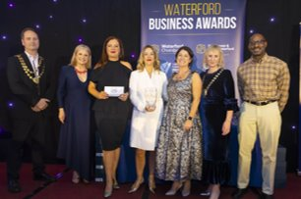
Leaders in Advocating for Equality, Diversity and Inclusion
SETU is officially designated as a University of Sanctuary, affirming its commitment to welcoming refugees, asylum seekers, and vulnerable migrants.
SETU Sanctuary Scholarship Graduate, Grace Finlari pictured with her family
SETU was awarded the prestigious Athena Swan Ireland Bronze Institutional Award, recognising its commitment to advancing gender equality and fostering an inclusive academic and research environment.

Slide 11

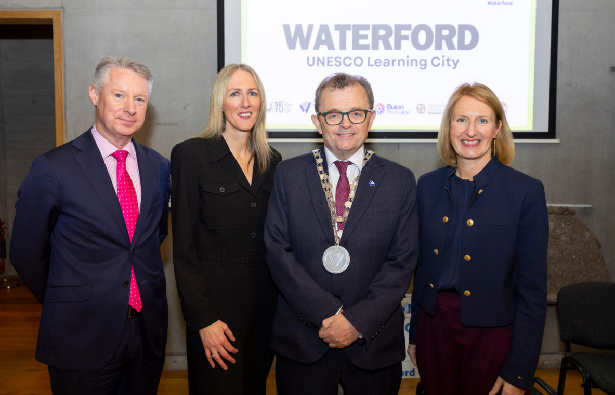
Waterford as a UNESCO Learning City
Notes:
Waterford was officially launched as a UNESCO Learning City in October.
- Initiative led by Steering group: Waterford City & County Council, SETU, WWETB.
- Supported by a strong working group including Buíon Phortlairge, Kilkenny County Council, Waterford Chamber and Southern Regional Assembly.
- New PM Laura Power is based in SETU.
- This initiative responds to low lifelong learning rates in the Southeast, and supports the ambitions to become the world’s first UNESCO Learning Region.
Some upcoming events for 2026: leading and hosting a shared Ireland exchange on Sustainability, Waterford’s first Learning Neighbourhood, and a new Waterford Lifelong Learning Festival.
Further info: laura.power@setu.ie

Slide 15
Record Postgraduate Numbers Graduated in 2025
51 postgraduate research students graduated from SETU in October 2025.
43 doctoral graduations.
11

Slide 16
Global Collaboration
Global Partnership Strategy developed
EU-CONEXUS European University
European University Association
TrustEd Ireland Quality Mark
RDI global partnerships
Collaborations and top research areas from the last five years

Slide 17
Capital Projects (2023 – 2028 and beyond)
Administration Building – Carlow (2024)
Energy Retrofit Business Building Waterford (2024)
Engineering & Advanced Science 12,800m² - Waterford
Advanced Science Building – Carlow
Vet & Pharma Building – GlassWorks
One Health Building - Glassworks
Wexford campus – New campus site
Student Accommodation
University-Enterprise Quarter on former Waterford Crystal site planned as regional innovation hub, co-locating business, education, research and building on existing successes

Slide 19
Our Ambitions for the Future
Scale HE provision in the region – retaining students in region & widening programme provision
Increase our part time learners
Double student numbers at doctoral level
Grow stakeholder relationships in civic & community sector
Accelerate RDI capacity, capability and investment in region
Extend our reach internationally and drive an inclusive and outward looking region
Develop GlassWorks site as a regional campus supporting University / Enterprise collaboration

