Slide 1

Overview of the Sláintecare Health Regions
Right care, in the Right place at the Right time
Derval Howley
May 2026

Slide 2
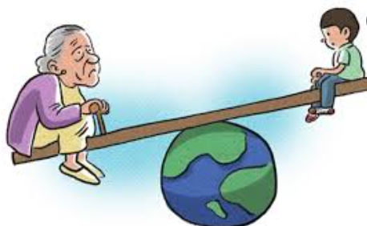
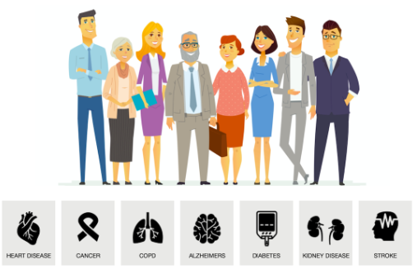




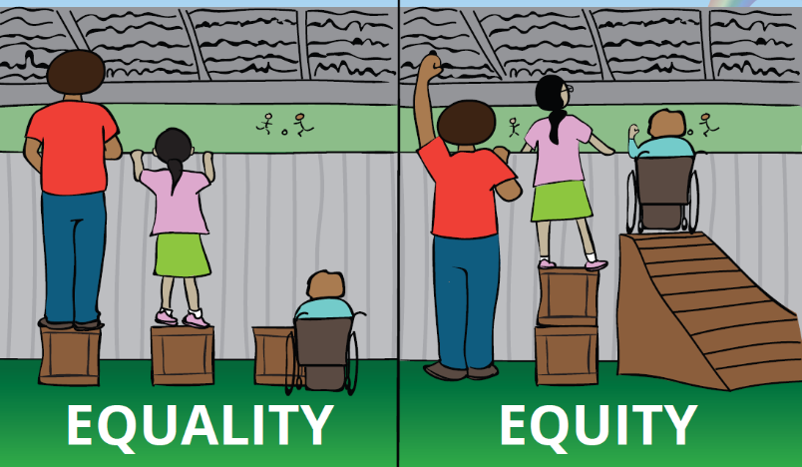



Drivers of Change in the Irish Health Service
Ageing Population - Living Longer
Increasing Chronic Disease (Diabetes, COPD, Heart Failure, Obesity)
Increasing Population (Changing Needs & Expectations)
Technological Advancements (e-Health, Ai)
Limited Resources & Capacity (Service Access & Quality)
By 2028, in Ireland, there will be more people aged over 65 than under 14
Rising Healthcare Cost (Burden of care)
Health Inequity
(socioeconomic demographics)
Changing Legislation & Increased Regulation
Workforce Shortage
Pressure Groups
& Patient Voice
Political Representation

Slide 3


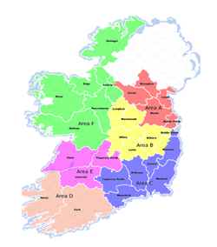






Health Regions Strategic Objectives
2. Clarify and strengthen corporate and clinical governance and accountability at all levels
1. Align and integrate hospital-based and community-based services to deliver joined-up, integrated care closer to home
3. Support a population-based approach to service planning and delivery which aims to address health inequalities
4. Improve equitable regional investment and balance national consistency with appropriate local autonomy to maintain consistent quality of care across the country
5. Run an efficient, highly productive, and transparent health and social care service with aligned incentives to provide people with timely access to safe, high-quality and integrated care.
Source: RHA Strategic Objectives

Slide 4
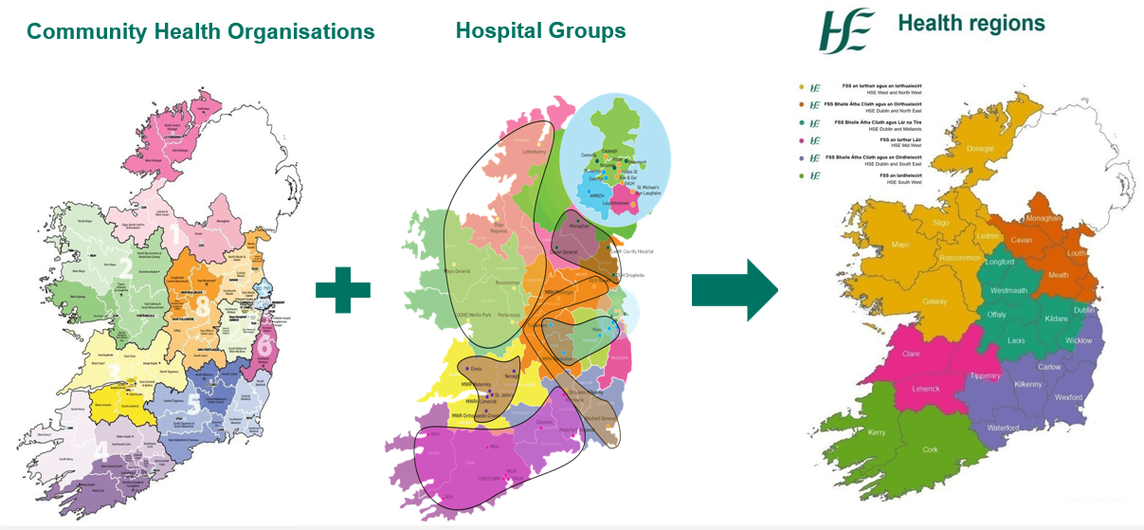
CHOs and HGs to Health Regions

Slide 5
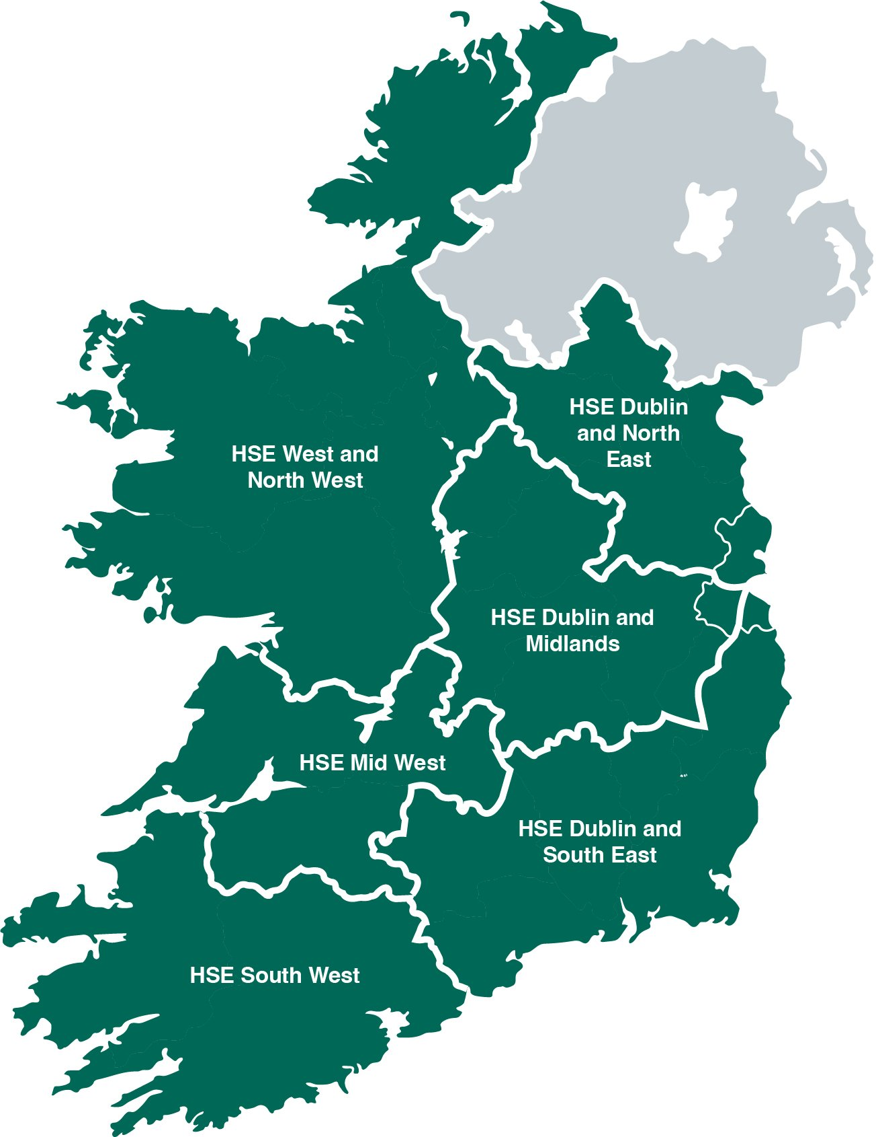

HSE Dublin and South East
Parts of South Dublin
(East)
Wicklow
Carlow
Tipperary South
Kilkenny
Wexford
HSE Dublin and South East
Waterford
IEHG, SSWHG, CHO 5, CHO 6
Further details can be found at www.hse.ie/healthregions

Slide 6
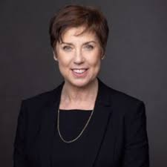
New Leadership Team Dublin South East
Martina Queally took up her role as Regional Executive Officer, HSE Dublin and South East on 29 January 2024. Martina has over 30 years’ health service leadership experience with particular expertise in strategic change management in public services and integrated service delivery. Since 2015, as Chief Officer in HSE Community Healthcare East, she has led the planning and delivery of all community health services in South Dublin and Wicklow, a range of national programmes, and a combined HSE and voluntary workforce of nearly 4000 staff.
Martina has led a range of change, crisis and service transformation programmes; in 2011 as Integrated Services Area Manager for Dublin South East Wicklow she amalgamated three community health services and an acute hospital network, and in 2005 she led the establishment of the Local Health Office structure in Kildare and West Wicklow. Martina trained as a Registered General Nurse before qualifying as a Midwife and Public Health Nurse and she graduated with a MSc. in Heath Services Management from Trinity College Dublin in 2002.

Slide 7

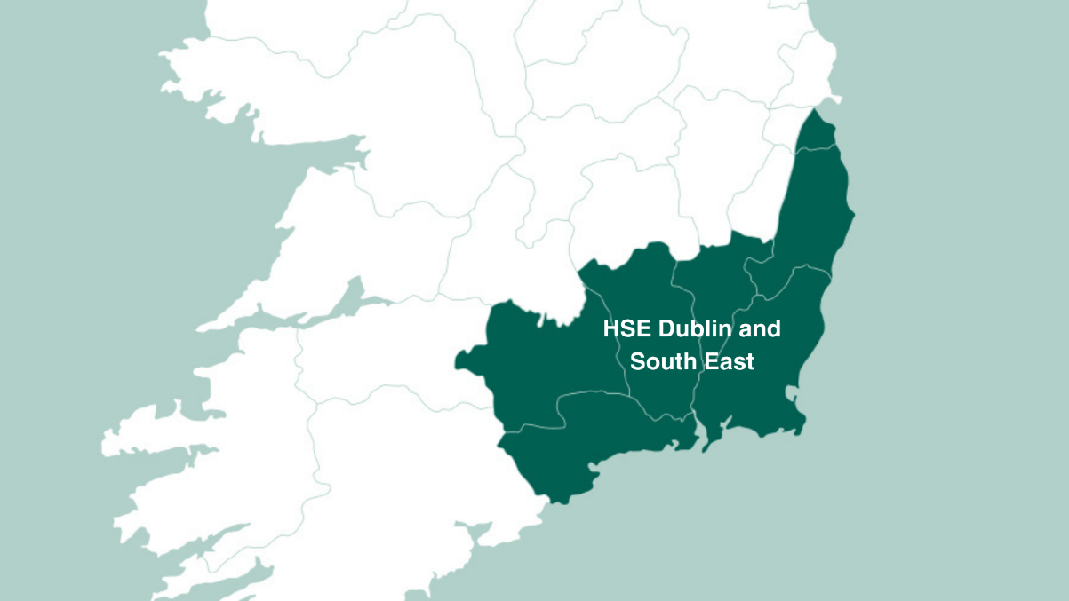

Dublin and South East Health Regional Overview
Serving 971,093 people – through 3 IHA’s
With a Financial Limit of circa €2.4 Billion
Providing employment for 24,000 people
Notes:
30,718.82 Staff Profile
+2,308.85 increase DEC 22 V April

Slide 8
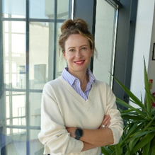
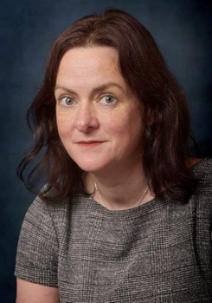

IHA Management HSE Dublin and South East
HSE Dublin South & Wicklow
Manager- Aisling Heffernan
HSE Waterford & Wexford
Manager- Sinead Reynolds
HSE Carlow Kilkenny & Tipperary South
Manager- Roseanne Killeen
Population (circa)
421,373 people
Population Increase of 7.2%
Population:
302,955 people
Population Increase of 9.4 %
Population:
246,765 people
Population Increase of 5.7 %

Slide 9

Community Health Networks
96 CHNs across Ireland.
Primary healthcare services across a a population of 50,000.
4-6 primary care teams
Multi-disciplinary teams, with GPs involved in the delivery of services.

Slide 10

Integrated Care Teams
Integrated Care Programme Older Persons (ICPOP)
Community Specialist Teams for Older Persons – across Hospital & Community
Supporting a population of circa 150,000
Chronic Disease Hubs
These aim to improve the lives of older persons and the standard of care for four major chronic diseases including cardiovascular disease, type 2 diabetes, chronic obstructive pulmonary disease (COPD) and asthma.

Slide 11




Chronic Disease Community Specialist Services
?
?
?
?
Respiratory
COPD and Asthma
Type 2 Diabetes
cardiology
Stop Smoking
Consultant Endocrinologist, nurses, dietitian, podiatrist
Clinics and Group education
Consultant Cardiologist, Nurses, Psychologist
Clinics
Respiratory Consultant, nurses and physios
Clinics and Pulmonary Rehab
Health Promotion Officer
Clinics and Groups

Slide 12
Next Steps
Development of Community Health Areas
Including all community services within a geographic area
Development of Integrated Models of Care
Such as Women’s Health and Integrated Child Health
Standing up of Integrated Health Area Management Teams from within existing resources

Slide 13
Overview of HSE Health & Wellbeing
Waterford

Slide 14
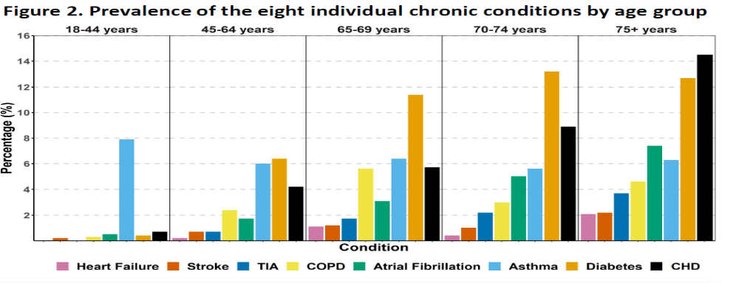
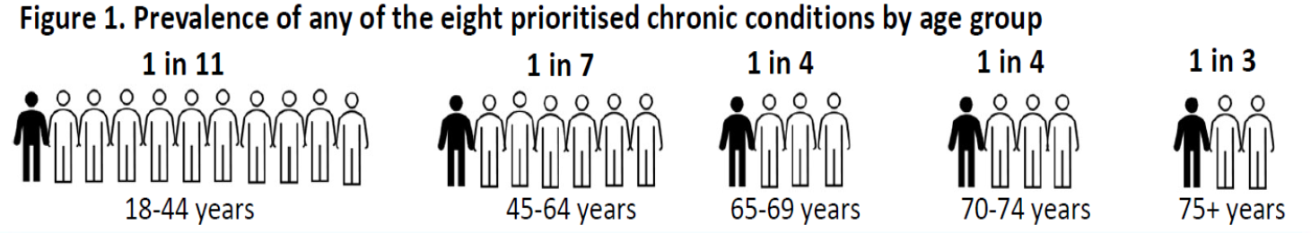

Prevalence of Chronic Disease in Ireland by Age
EPICC Team UCC
Notes:
Our research shows, that the most prevalent chronic conditions in Ireland are: • Diabetes (in those aged 45 to 74 years) • CHD (in those aged 75 years and older). Prevalence of multimorbidities also increases with age: • 10%of those aged 75 years and older have two or more chronic conditions.
10% of those aged 75 years and older have two or more chronic conditions
The most prevalent chronic conditions in Ireland are:
Diabetes (in those aged 45 to 74 years)
CHD (in those aged 75 years and older)
Demographic change is likely to have a profound effect on the number of people living with chronic disease in Ireland and, consequently, on health service utilisation and capacity.

Slide 15







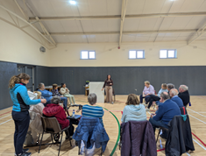
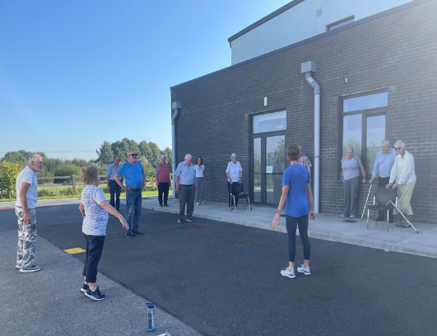
Example: Respiratory Services
Integration with UHW
One stop Consultant, Nurse, Physio MDT,
Diagnosis and Care plan
Waterford Respiratory Community Specialist Team
Close to patient
SouthEastStopSmokingSupport@hse.ie
Pulmonary Rehab
Exercise & Education twice a week for 8 weeks
Weekly COPD support and exercise classes and/or the Living Well Programme

Slide 16


3 hours
8,757 hours
Healthcare provided by professionals represents the ‘tip of the iceberg’ in supporting people with a chronic condition.

Slide 17



What is Self-management?
The process where individuals with chronic conditions take control of their health and actively manage their chronic condition(s) to the best of their ability.
The process whereby individuals develop knowledge and skills in how to manage the consequences of their chronic conditions in their everyday lives.
The day-to-day tasks an individual must undertake to control or reduce the impact of disease on physical health status. At-home management tasks and strategies are undertaken with the collaboration and guidance of the individual’s physician and health care providers’ (Clarke et al., 1991)
Notes:
great deal of overlap, however, exists with the concept of self-care and related concepts of self-management, self-monitoring, symptom management, and self-efficacy. While the concepts have been discussed in detail in nursing and related literature, the differences between and relationships among the concepts are not clear.
Let us start by focusing on the principles and definitions of self-management.
What is self-management?
Self-management is the process where individuals with chronic conditions take control of their health and actively manage their chronic condition/s to the best of their ability. Chronic conditions can result in considerable difficulties for individuals physically, psychologically, and socially. So, self-management is a process whereby individuals develop knowledge and skills in how to manage the impact of their chronic conditions in their everyday lives.

Slide 18

Self-management: What does it look like in practice?
Monitor/
Manage Signs & Symptoms
Deal with treatments
Make changes to daily life
Deal with Emotional, Relational & Social Impacts
Make the required changes
Manage & Take Medication
Respond to Raised or Low BGLs/Flare ups/
exacerbations
‘No days off - always on’

Slide 19
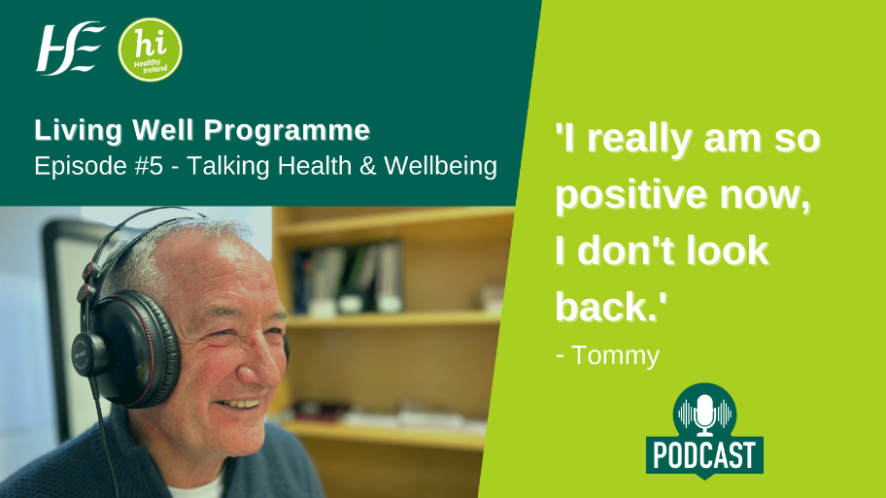
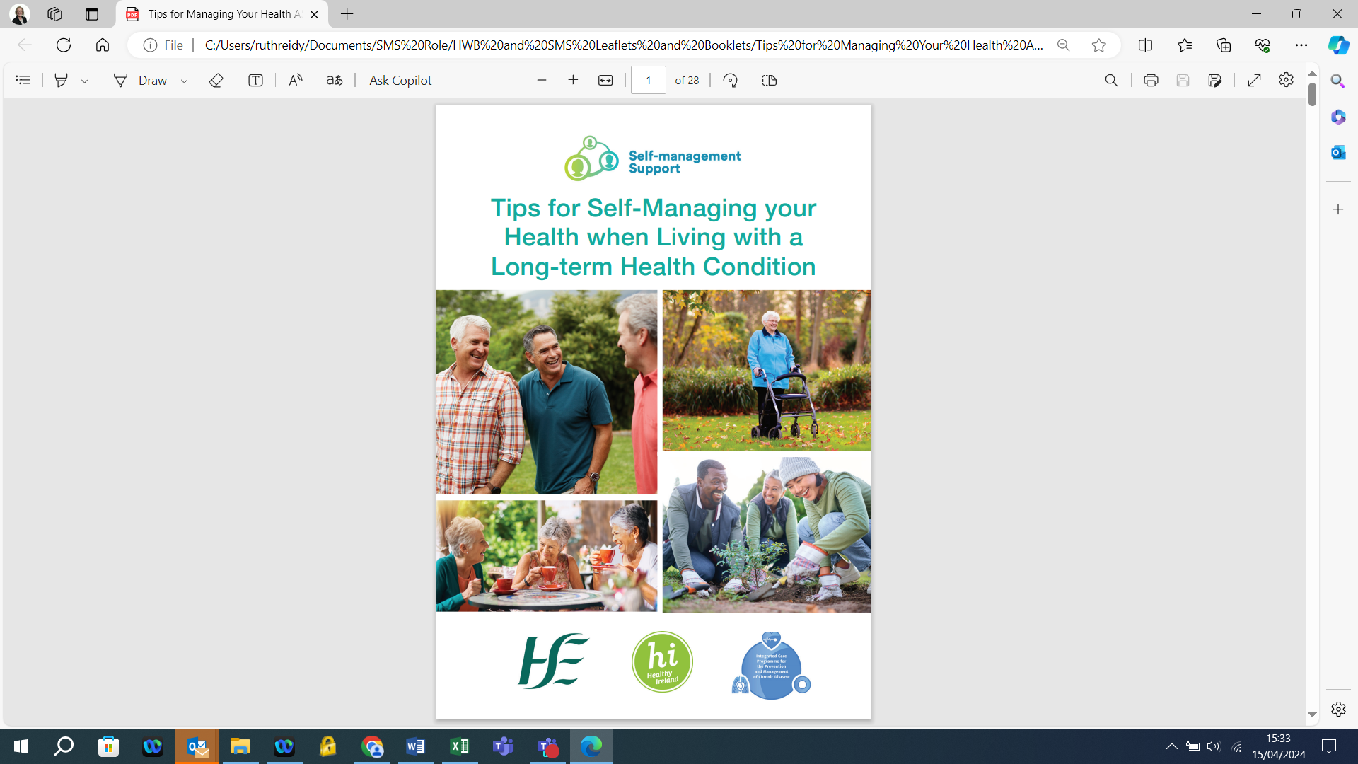
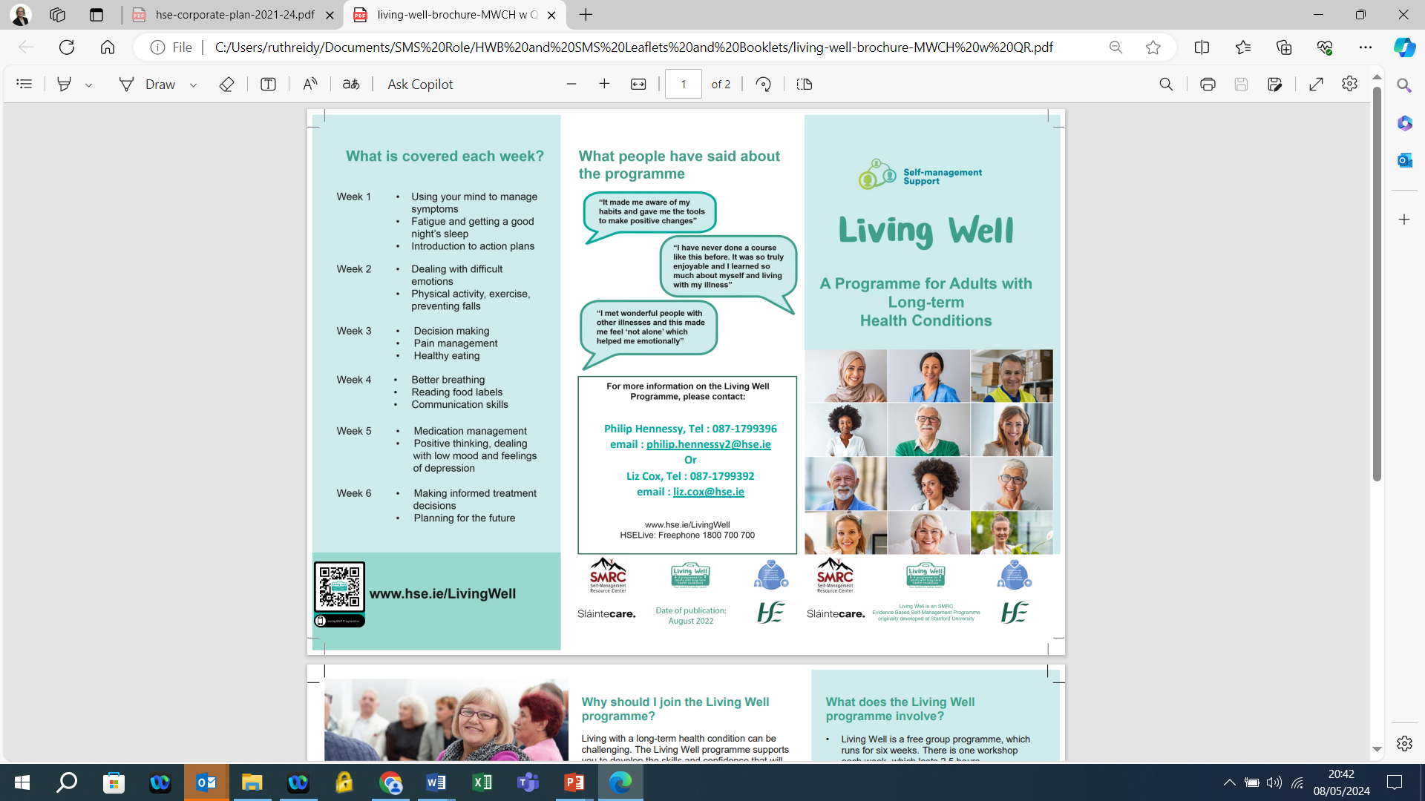

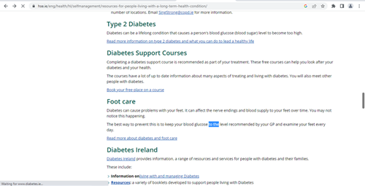
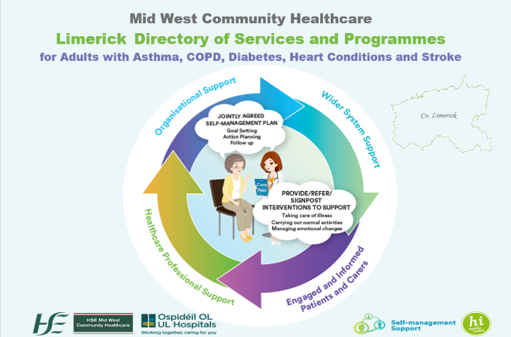

Slide 20
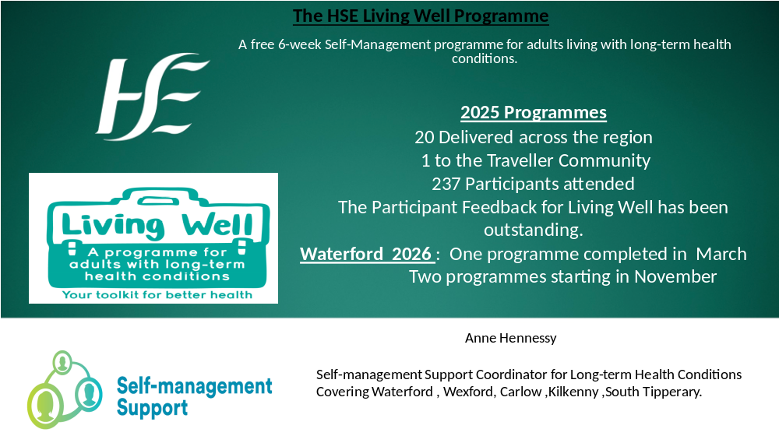

Slide 21


Cancer Prevention and Early Detection key areas of work
Embed into HP&I Teams
Prevention & early detection
Breast, Lung, Bowel, Prostate & Skin cancer
Notes:
21

Slide 22

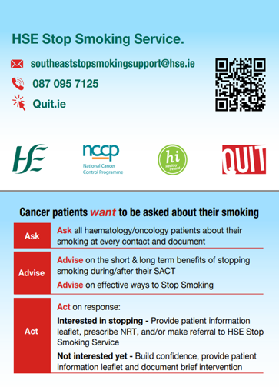
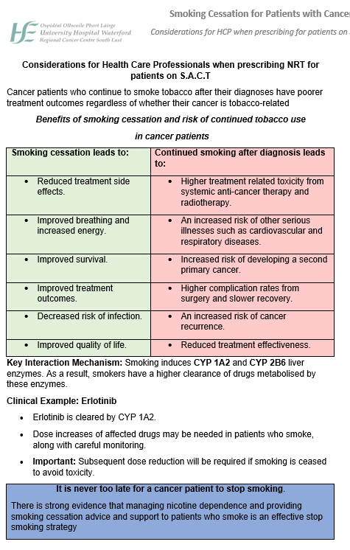
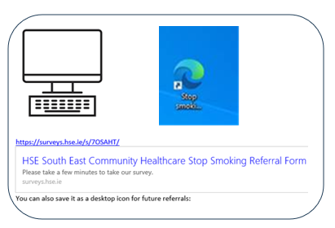

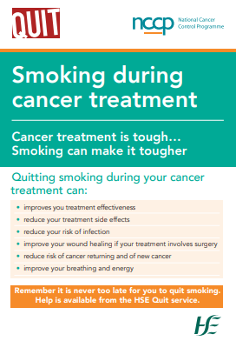
Tools Developed & Disseminated

Slide 23

Social Prescribing
Health Promotion & Improvement funds two SP programmes in Waterford:
City, and West County Waterford
Engages participants in a 6-10 week personal plan to improve social, mental and physical health.
Works on developing interests, deciding on what matters to client, and co-designs a well-being plan.
Develops networks with statutory agencies, further and higher education, and community groups to provide pathways for clients to sustainable
personal development.

Slide 24
Minceíri Port Lairge Traveller Health Initiatives
Funded by HSE Traveller Health Unit
Minceiri Portlairge provides mental health and wellbeing supports for Traveller Community through community‑based, preventative work that is delivered in a way that is accessible, culturally appropriate, and responsive to need.
A Healthy Relationships Programme was delivered to a group of 15 Traveller women. The programme was extended from 6 to 8 weeks on request of participants.
Weekly sessions provided a safe and supportive space to explore healthy and unhealthy relationships, communication, boundaries, self‑esteem, emotional wellbeing, and awareness of available supports.
To support engagement and inclusion, the programme also incorporated a craft element, which culminated in the creation and donation of a piece of artwork to Oasis Women’s Refuge, Hand in Hand sculpture piece which reflected shared messages of empowerment, solidarity and support for women experiencing domestic abuse.

Slide 25

Hand in Hand art installation donated to Oasis House by Minceíri Port Lairge

Slide 26
Minceíri Port Lairge Traveller Health Initiatives
– Men’s Health
The Waterford Health Project delivered a 4‑week Breakfast Programme for Traveller men, designed to provide a safe, informal and supportive space to engage men around health, wellbeing and mental health. The programme combined shared meals with structured discussions and input from external services, recognising the value of relationship‑based and community‑led engagement when working with Traveller men.
Over the course of the four weeks, Traveller men attended weekly breakfast sessions that combined informal social interaction with focused health discussions. Sharing food was a central element of the programme, helping to break down barriers, encourage attendance and support open conversation.
Traveller Health Project continues to run a weekly Men’s Shed in Kilbarry Halting Site, delivered by our Men’s Health Worker. The Men’s Shed provides an ongoing space for Traveller men to connect, take part in practical activities, and continue conversations around health, wellbeing and personal development.

Slide 27
Traveller Men’s Breakfast Group - talking points
SOS – Suicide or Survive:
A dedicated session was delivered by SOS Suicide or Survive, focusing on mental health awareness, recognising signs of distress, understanding coping strategies, and reducing stigma around mental health and suicide. Men were encouraged to speak openly about stress, pressure and emotional wellbeing in a safe and non‑judgemental space.
Substance Misuse Services:
Substance misuse services attended the programme to engage directly with participants. Discussions focused on alcohol and other substance use, the impact on mental and physical health, family life and wellbeing, and pathways to support. This engagement allowed men to access information in a comfortable, trusted environment and ask questions openly.
Group Discussions:
Across the four weeks, a range of group discussions were facilitated, shaped by the interests and concerns of the men attending. These discussions supported peer learning and encouraged men to share experiences and support one another.

Slide 28


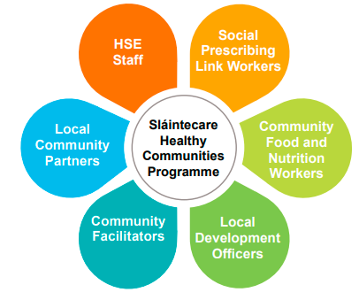
The Healthy Communities initiative works with community-based partners in Waterford to deliver health improvement programmes directly into targeted communities in electoral divisions registering high levels of disadvantage. A Coordinator and a Health Promotion & Improvement Officer supports the programme, contributing to programme delivery, stakeholder engagement, and developing needs-led community-based health improvement responses.
Notes:
Some examples of SHC Health Development work with the migrant community in Waterford, and the Waterford Food Poverty initiative.

Slide 29

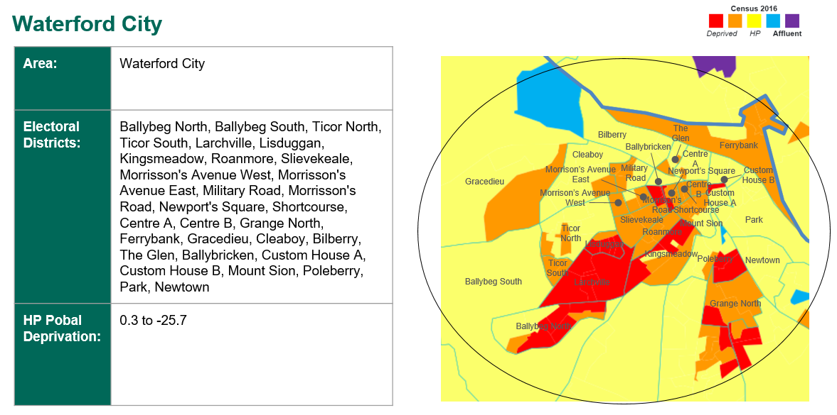
Waterford site with deprivation indices

Slide 30







Waterford SHC Site, 2025
1 Community Food & Nutrition
Worker
18 Community initiatives
Food Poverty Initiative
12 programmes
112 participants
9 workshops
103 participants
6 programmes
42 participants
Two programmes, one SHC
237 new open cases
394 referrals
161 participants
82 provided with free NRT
1 programmes
18 participants

Slide 31

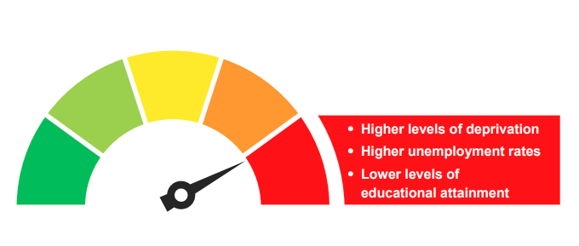
Health and Community Development work with groups experiencing disadvantage
Ongoing work with Oncology dept in University Hospital Waterford to improved referral and treatment pathways for people with a cancer diagnosis who smoke.
Foundation Programme for Sexual Health delivered in Kilcohan Vaccination Centre to V&C staff.
Support for Waterford Traveller Genio funded project with We Can Quit and Healthy Food Made Easy delivered in Kilcohan Vaccination Centre.
Work with the MDT for Weight Management for Children and Young People to improve pathways to community supports for parents of patients.
Ongoing work on the Food Poverty Initiative, with SETU and Sacred Heart FRC CFNW.
Breast cancer awareness sessions with community groups.
Wellbeing sessions delivered to youth groups.
Contribution to MDN Men’s Health Week event.
Support for Older Person’s Council events.

Slide 32
Regional Mobile Vaccination Team
Waterford – January 2026
Protecting health
Reducing serious illness and complications of vaccine preventable illnesses
Supporting winter resilience
Reducing inequality
Outreach to vulnerable groups – travelling to where they’re at
Access across urban and rural areas
Strengthening communities
Working with care settings and schools
Supporting local services
Prevention close to home

Slide 33
Vaccination is a practical, community based LECP action in Waterford
How we work:
Prevention focused, Flexible, adaptable and mobile service, Responding to local need.
What we deliver:
Flu & Covid 19 Vaccinations to Long Term Care Facility residents & Healthcare Workers.
RSV immunisations to eligible babies under the RSV Pathfinder Programme
School based nasal flu vaccines (LAIV).
Targeted and outreach vaccinations (including outbreak situations) for hardly reached groups including BOTP/IPAS.
Supporting HCW vaccination in the winter season with pop-up clinics.
Supporting a Peer Vaccinators Programme for HCWs in residential facilities.

Slide 34
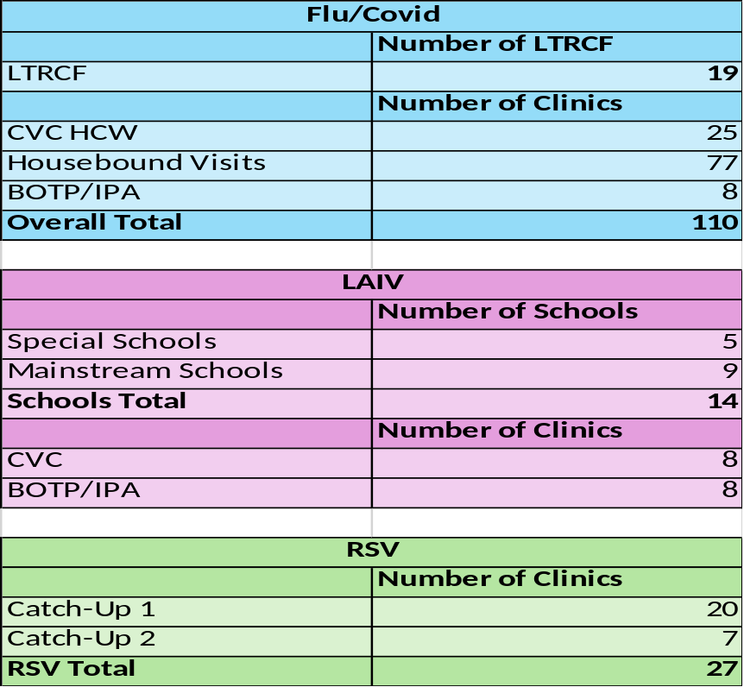
Waterford Data for Winter Vaccination Programme
2025 – 2026

Slide 35
HSE Dublin and South East
Thank you

